Slide 1
The Musicon Path:
Liquid Light

Slide 2
Vision:
To decrease car traffic between Musicon and Roskilde Station by 50% in 2030

Slide 3
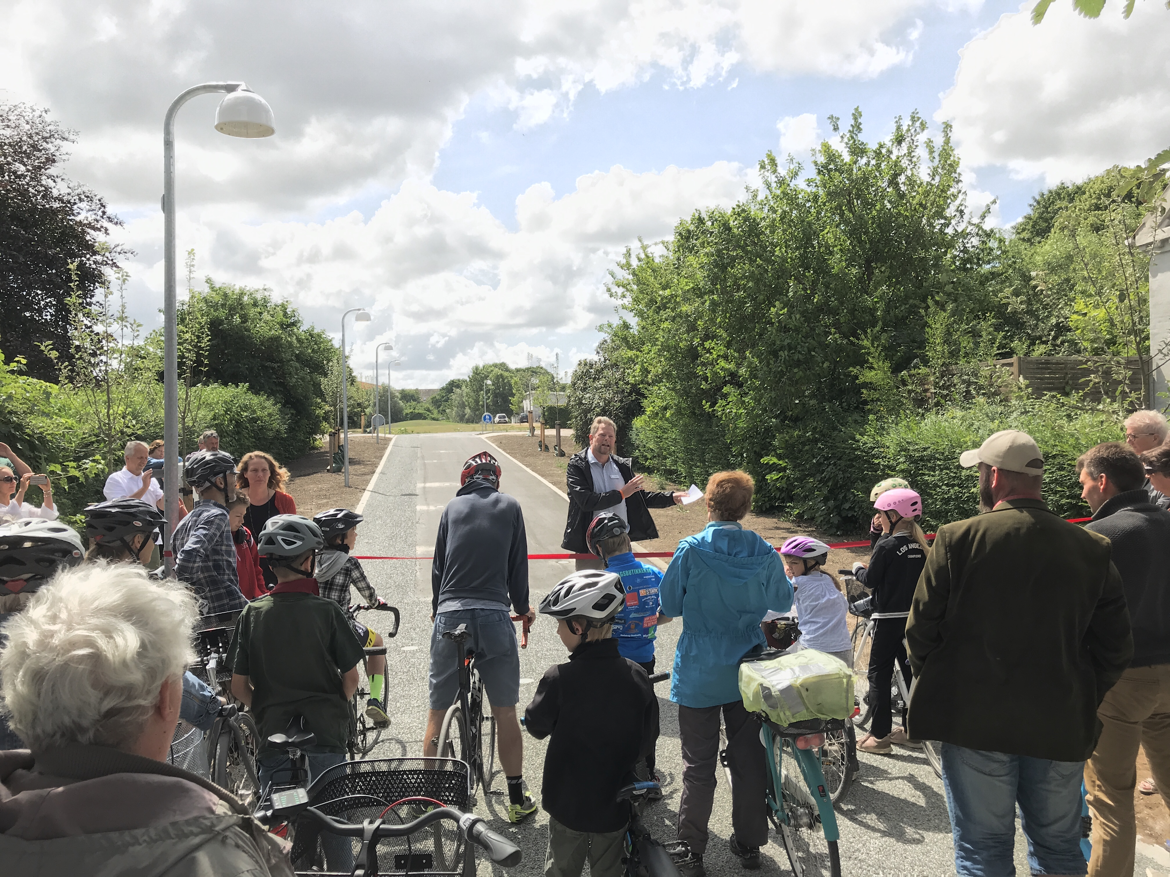
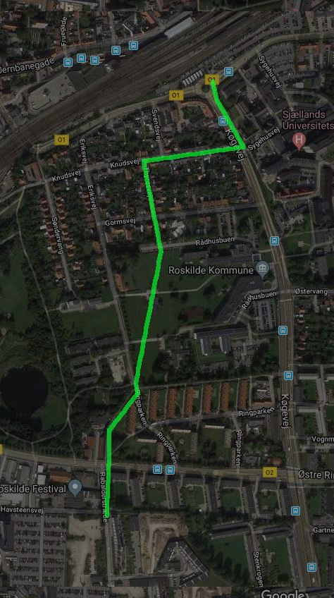
A direct, attractive and playful path
Roskilde Station
Musicon

Slide 4
How can we use interactive lighting to make the Musicon Path more attractive for visitors, even during the cold and dark winter hours?

Slide 5
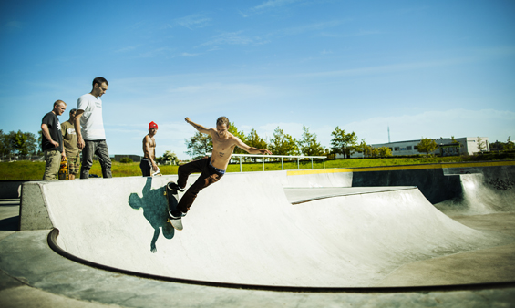
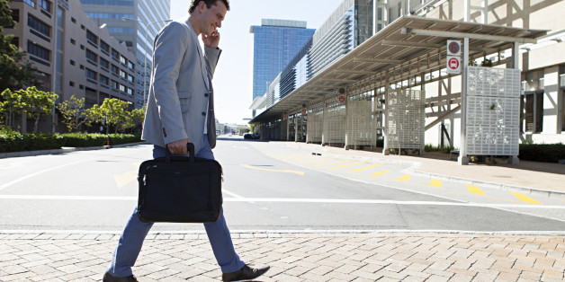
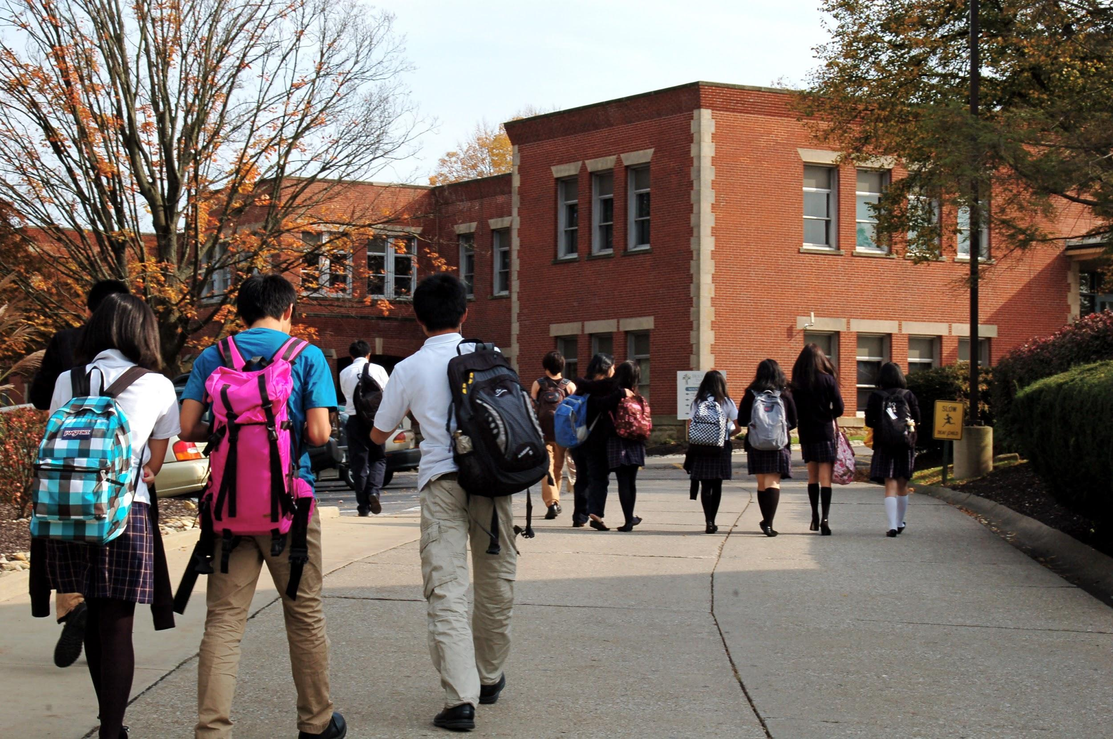
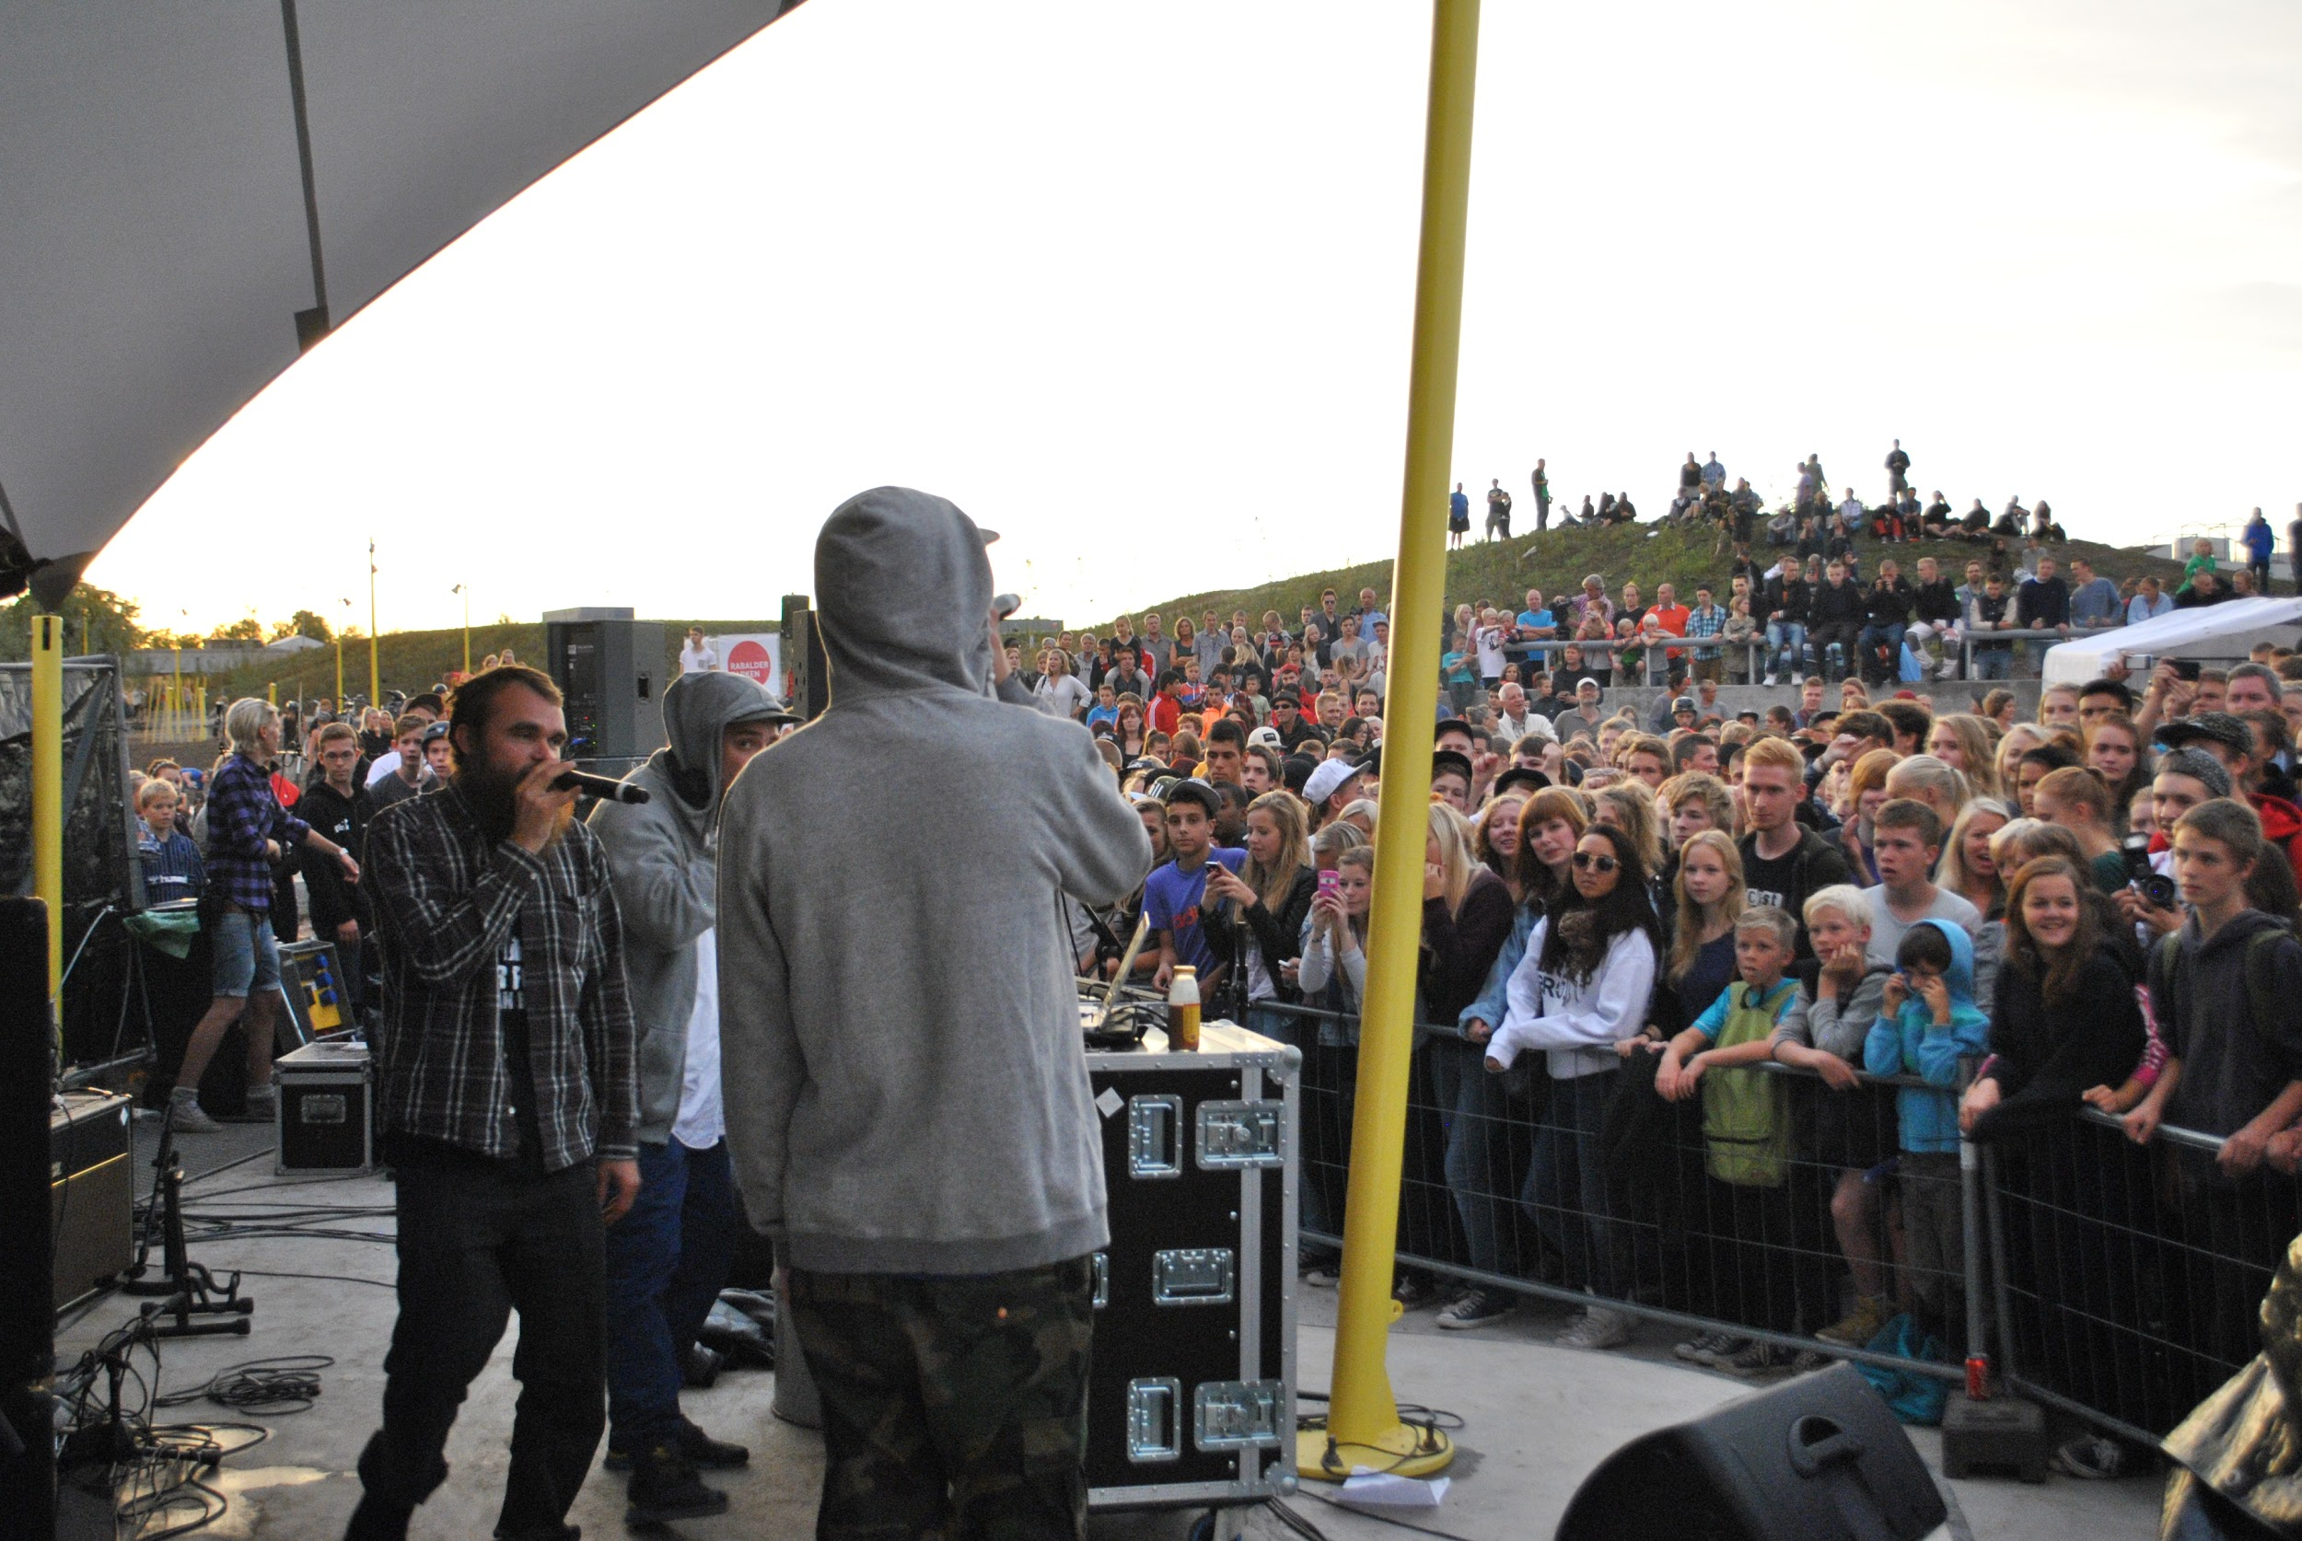
Leisure activities
Work
Education
Culture

Slide 6
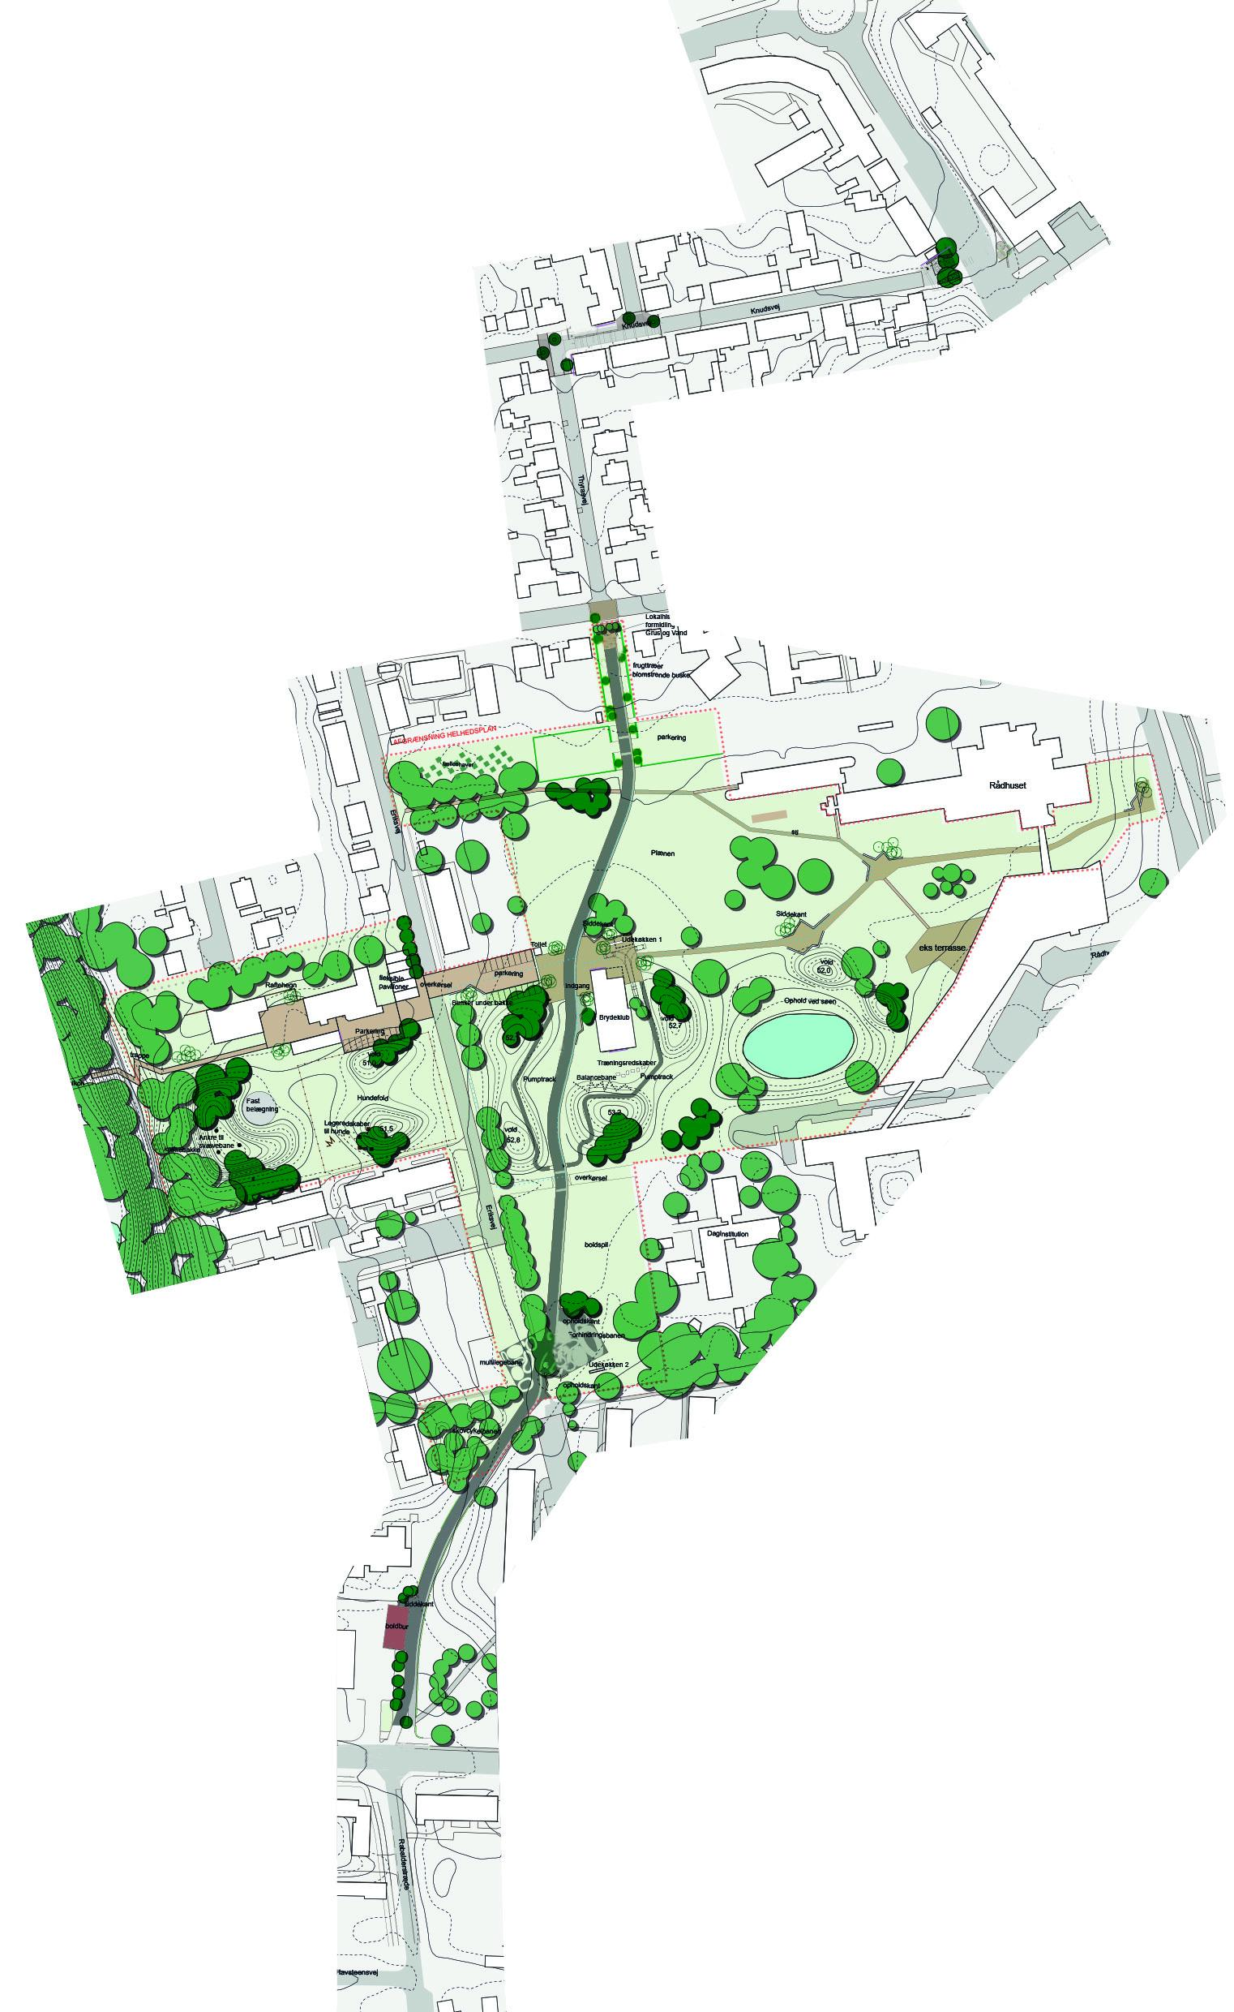
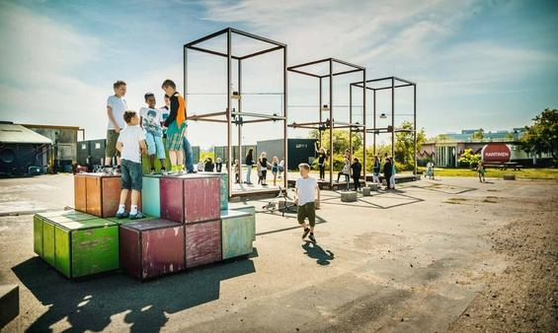
Field observations

Slide 7
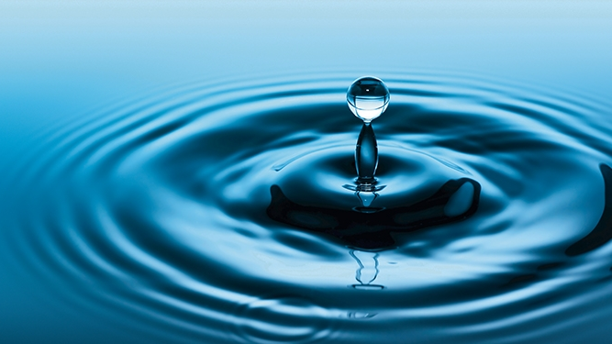
Overall theme: Flow of water

Slide 8
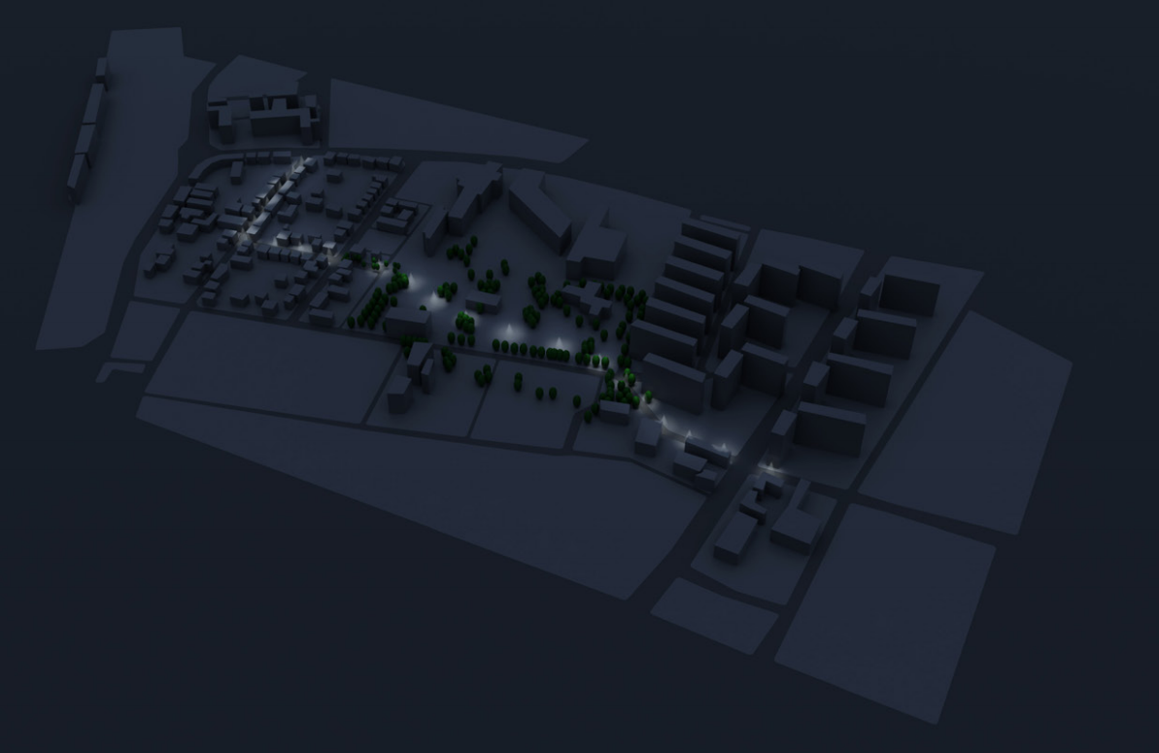
Overall path
Photo by Esben Oxholm Bonde

Slide 9
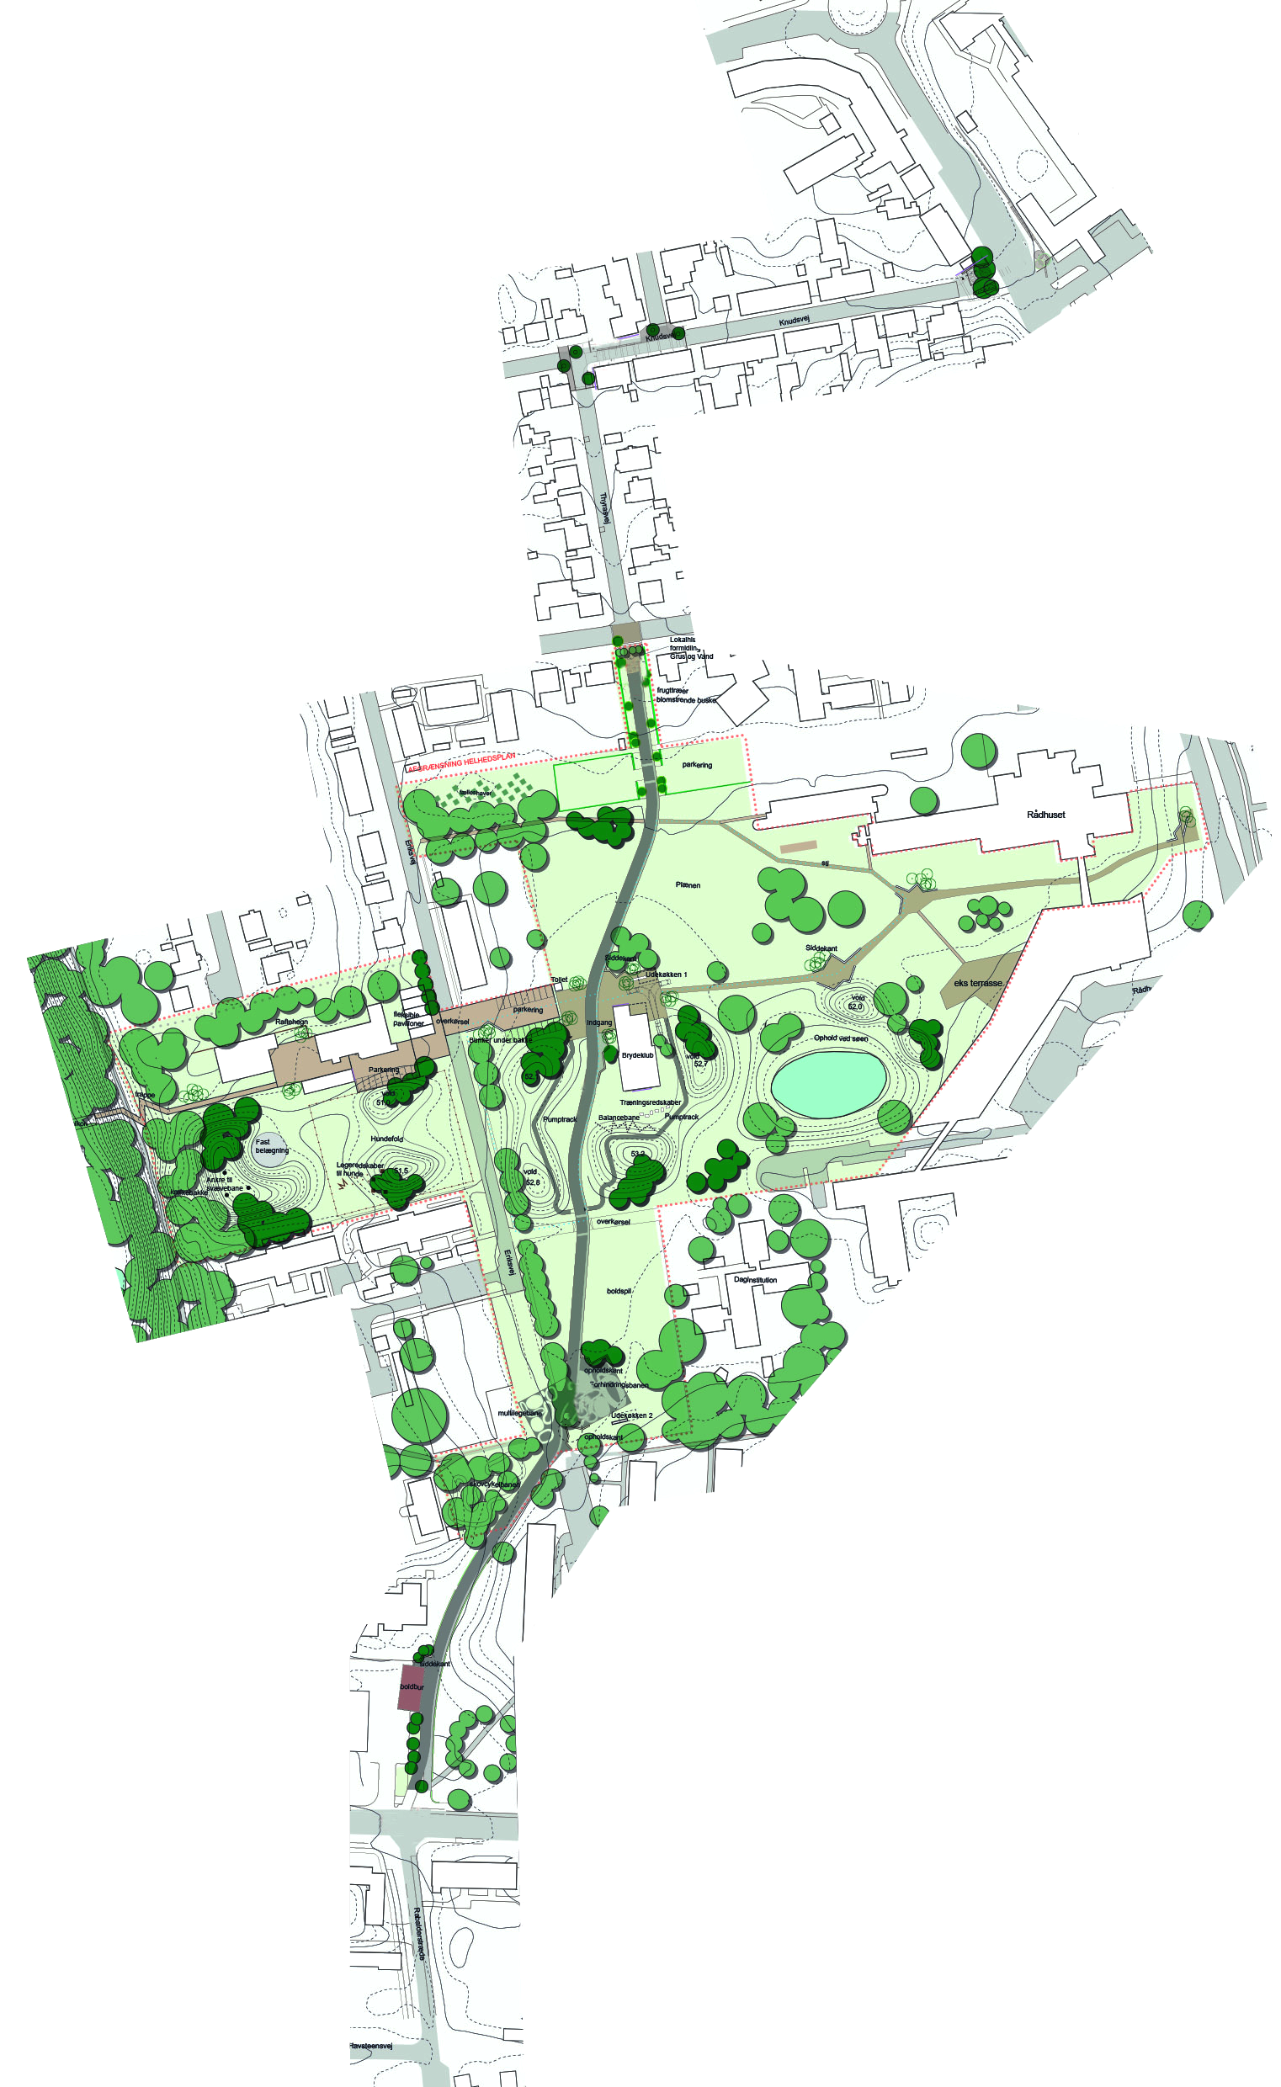
Effect lighting

Slide 10
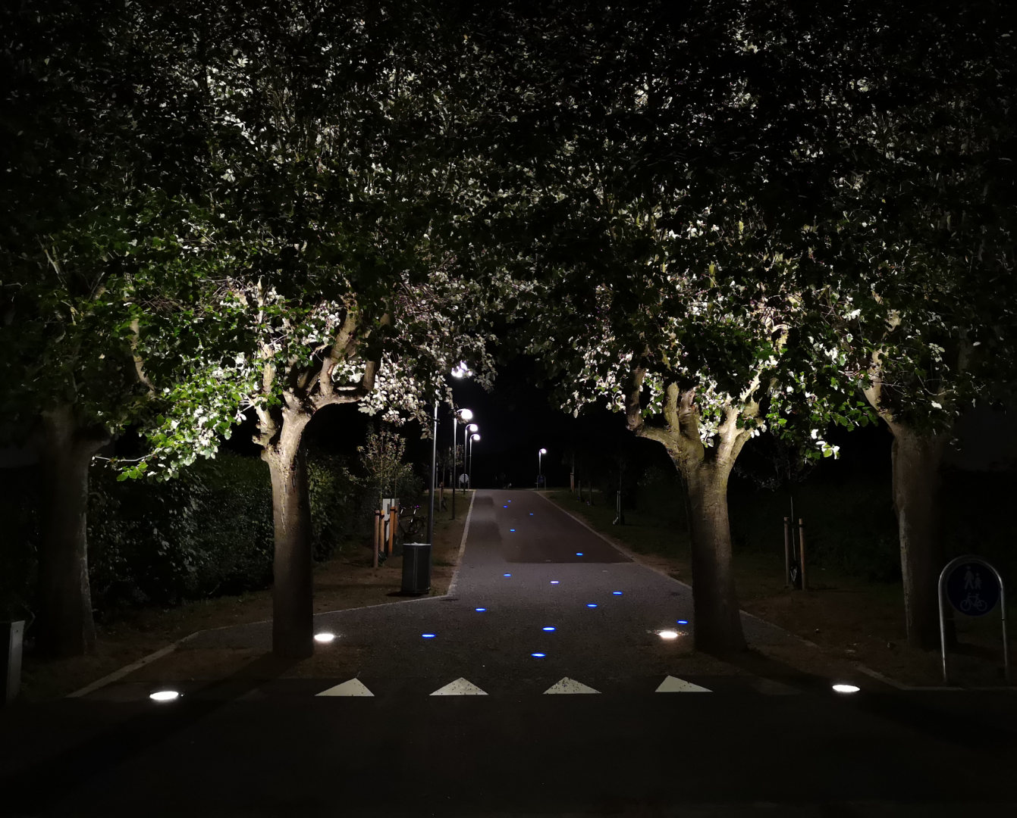
Northern entrance

Slide 11
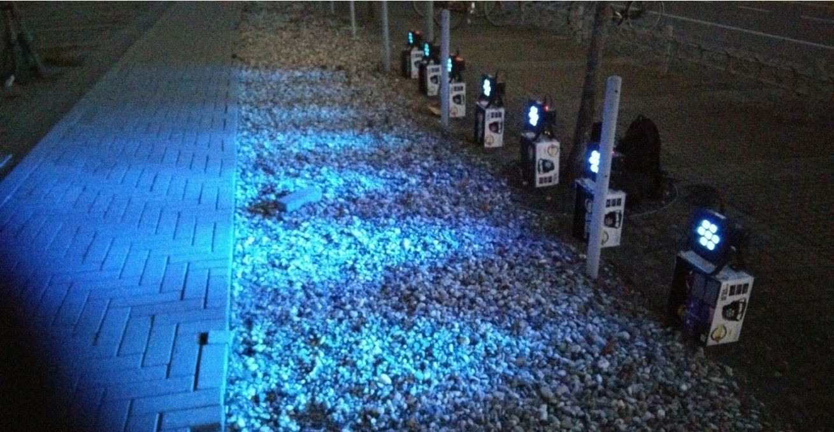
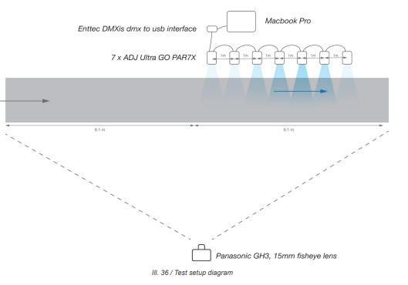
Can a row of light with animated intensities along a path could affect people walking speed?

Slide 12
Southern entrance

Slide 13
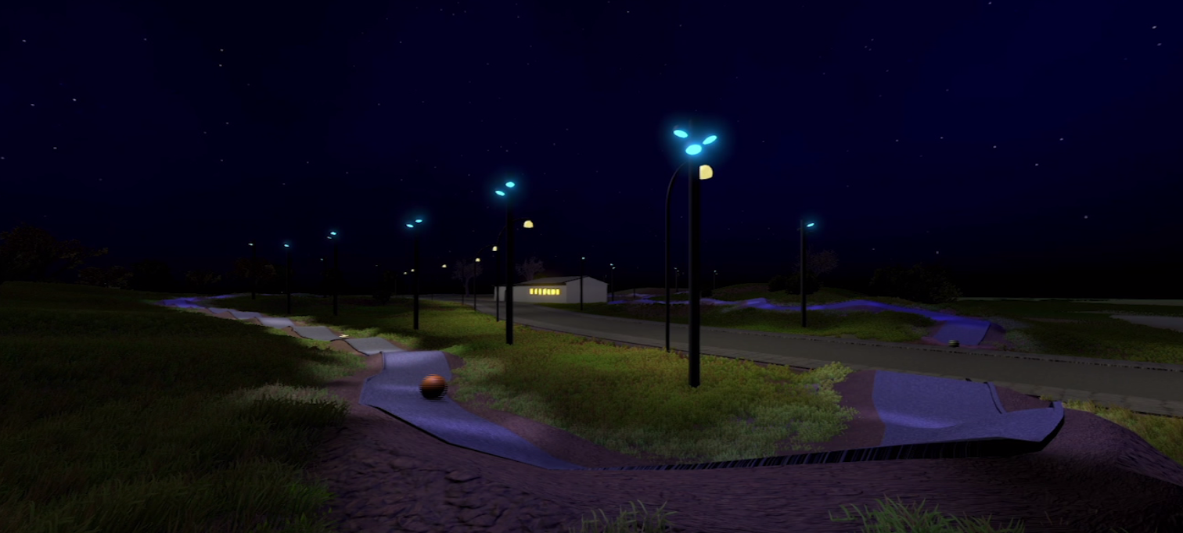
Evaluation
Middle of park
How can we use lighting to simulate the movement of, and interaction with, water on a pump track, while ensuring sufficient visibility?
Recreated the space in Unity
addressed spotlights in c#
simulated interaction through animated balls
Incorporated water codes
Observations and evaluations
Notes:
Recreated the space in Unity
addressed spot lights
simulated interaction
Incorporates water codes
Observations and evaluations
the thesis serves to support the realisation of the project in two aspects:
the selection of appropriate components (primarily lighting system, fixtures and sensors), and
the development of simulating water movement and behaviour under different stimuli on a pump track.
In the same way that the behavior of water is always a result of external forces, the lighting installation of the pump track in Raadhusparken will be fully dependent on the amount of “energy” that is applied to the area. The types of energies that can have an influence on the installation can be divided into three categories:
the amount of activity (events) in Musicon,
the amount of activity on the pump track over time
the current activity on the pump track

Slide 14
Middle of park

Slide 15
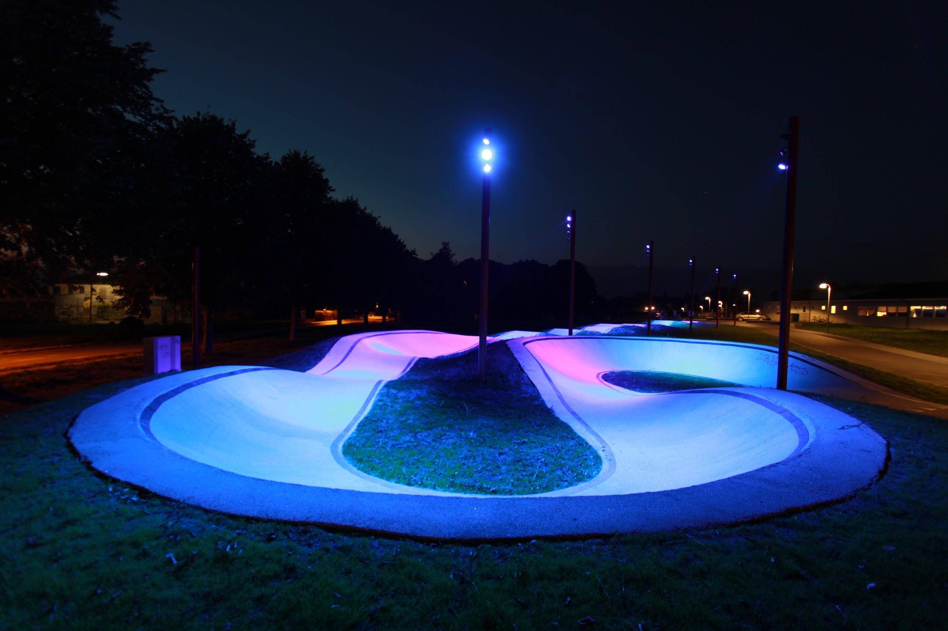
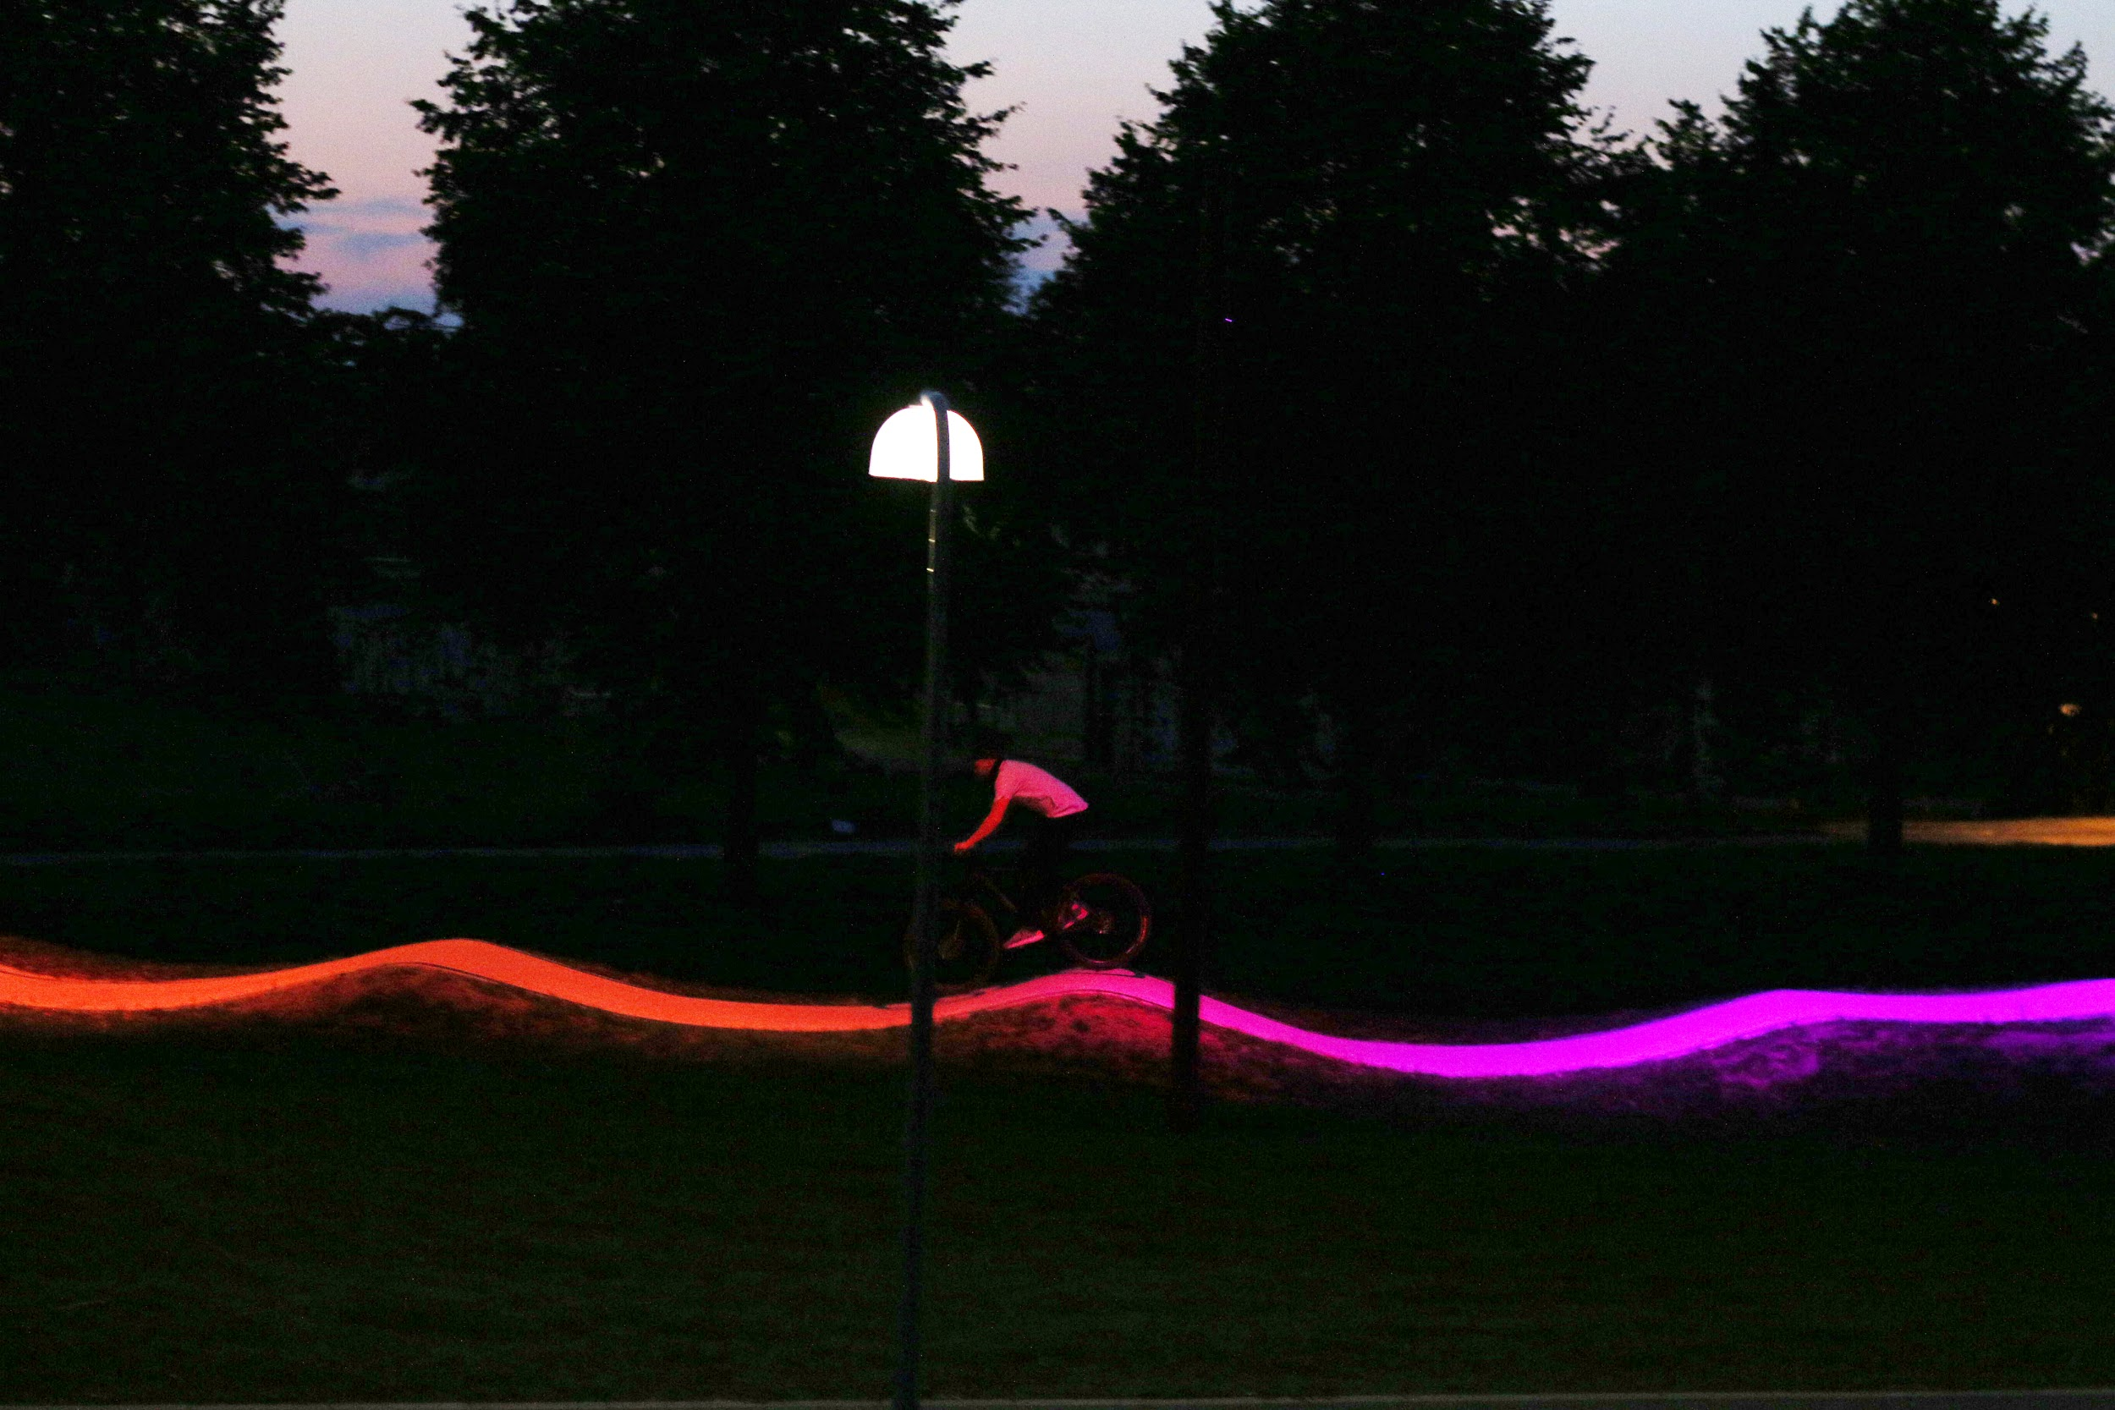
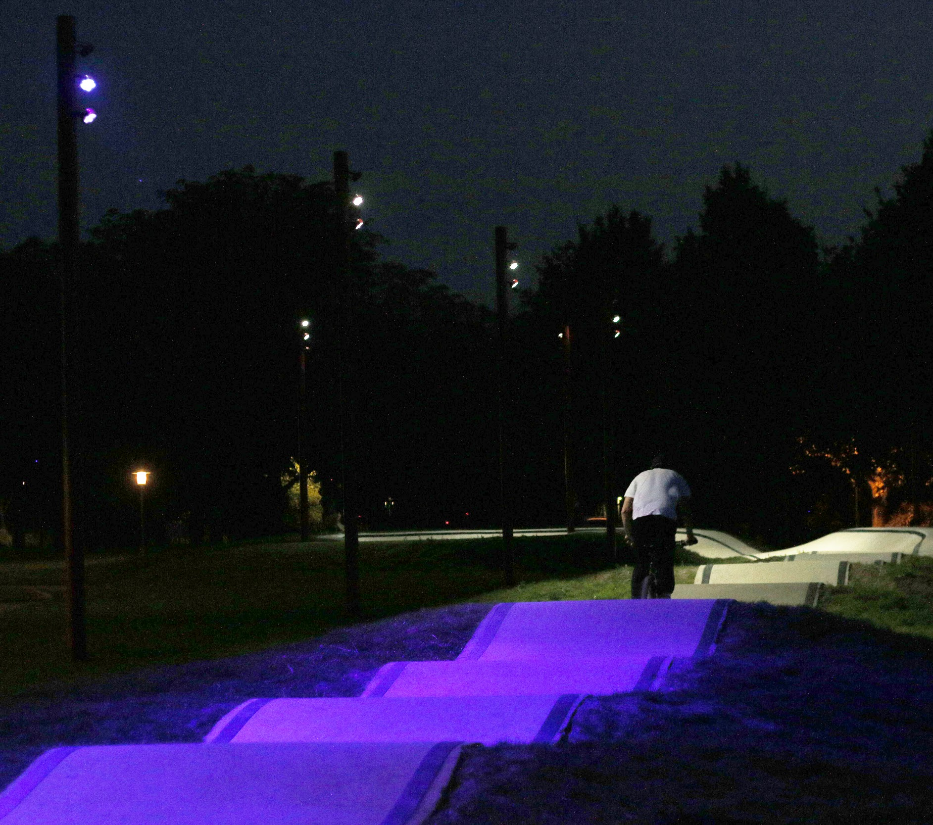
Middle of park

Slide 16
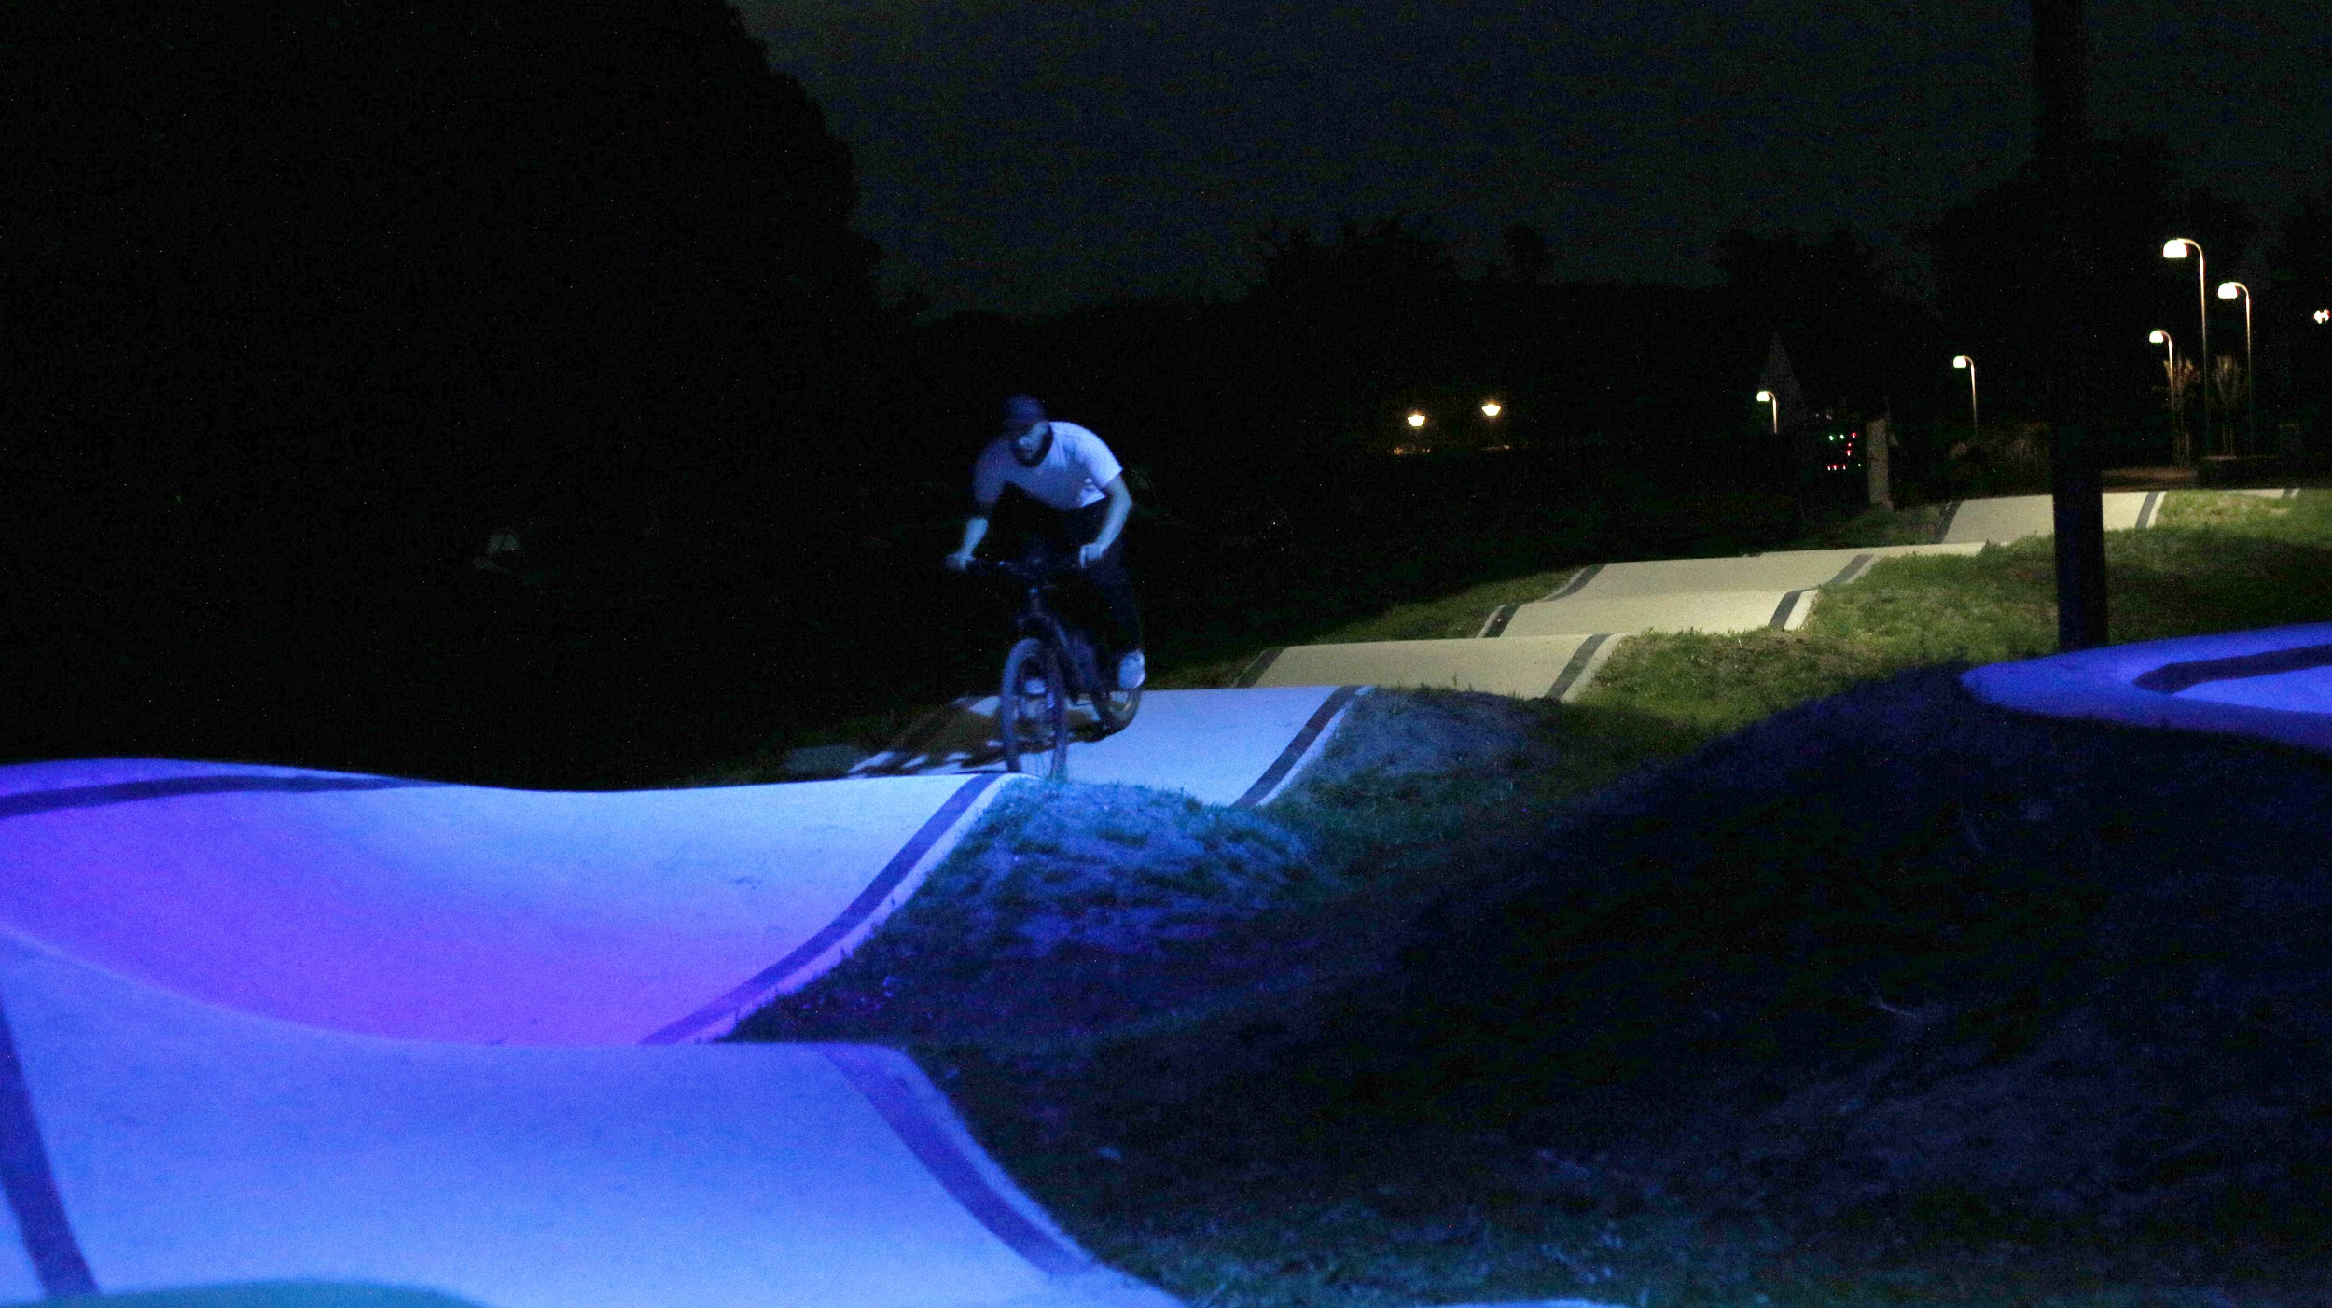
Future perspectives - Living Lab
Notes:
All together the lighting design will be used as a living lab investigating the interaction between lighting and users.

Slide 17
Future evaluations
Social atmosphere
Information
Do people understand which effects means what?
Playfulness
Do people enjoy riding the pump track more with colors than regular light?
Can the light convey how fast the rider go?
Will this motivate people to compete against each other and themselves?
Safety
how well do people perform under different colors?
Usage/attractiveness:
The motion-sensors can reveal usage patterns
Notes:
http://lightingmetropolis.com/projects_post/light-on-the-green-path/
Social atmosphere
Information:
Do people understand which effects means what?
Playfulness:
Do people enjoy riding the pump track more with colors than regular light?
Can the light convey how fast the rider went?
Will this motivate people to compete against each other and themselves?
Safety:
how well do people perform under different colors?
Usage:
The motion-sensors can reveal usage patterns
interview s and observations will gives us vast insight into what effects the musicon path as a whole, and the
Comparing usage of Musicon Path with usage of Pump track: how many people, out of all people using the Musicon Path, will actually ride through the pump track? And how will this ratio develop over time?
store the fastest user of the day/week/month.

Slide 18
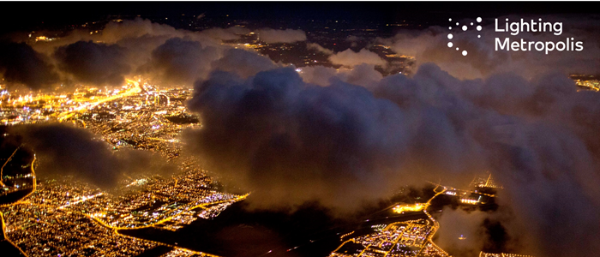
What we learned
Working with innovation requires:
Strict planning, commitment and patience
Communication between all partners during the construction is crucial
Innovative projects like this is more expensive than expected

Slide 19
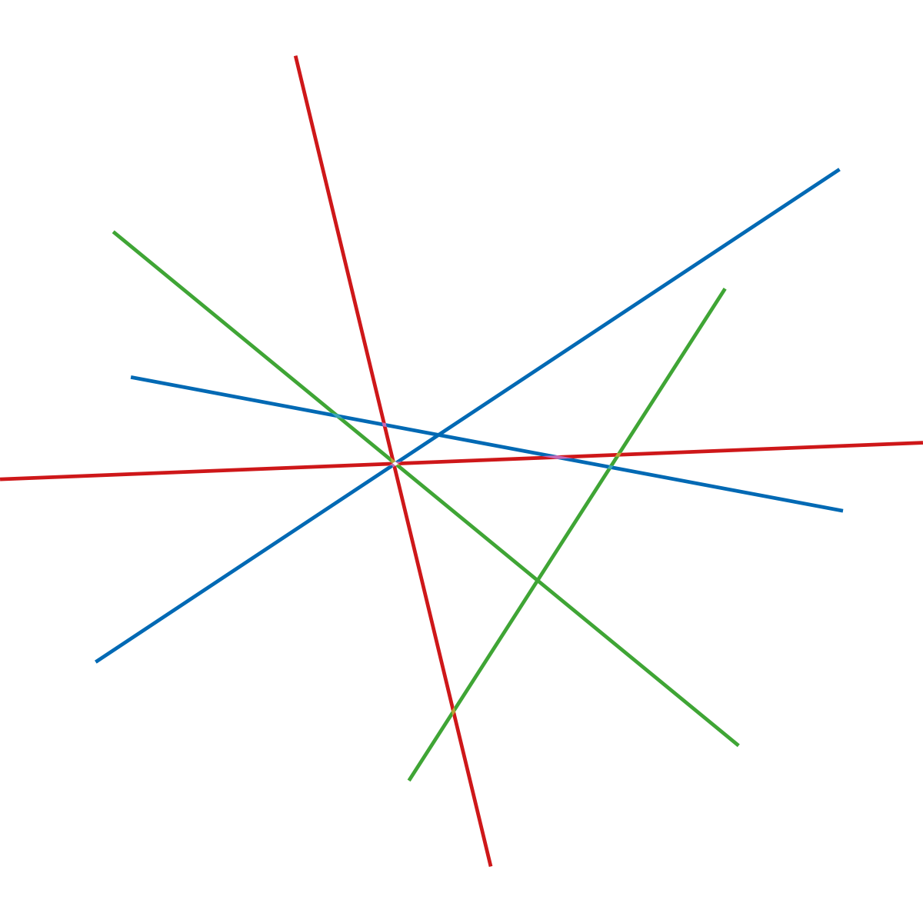
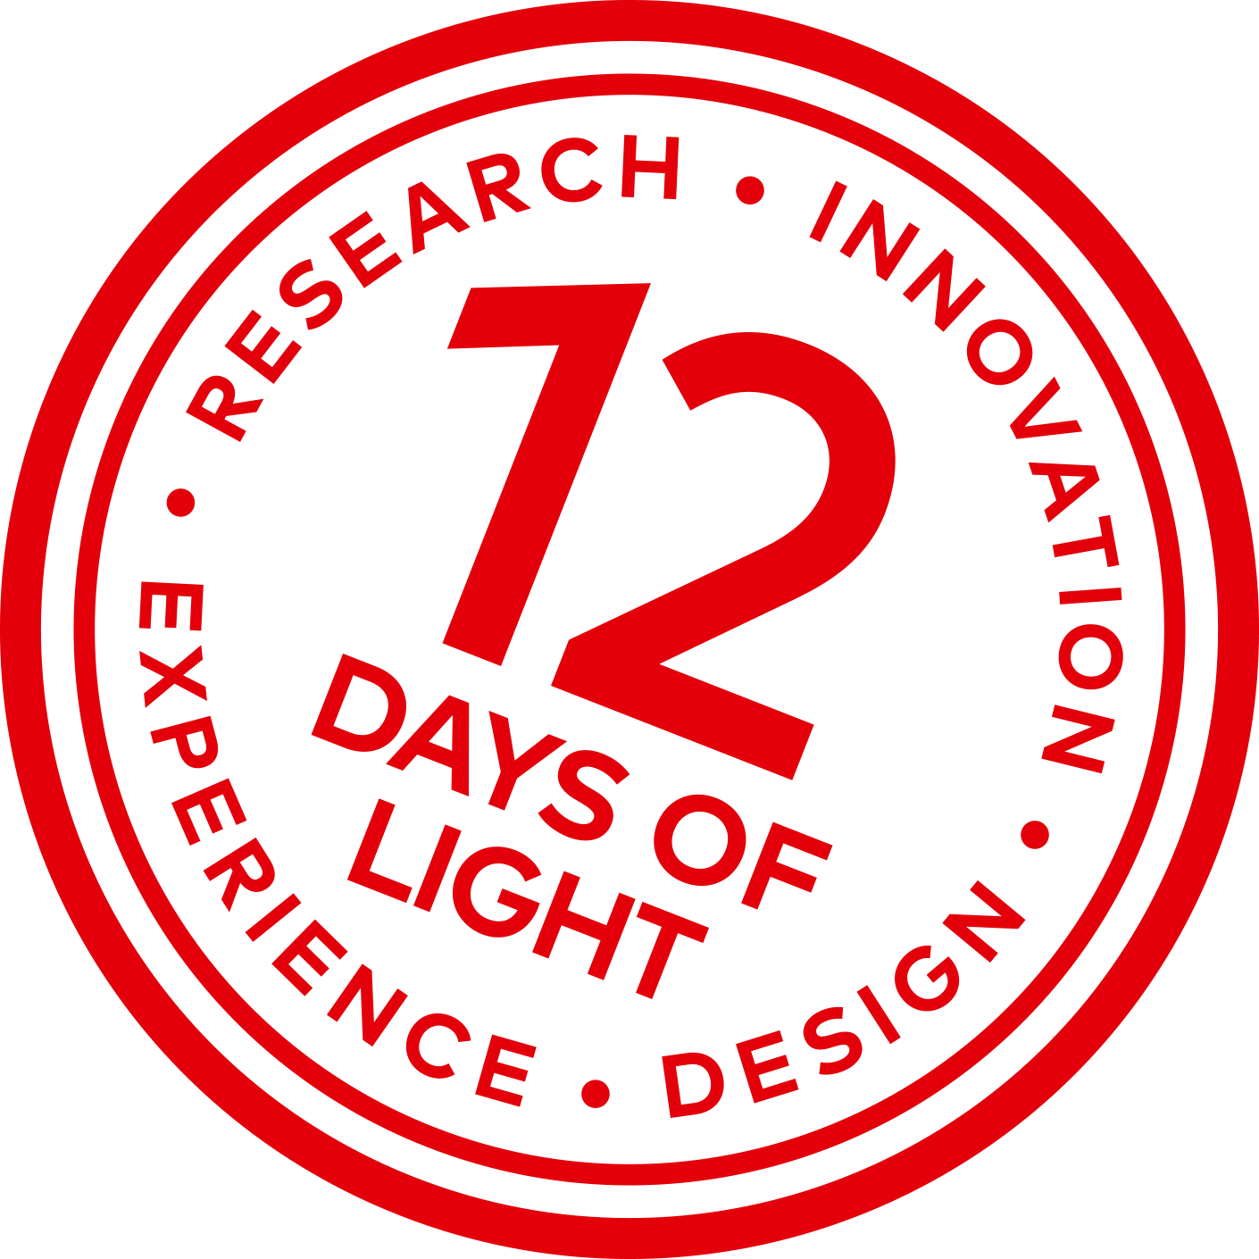
Key takeaways -
Combining existing technologies in new ways (sensors from the robot industry and light control) can open up a whole new perspective on interactive lighting
Post-testing and observations are essential to understand the effect of new types of interactive lighting on the general public and their behavioral patterns
Find the right balance between complexity and clarity of information conveyed

