Slide 1
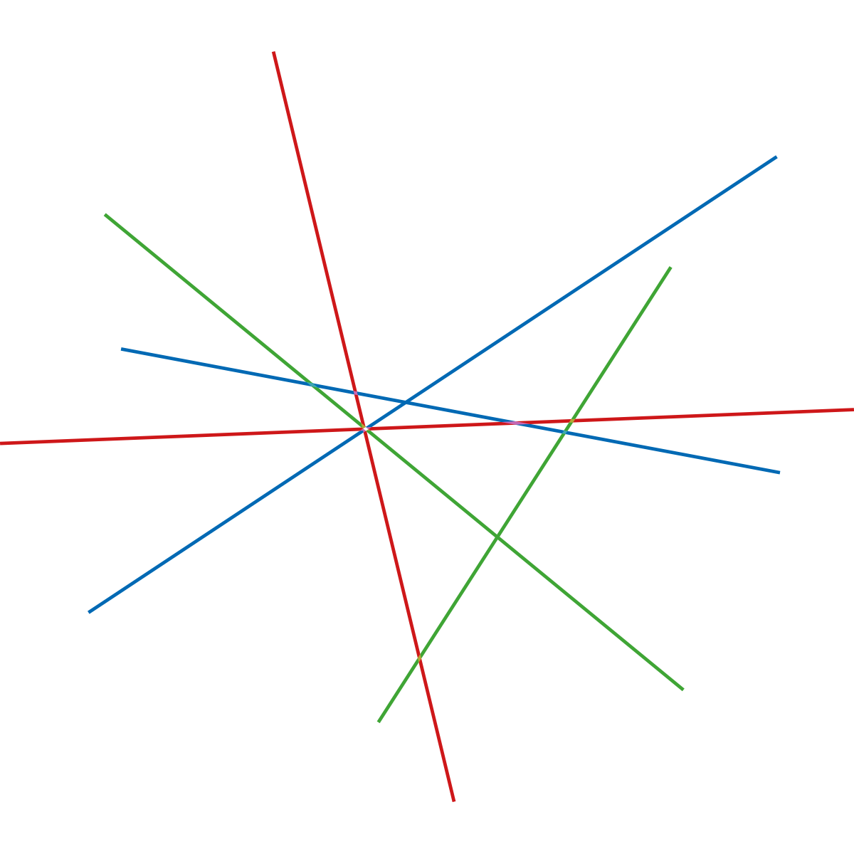

Interactive and safety lighting
in public spaces
Johan Ib Hansen
Senior Project Manager
Kalundborg Municipality

Slide 2
Lighting Metropolis in Smart Village Svebølle

Slide 3
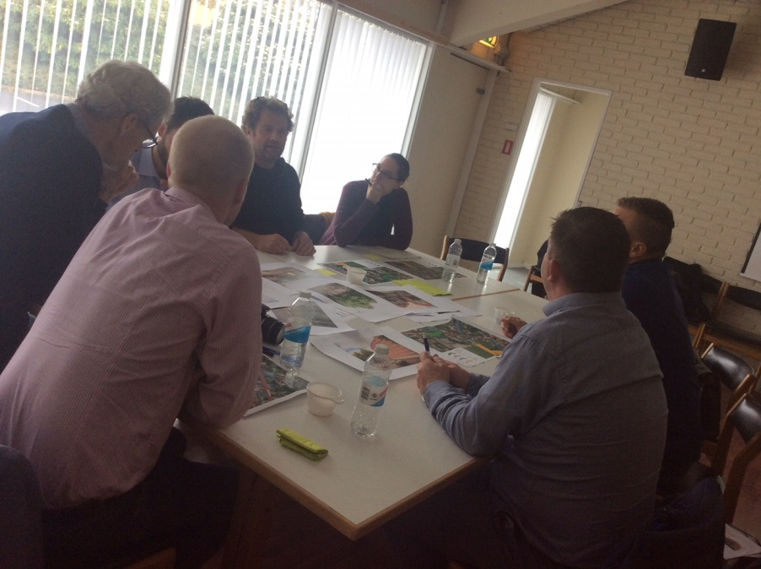
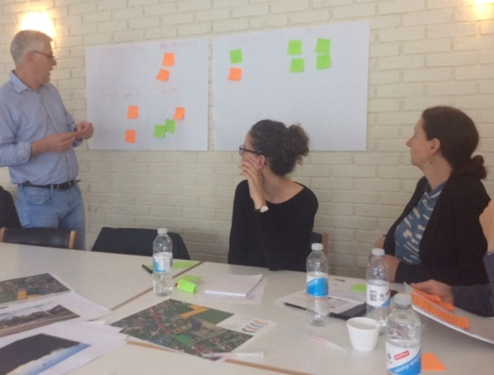
Early stage co-creation workshop
Citizens
Possible project partners
School representatives
Municipality
Local businesses

Slide 4
Ideas: Main topics - workshop conclusions
Traffic safety
Livability, transform the often empty, square to a more livable part of the village
Include school and education in Smart Village
Profiling/branding the school

Slide 5
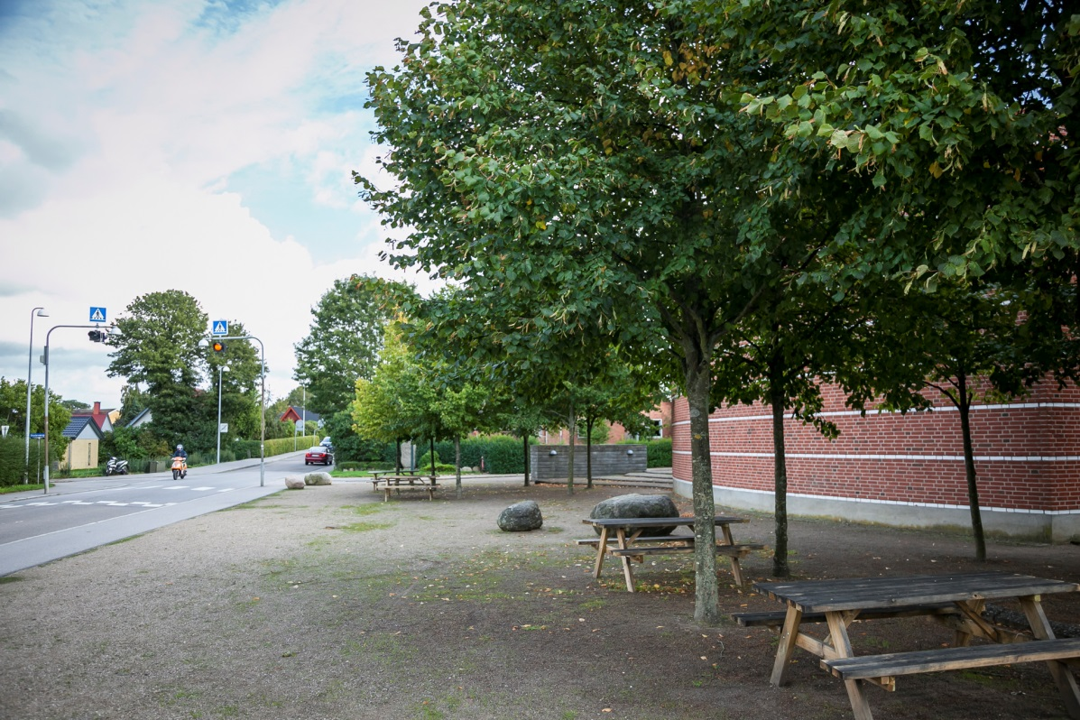
The square prior to the project
This square is often deserted and is seldomly occupied.
Citizens and students have expressed that they find it dull and boring.

Slide 6
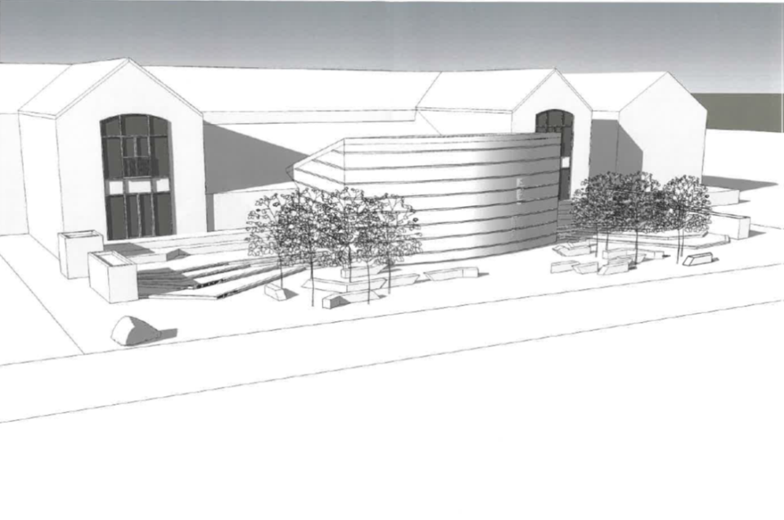
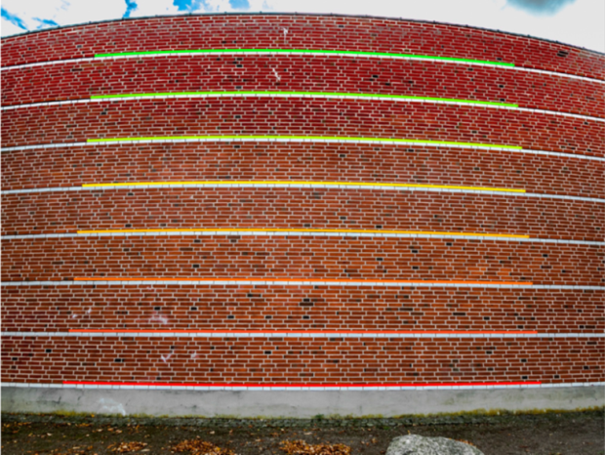
Ideas - Sketches

Slide 7
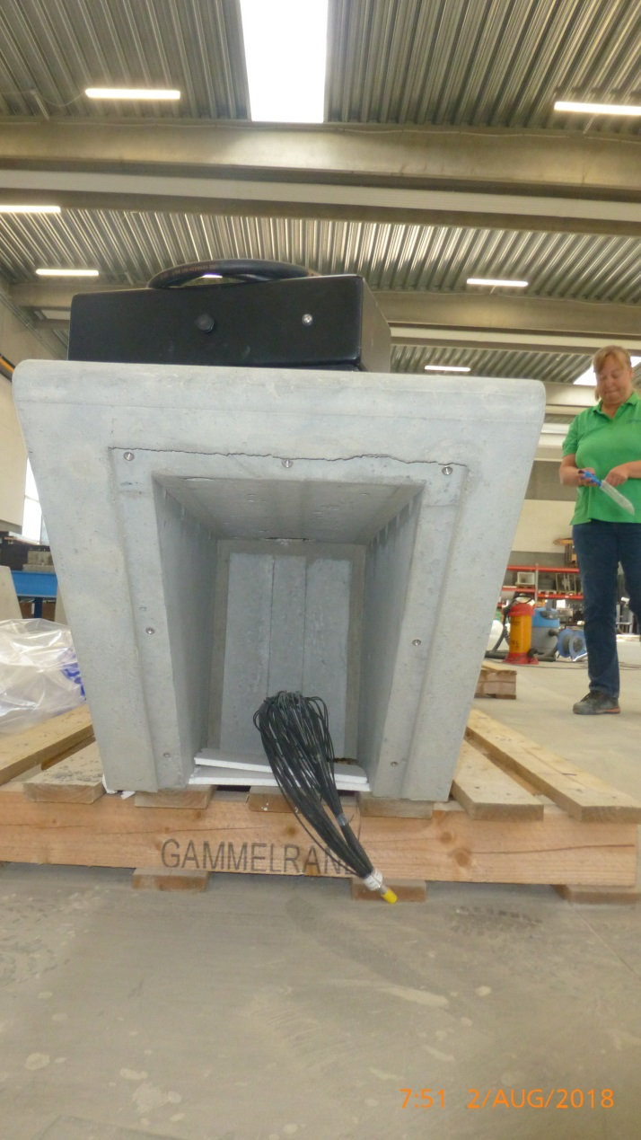
Smart City ready concrete benches
A concrete bench has different cavities.
Here is a cavity for mounting a LED light source.
Likewise, there
is room for mounting of sensors.

Slide 8
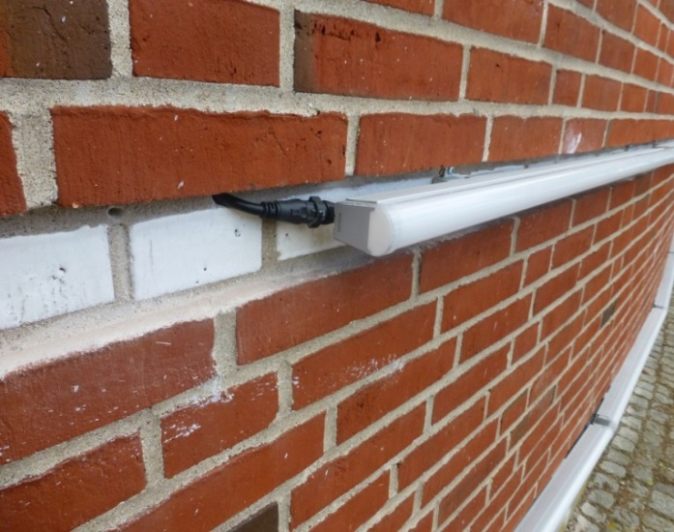
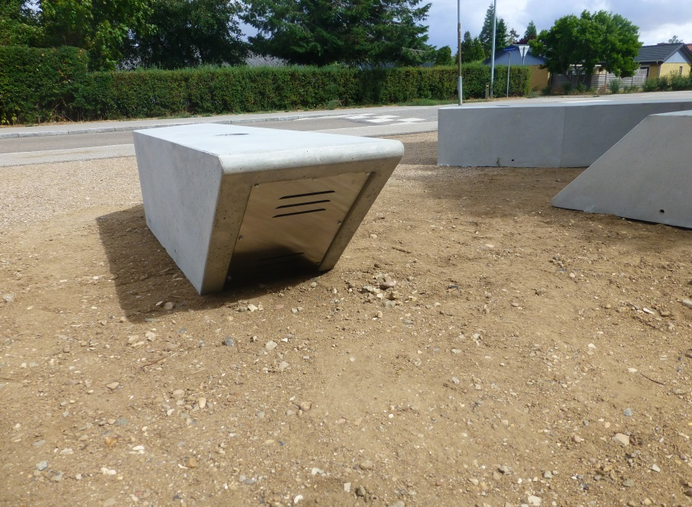
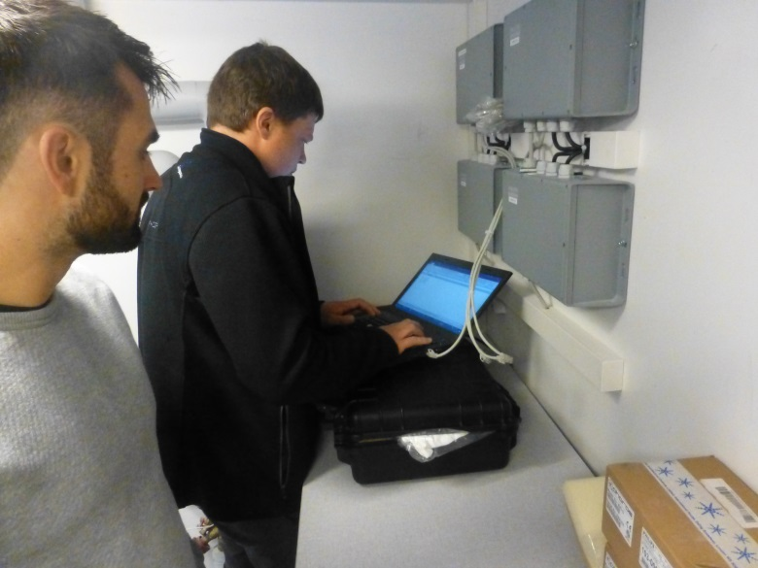
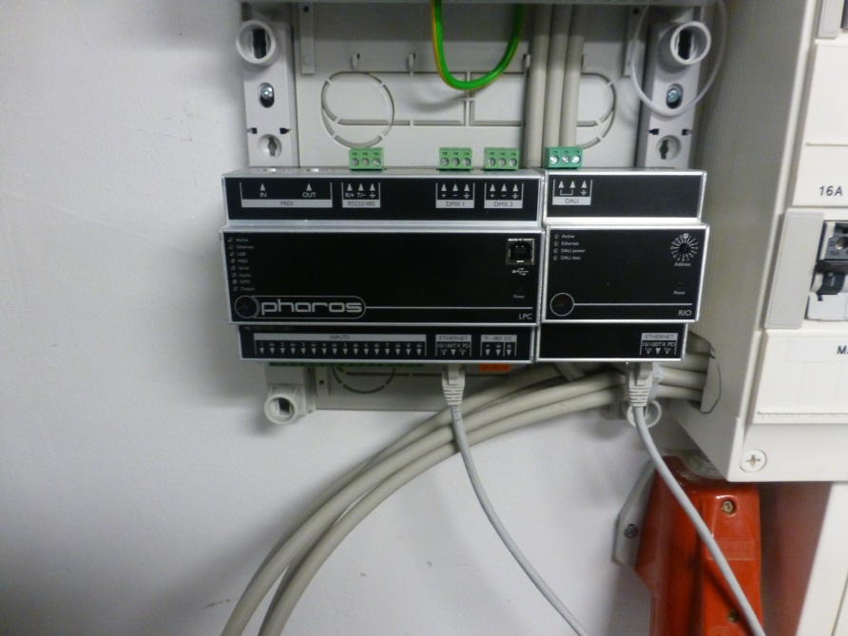
Light sources and sensors are connected in a technical control room at the school
DMX
DALI

Slide 9
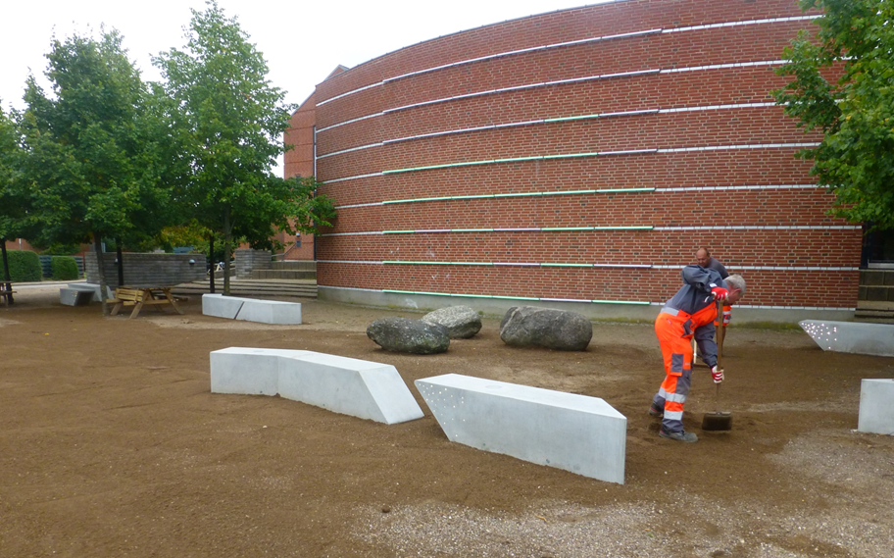
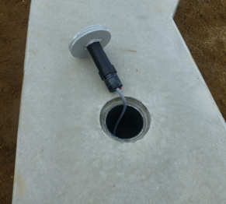
The installations are almost ready
The square in the front of the school.
The square is prepared after the installation of benches, light and sensors.
Some benches have electrical current via cables and sensors, others are prepared for sensors with batteries and LP-wan communication.

Slide 10
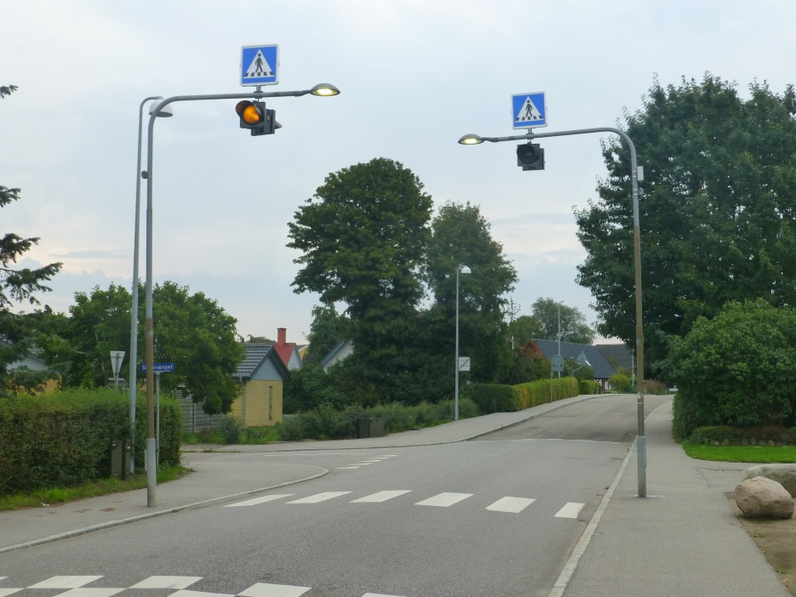
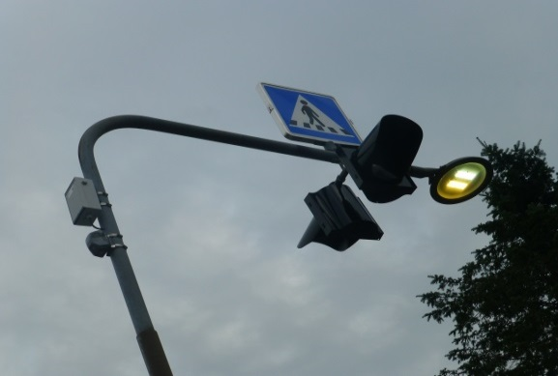
School crossing
Street luminaire with tunable white LED, controlled by PIR sensors.
The light set up is controlled via Wi-Fi.
When a pedestrian approaches, the light intensity is increased automatically.

Slide 11
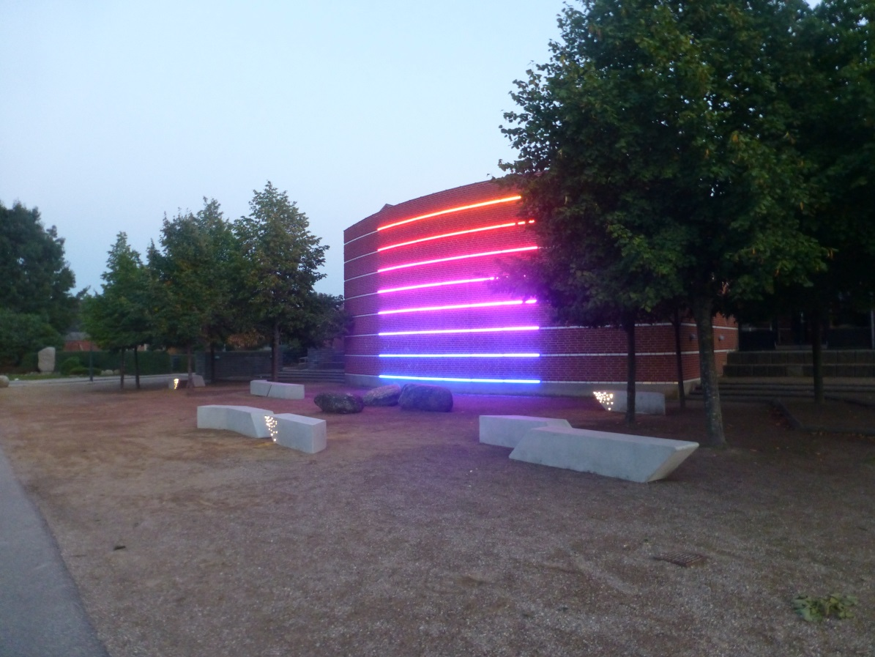
iColor Accent Compact
The LED illumination is so strong that it is clearly visible in daylight and it is necessary to lower the intensity when it gets dark, in order not to bother the neighbors.
Notes:
iColor Accent Compact, Philips color kinetics

Slide 12
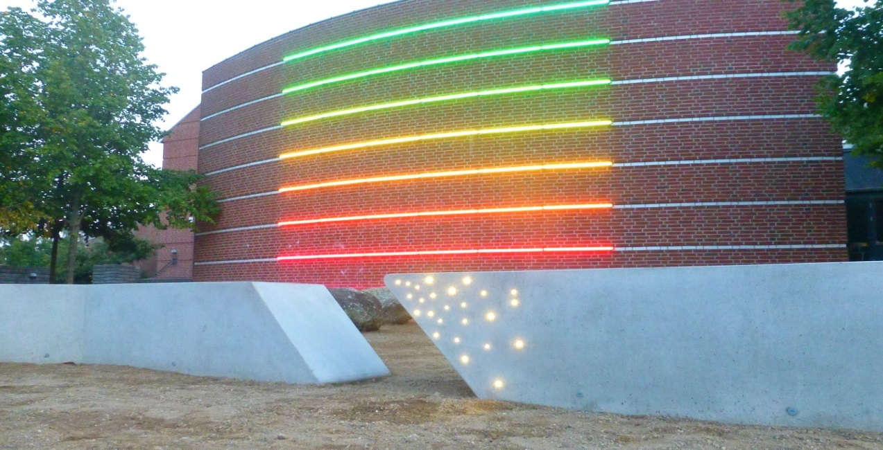
Benches with light conductors and manageable LED lights
Both the light in the benches and on the wall may be programmed to react on impulses from sensors.

Slide 13
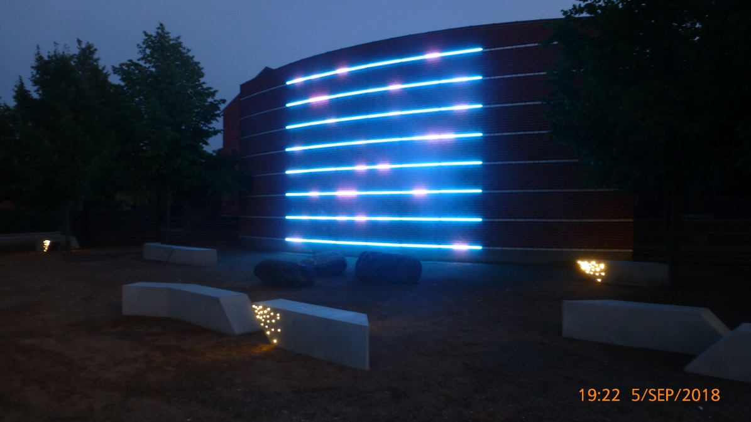
Star-light on benches and wall

Slide 14
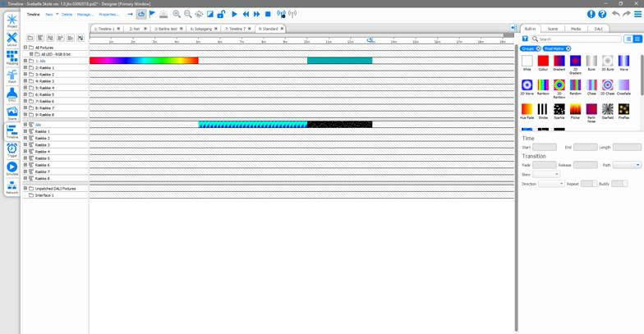
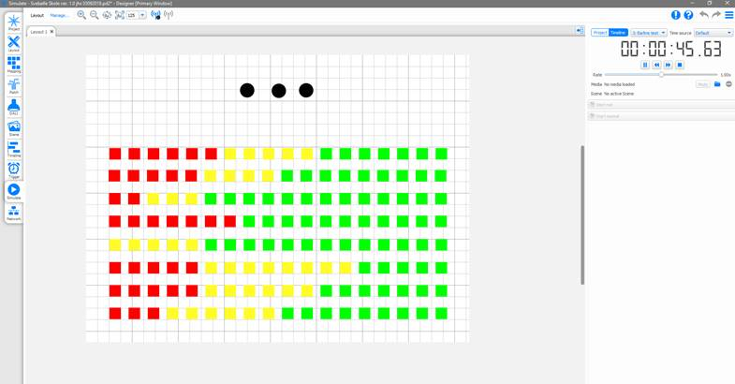
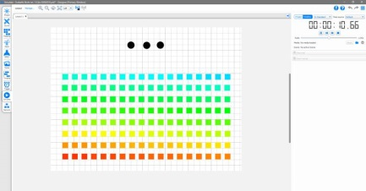
Pharos Lighting Control
Pharos Designer 2.5
From autumn 2018 Svebølle School will use data for teaching in different subjects, and offer ”Smart City” as project work

Slide 15
The final set up
examples of available data:
indoor climate data from classrooms
traffic data
outdoor climate data
surface temperature from sidewalk
outdoor environmental data
data from reactive sensors in benches
parking data
RFID-tracking data, traffic behavior.
A small scale ”smart city infrastructure”, where the users (students) can explore and make data valuable
an interactive light installation, responding on activity in surroundings
Tunable White in crossing, responding on traffic
programmable setup for engaging data and installations in education
Notes:
Elements:
Education
Programming
Gamification
Exploitation
Light design
Interactivity

Slide 16










Project participants:
Primary Products, Technologies and services:

Slide 17

Key takeaways -
Key point #1 interactive light integrated in education
Key point #2 focus on traffic safety as a smart city issue
Key point #3 smart city communicated by light

