Slide 1
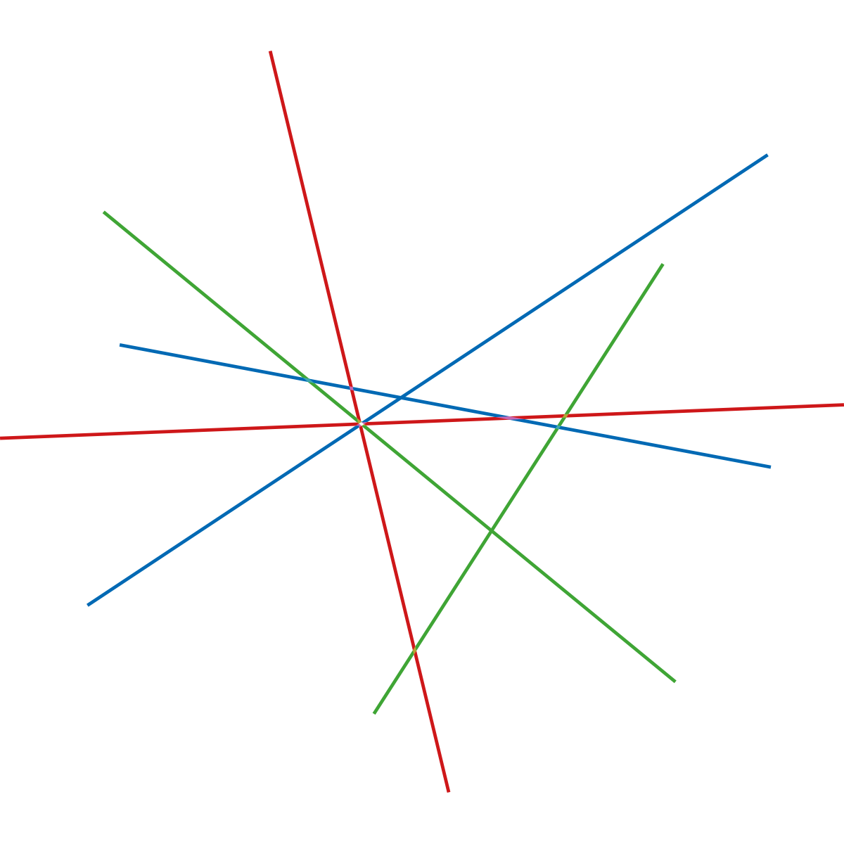
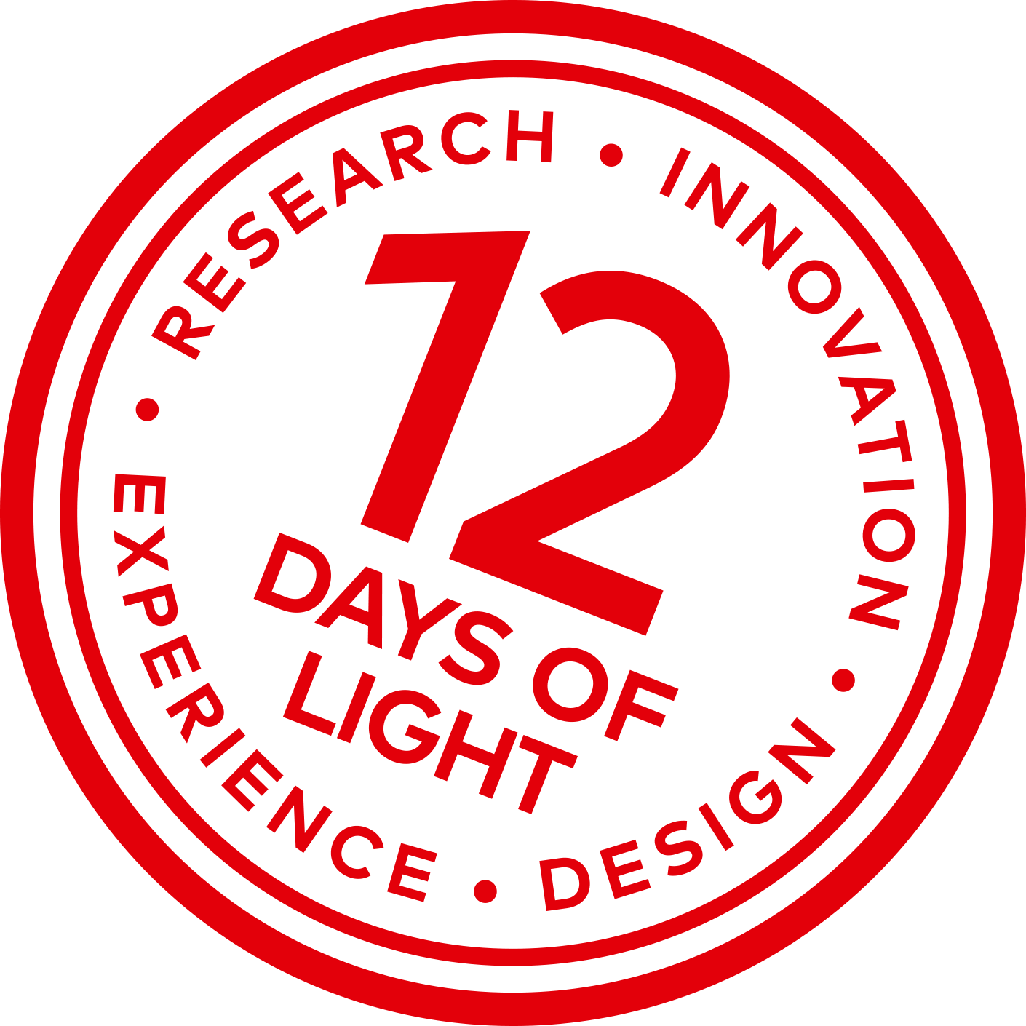
Presentation of Lighting Metropolis
Niels Carsten Bluhme,
Chairman of Lighting Metropolis
Project Director, City of Albertslund

Slide 2
> Vision
We´re making Greater Copenhagen a world leading living lab for smart lighting

Slide 3
> Main lighting areas
Livable cities
Urban renewal
Biological light
Learning
Intelligent system
Environment
Energy efficiency
Economy
Total Cost of Ownership
Safety
Identity
Attractiveness
Health & wellbeing
Preventative & treatment
Smart City
Sensor network
ITS, waste, water, energy
IoE communication
Impact
Life cycle
Investment strategy & procurement
Maintenance & operation
Art and technology
Interactive installations
Nudging
Gaming

Slide 4
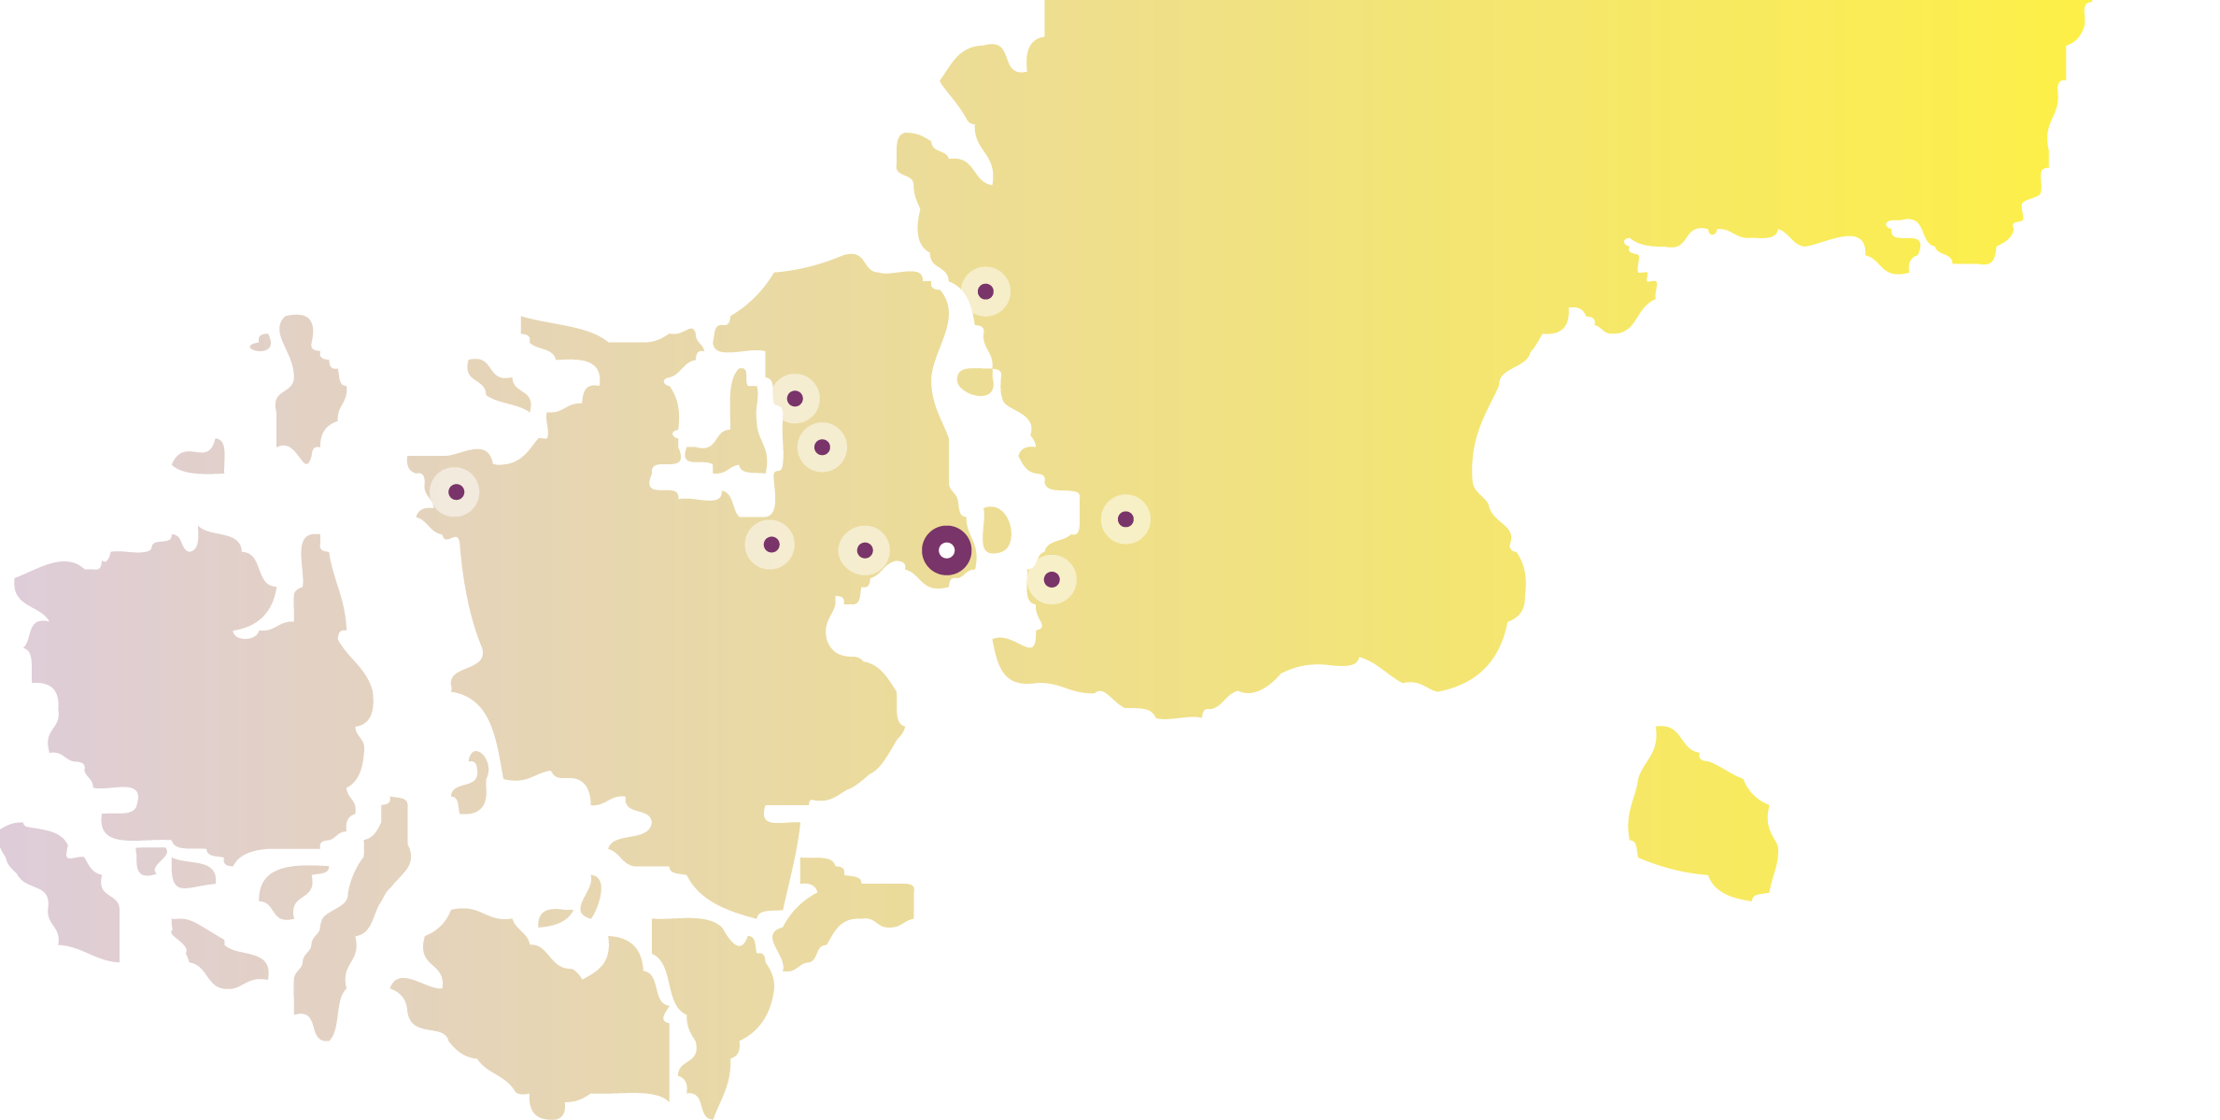
Big screen in public space (Egedal)
Light in Neonatal department (Region Skåne in Helsingborg)
Interactive lighting on school path (Egedal)
Human Centric Office Lighting (Innovation Skåne & LU Open)
Path lighting in Smart Village Svebølle (Kalundborg)
Reduction of flicker in fixtures (Innovation Skåne)
Brighter Brunnshög (Kraftringen)
Canteen lighting for reduced food waste (Lund)
Lighting up the Musicon path (Roskilde)
Green light on the alley (Lund)
Light on the cultural alley (Roskilde)
Light and culture (Copenhagen)
Experience energy efficient lighting (LU-Env. Psychology)
DOLL Living Lab (Albertslund)
Building of the future (Albertslund)
Toronto intersections (Copenhagen)
Outd. light. for people with visual impaired (LU-Env. Psychology)
Circadian light at nursing home (Albertslund)
Learning light in schools (Albertslund)
Interactive playground lighting (Albertslund)
Health light in the psychiatry (Region H)
Light for social sustainability – Sorgenfri (Malmö)
Smart lighting for energy optimization (Malmö)
The Living Lab

