Slide 1
Public Private innovation
Joakim Nelson, VD Innovation Skåne AB
Malmö SEPTEMBER 14th, 2018

Slide 2
Introduction to Innovation Skåne
Technology & Innovation trends
4 models for public private innovation
Key takeaways

Slide 3
Innovation Skåne is an innovation company owned by Region Skåne.
We contribute to regional growth and public services
through innovation.

Slide 4




Innovation Skåne offers
Business Advisory and Innovation Management
Innovation Arena
supporting public-private
collaboration
New possibilities
for regional growth and innovation

Slide 5
Introduction to Innovation Skåne
Technology & Innovation trends
4 models for public private innovation
Key takeaways

Slide 6
















Smartphone as a driver…
Low cost
>1.5bn smartphones per year!
Size
Low power consumption
2 application environments
Enormous amount of data
High speed and multiple communications modes

Slide 7











... and more it will be - IoT!
Exponential growth
+
Extremely low power consumption
Big Data & AI
>20bn units 2020 (Gartner)
~18bn 2022 (Ericsson)

Slide 8

IoT is driving …
AI / Machine
Learning
Cloud computing
& Big Data
Blockchain
Sensors

Slide 9
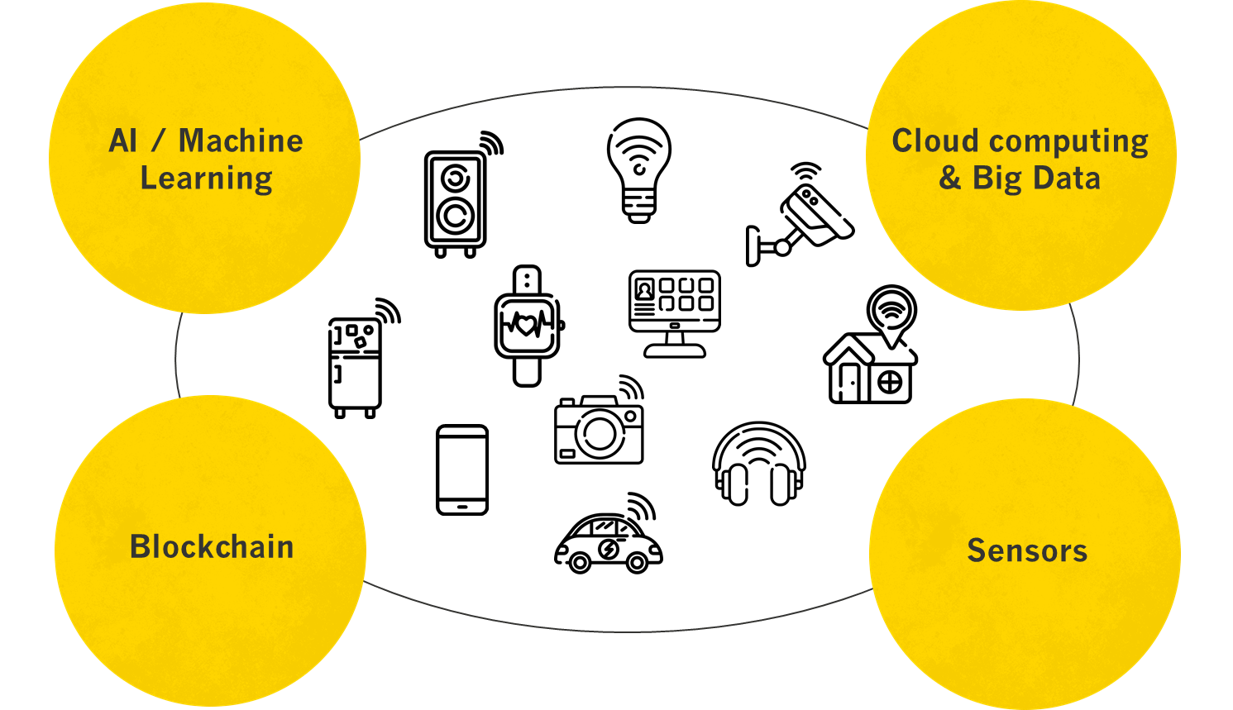
Impact into lighting …
Sensors all over
Smarter control
Efficiency
Lower cost
Connection to private & public data
New products
New business models

Slide 10
Introduction to Innovation Skåne
Technology & Innovation trends
4 models for public private innovation
Key takeaways

Slide 11


Two sides with different roles and logic
PRIVATE ACTORS
PUBLIC ACTORS
Growth
Future welfare services
External Innovation
Efficiency & Quality
New technology
Demands
System know-how

Slide 12
The sweet spot
PRIVATE ACTORS
PUBLIC ACTORS
Growth
Future welfare services
External Innovation
Efficiency & Quality
New technology
Demands

Slide 13
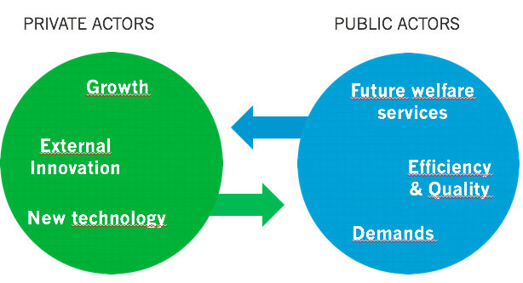
4 models for public private innovations
External innovation projects
Collaborative projects
Improvement projects
Internal, demand driven projects

Slide 14
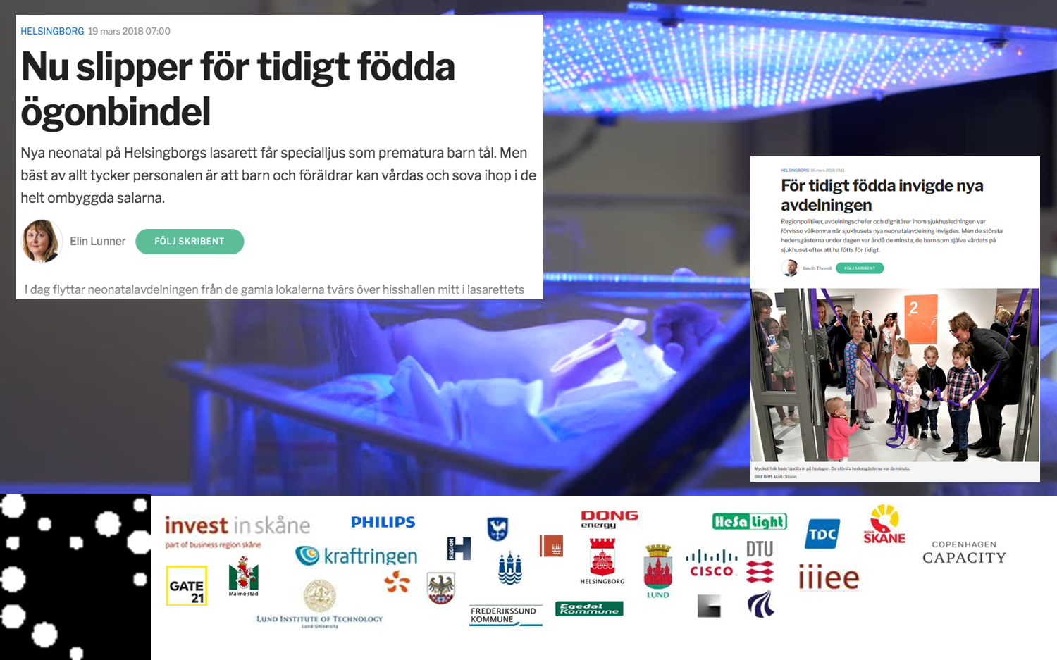
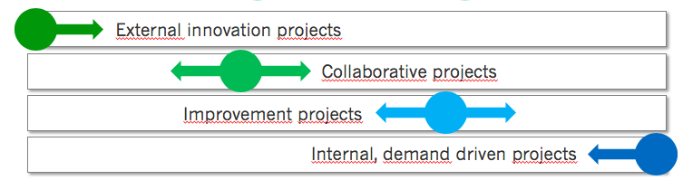
Example – Lighting metropolis

Slide 15
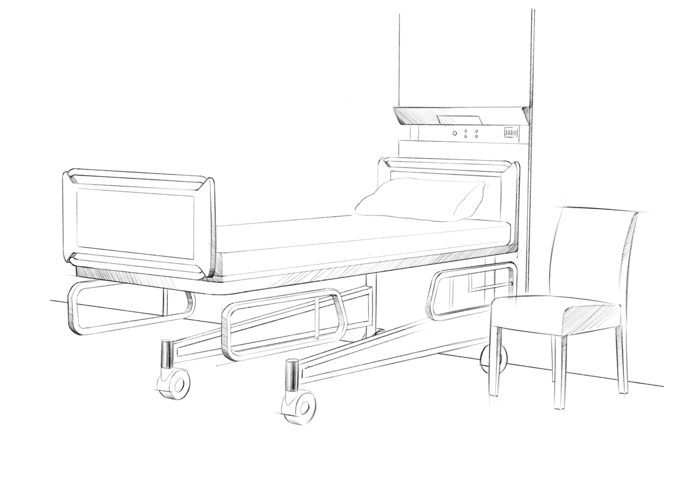




Example – Fall prevention
Innovation procurement

Slide 16
Introduction to Innovation Skåne
Technology & Innovation trends
4 models for public private innovation
Key takeaways

Slide 17
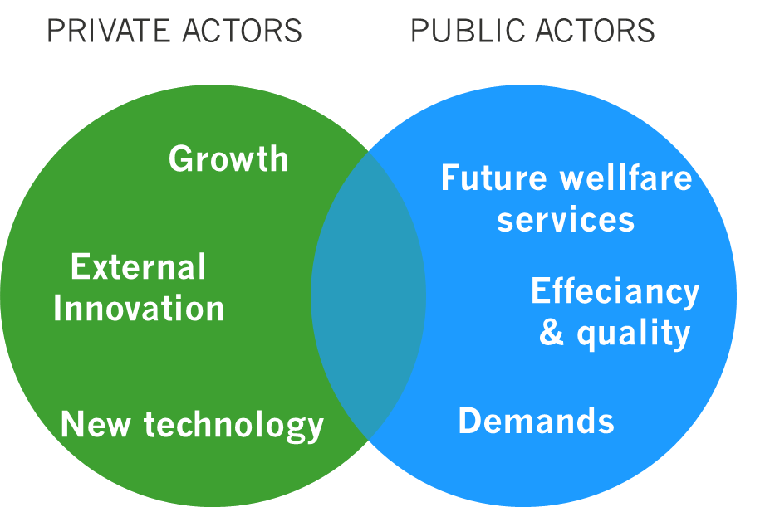
Key takeaways
New technology will affect everyone and everything
To understand the business logic of both sides is crucial
The possibilities with a public innovative purchaser are paramount

Slide 18
Thank you!
joakim.nelson@innovationskane.com

