Slide 1
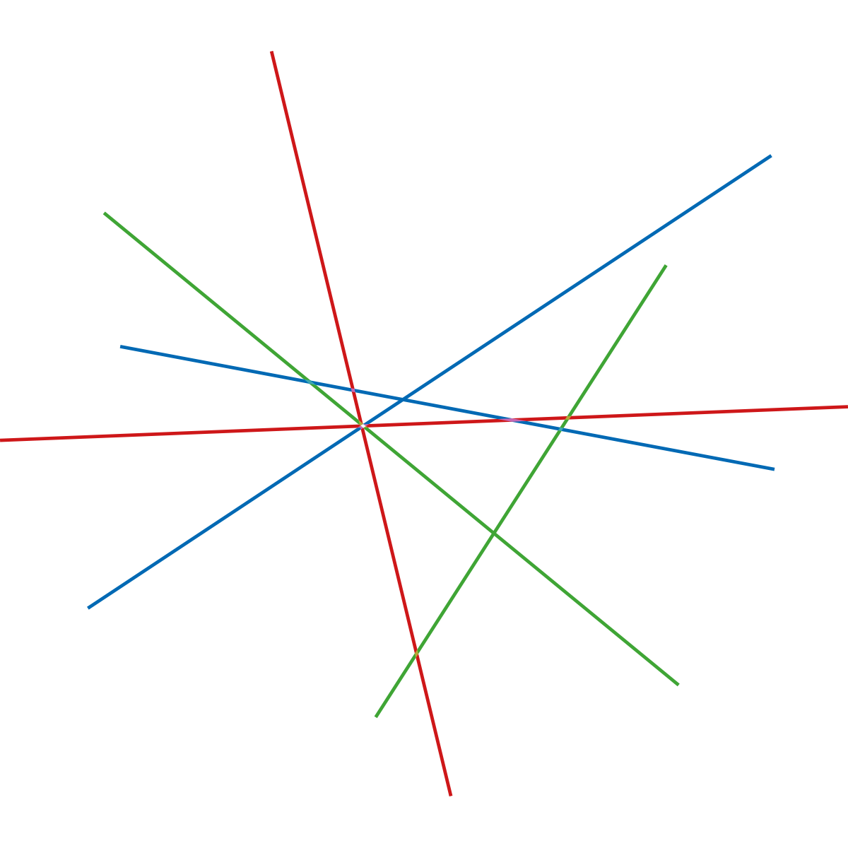

Public Private Innovation
A new way of making innovative lighting solutions for the citizens
Joakim Nelson, CEO at Innovation Skåne
Jacob Lundgaard, Director of Development, Gate 21

Slide 2

Lighting as one application
Eco system thinking
Innovation as a shared obligation
Demand driven
Public sector with green ambitions and large budgets

Slide 3

Accelerate both sides of the market
Traditional focus on companies and universities
New focus on maturing the demand side
Do both!

Slide 4

Degrees of uncertainty
Public Private Innovation
Market dialogue
Possibility to talk to market about
Visions
Targets
Challenges
Criteria
Possibility to make a cooperation contract prior to a tender
Testing
Demonstration
Co-creation

Slide 5

Public Private Innovation
Driven by public need or vision
Triple Helix Co-Creation across a partnership
Shared investment and risk
Balance interests in a neutral room
No specific deliverables – prototyping and testing

Slide 6
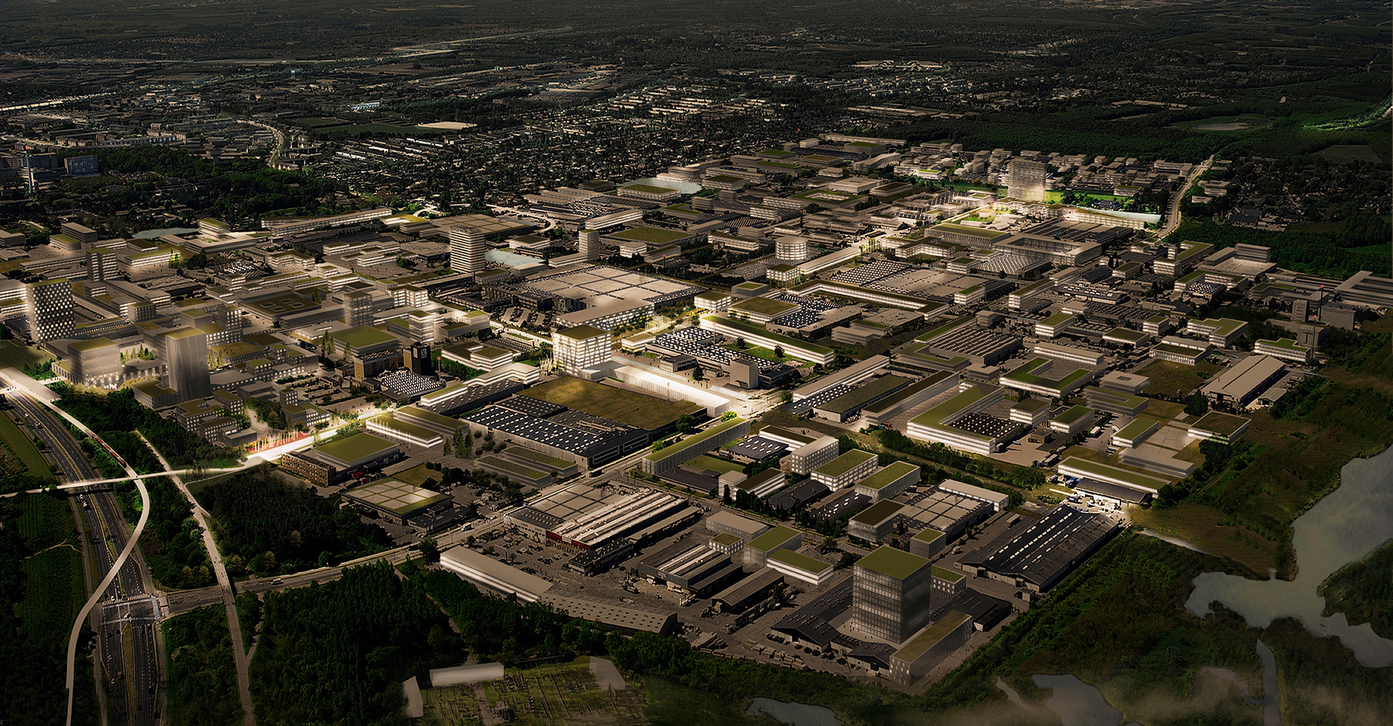



1:1
Maturing public market with Living Labs

Slide 7
40
40+ Municipalities
Projects
Public Private Innovation
Create projects
Build Living Labs
Secretariat
Get funding
Lead projects and labs
Facilitate networking
6 Knowledge Partners
40+
Companies

Slide 8

2 Countries
3 Regions
4 Mio people
79 Municipalities

Slide 9
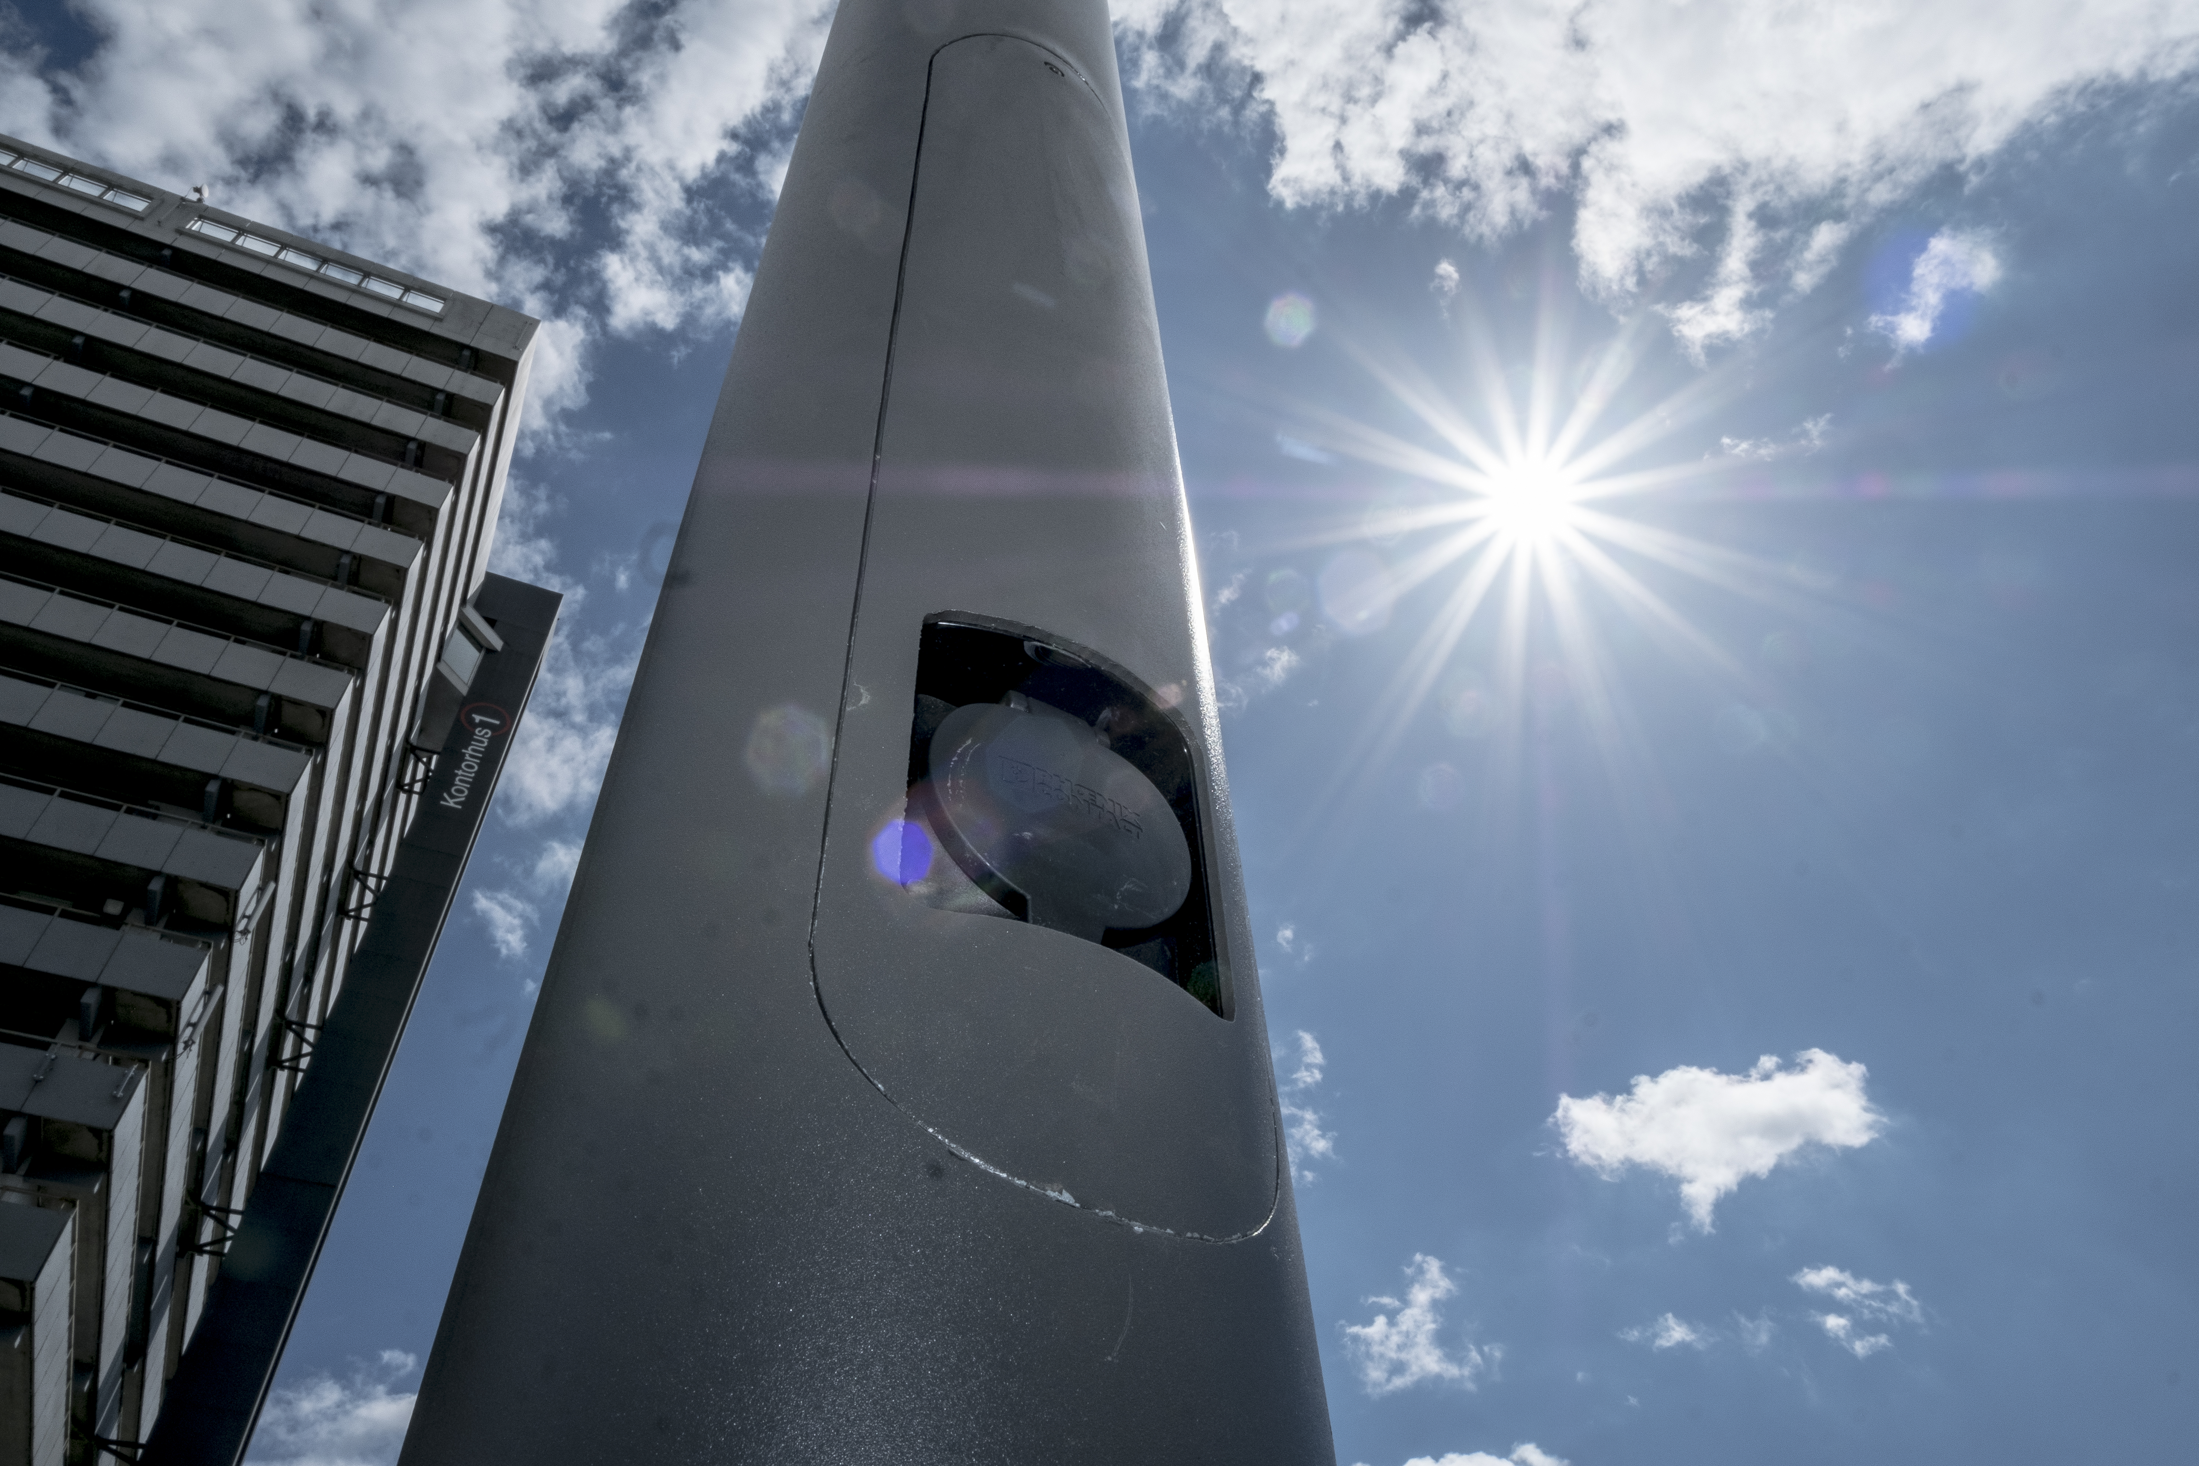
Recent examples of maturing both sides of the market
Green Lab for Scalable Urban Services
Lighting Metropolis Green Economy
Innovation Network for Smart Urbanization
The Academy for Smarter Communities

Slide 10

Key takeaways
Time for wider and deeper co-creation
Mature both sides of the market for scalability
Build on the advantages of our region

