Slide 1
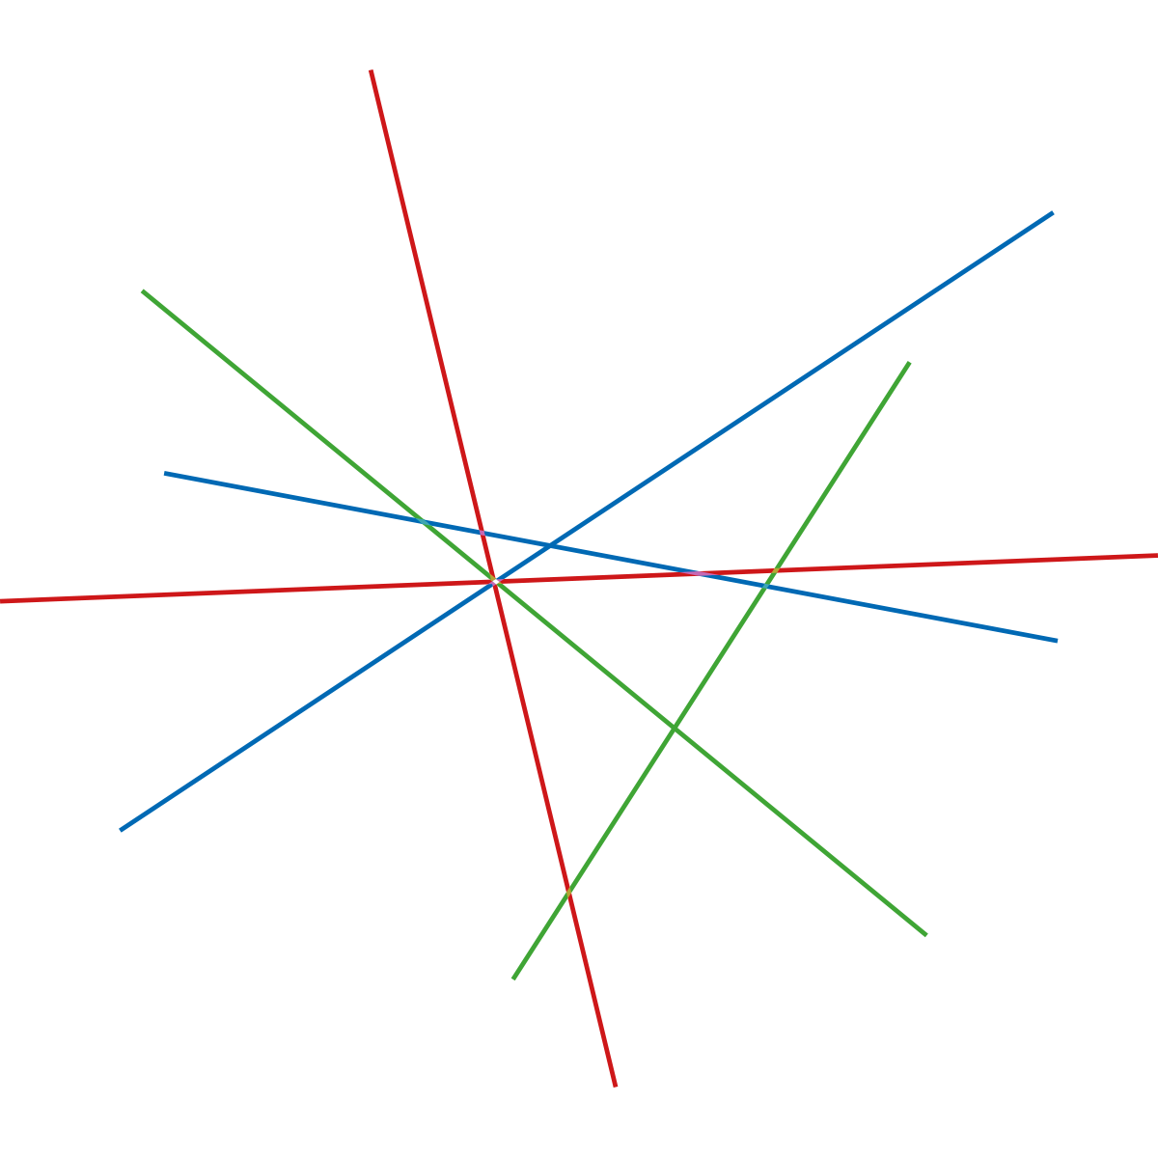

New Research in Lighting: Human needs
Maria Johansson
Hillevi Hemphälä

Slide 2




Outdoor lighting for pedestrians
Maria Johansson
Environmental Psychology, Dept of Architecture and Built Environment, Lund University, Lund, Sweden

Slide 3
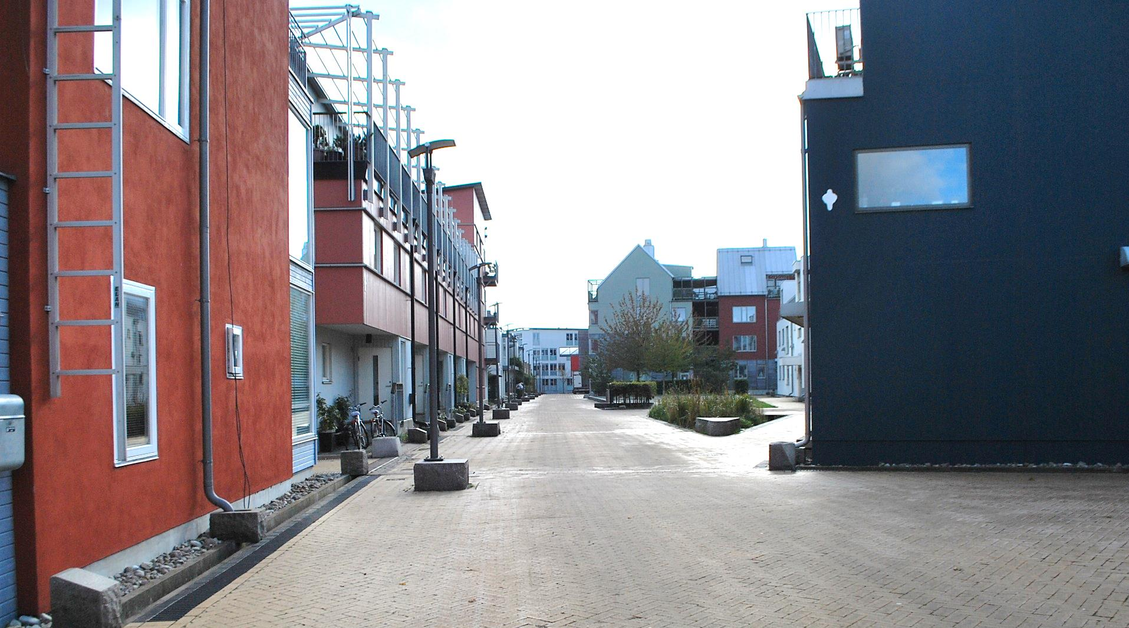
Walking as a desired mode of transportation
Foto: Catharina Sternudd

Slide 4
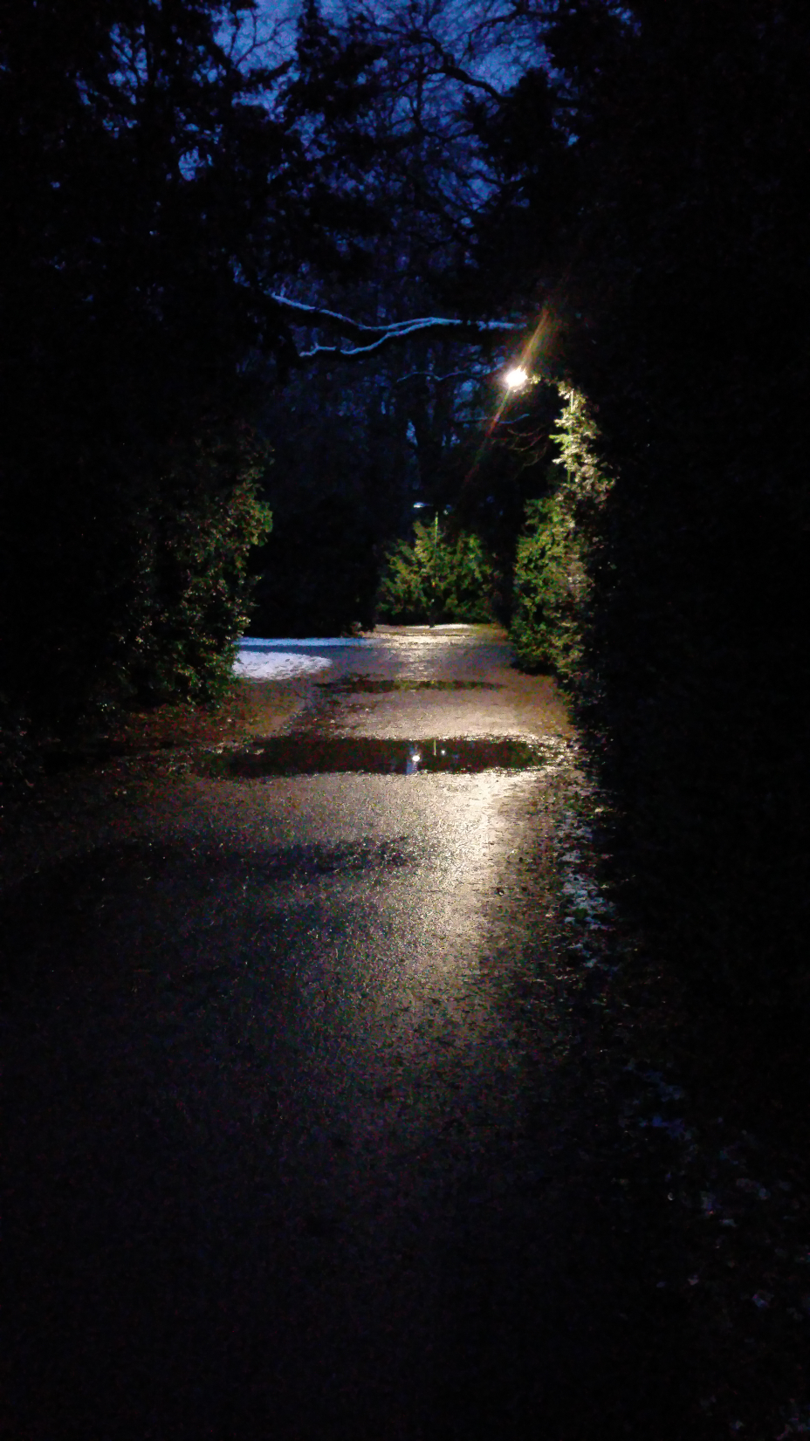

Pildammsparken Malmö
December 21, 2016
Sunrise: 08.35
Sunset: 15.36

Slide 5

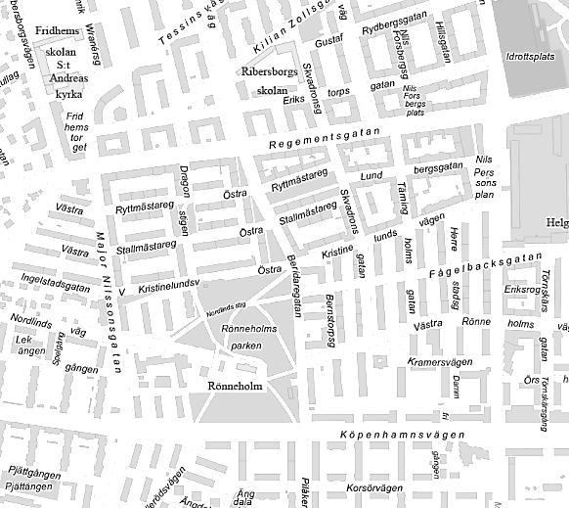

A model for urban walking
PERCEIVED URBAN DESIGN
QUALITIES
INDIVIDUAL
FACTORS
AFFECTIVE
EXPERIENCES
WALKING
PHYSICAL AND SOCIAL ENV FEATURES
Johansson et al., 2016
Johansson et al., 2016

Slide 6
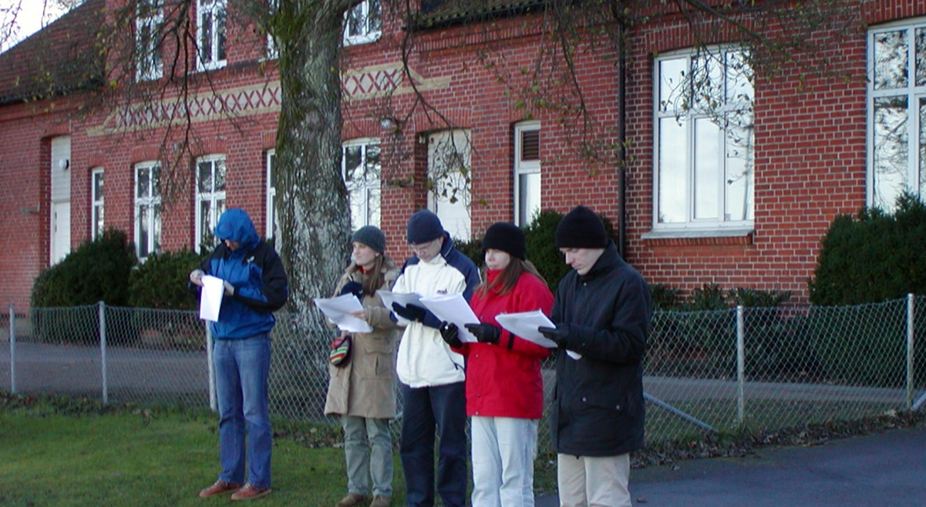
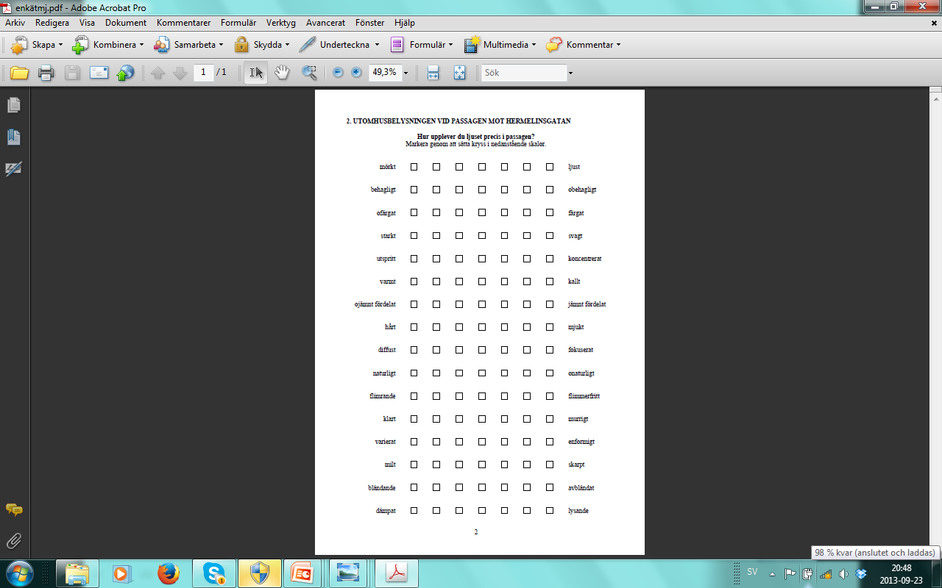
Observer-based environmental assessment
Foto: Maria Johansson

Slide 7
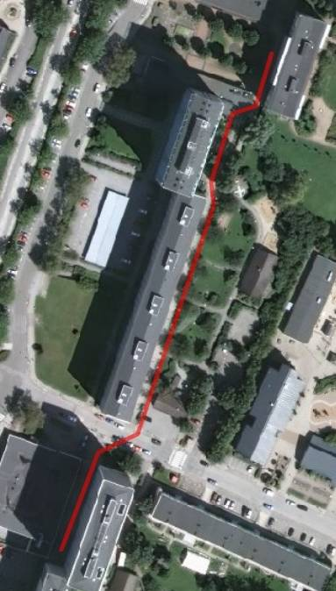
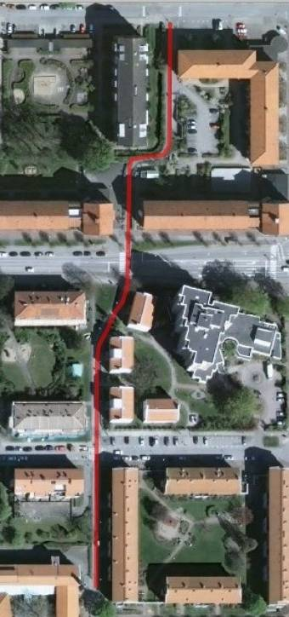
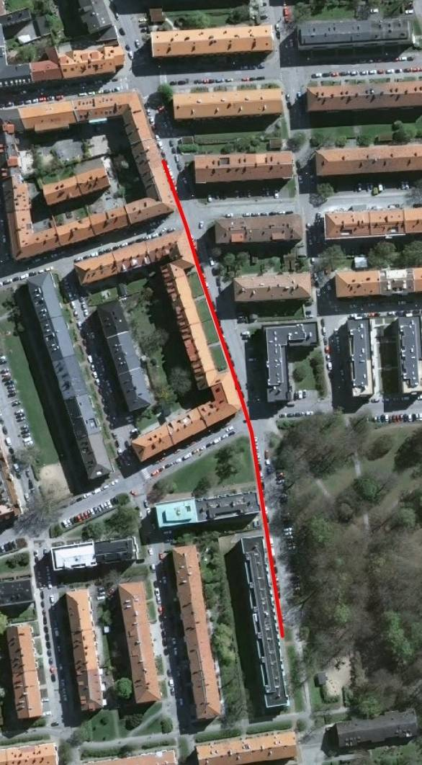
Structured walks
Bilder: Catharina Sternudd

Slide 8
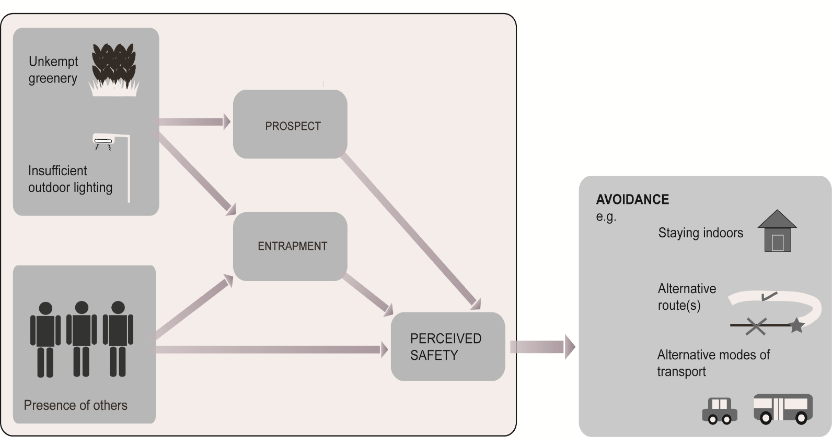
Insufficient lighting leads to avoidance behaviour
Rahm, Sternudd & Johansson, in manuscript

Slide 9
Research on outdoor lighting for pedestrians
Perception of the lit environment
Evaluation of the lit environment
Behaviour in the lit environment
Rahm & Johansson, 2017

Slide 10
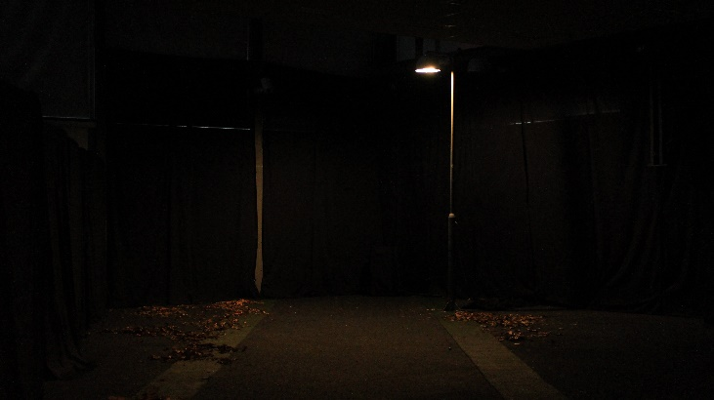
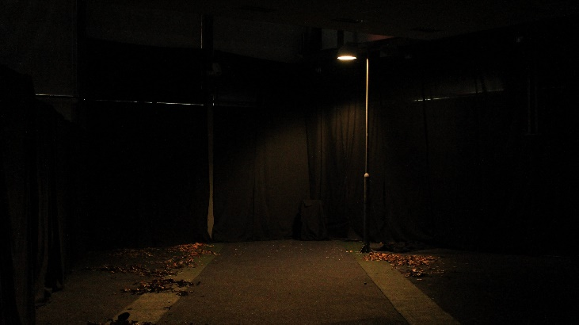
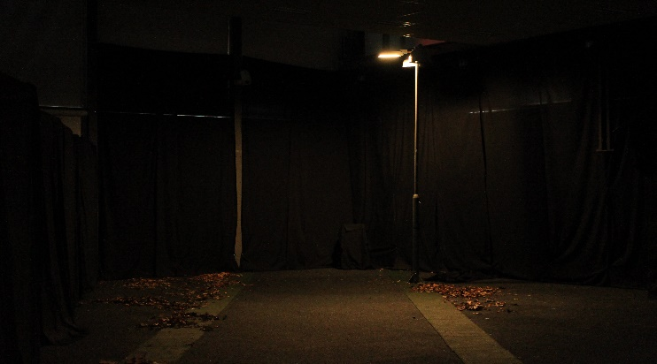
Three lighting applications
CDO-ET, CCT: 2890,
CRI: 81, S/P: 1,25
EH: 7 lx - 45 lx
LED1, CCT: 2912,
CRI: 75, S/P: 1,22
EH:18 lx – 81 lx
LED2, CCT: 3810,
CRI: 75, S/P: 1,48
EH: 15 lx – 67 lx
Rahm & Johansson, submitted

Slide 11
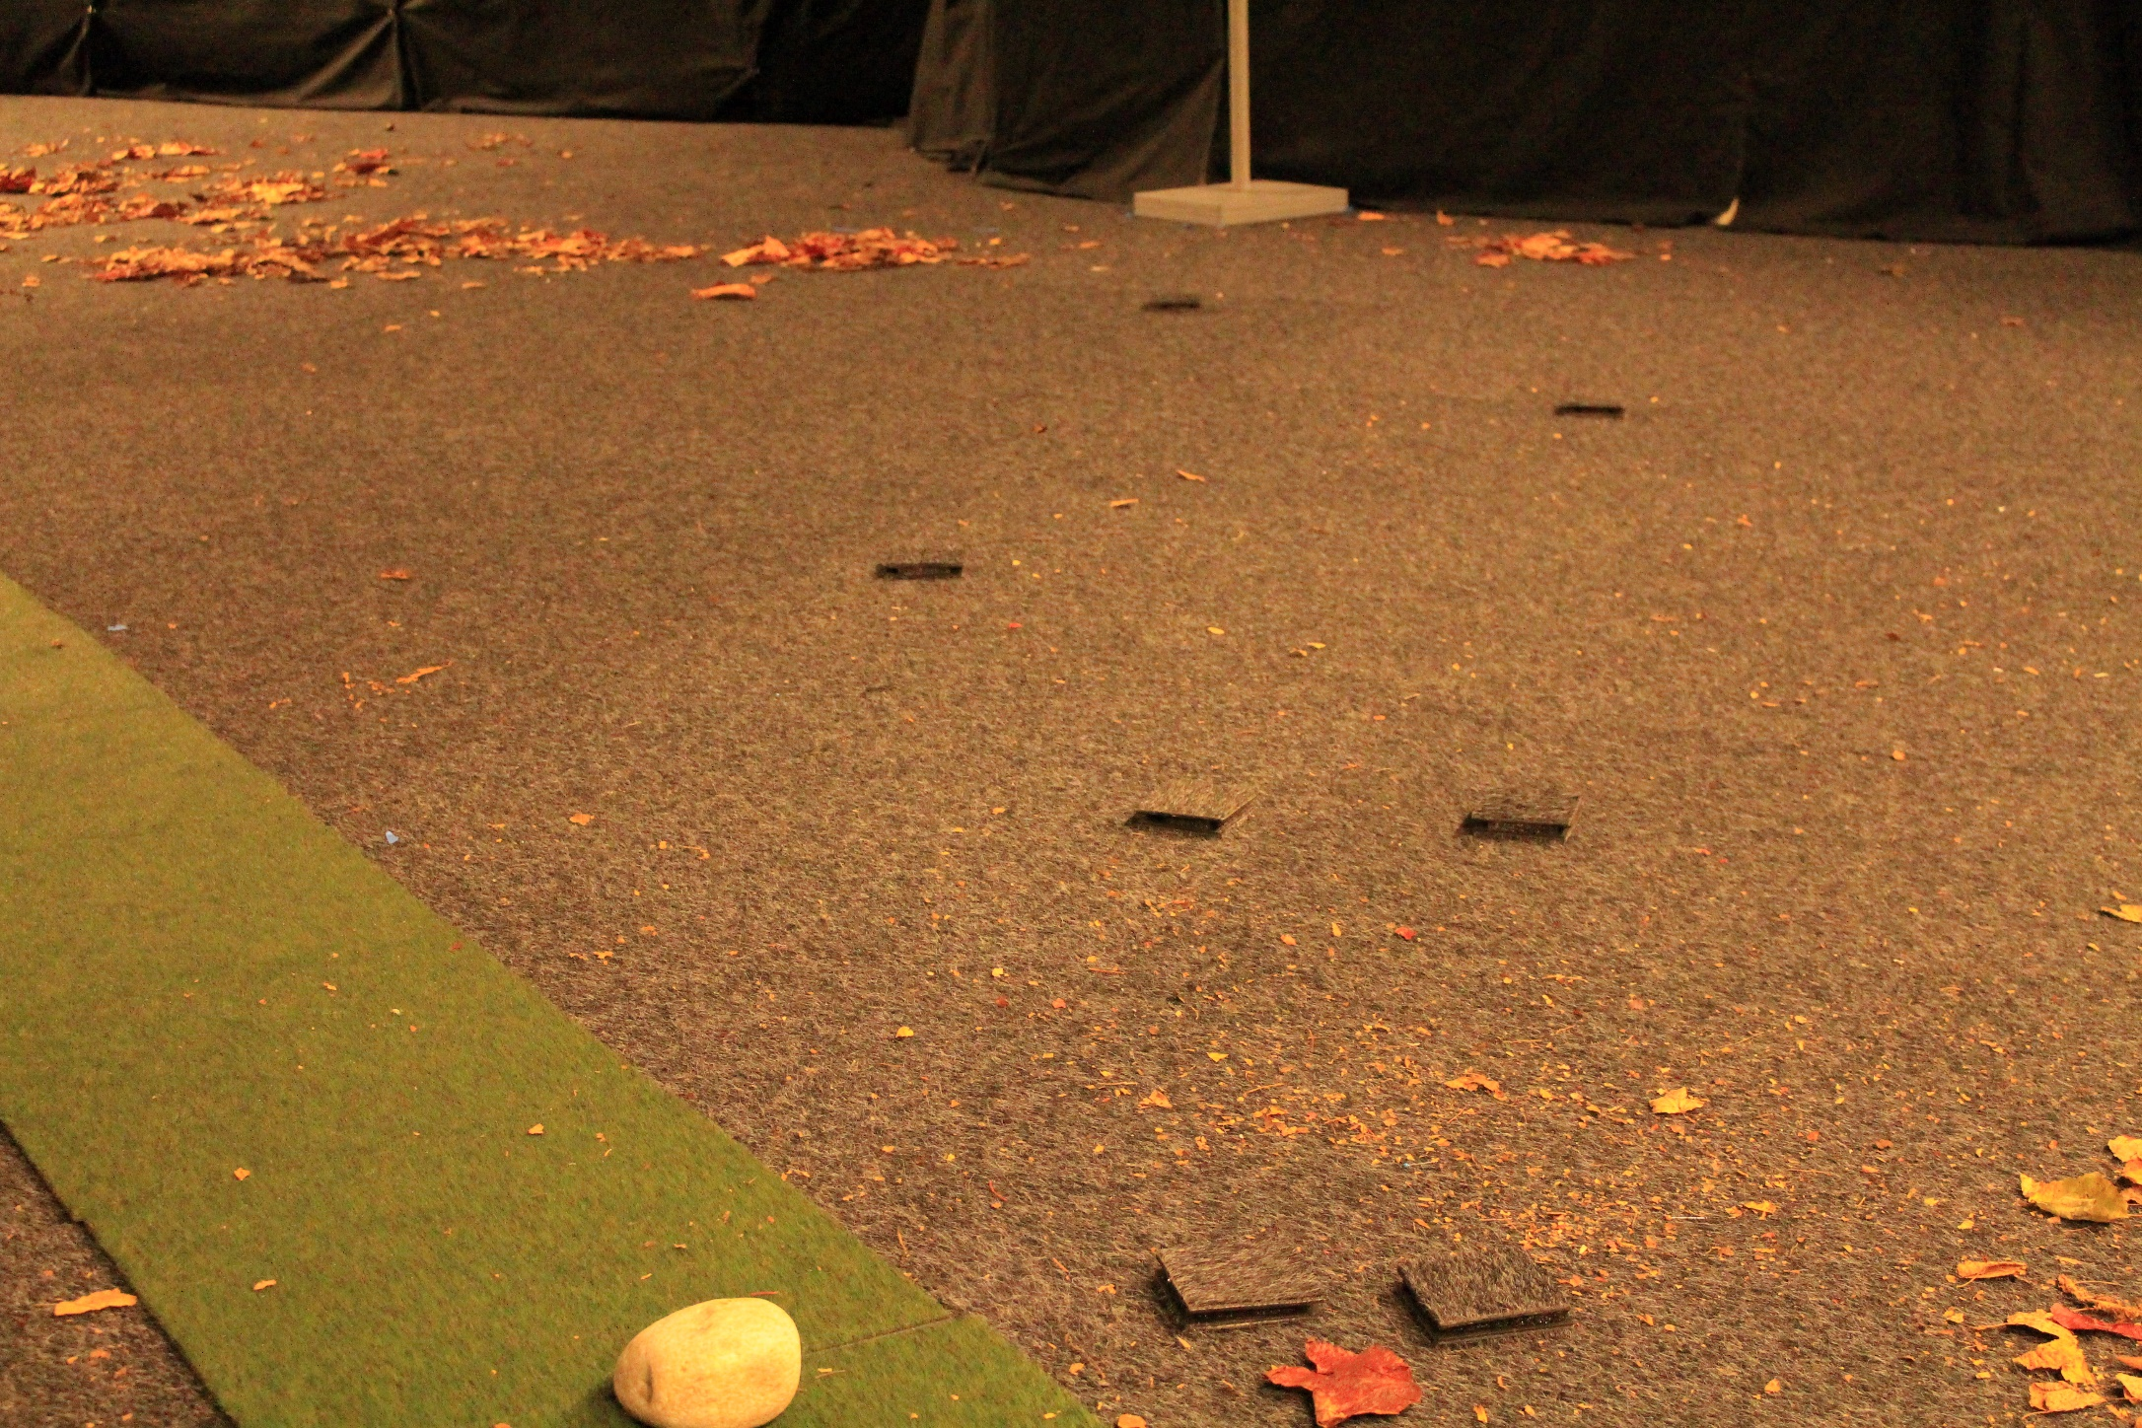
Perception: Obstacle detection

Slide 12
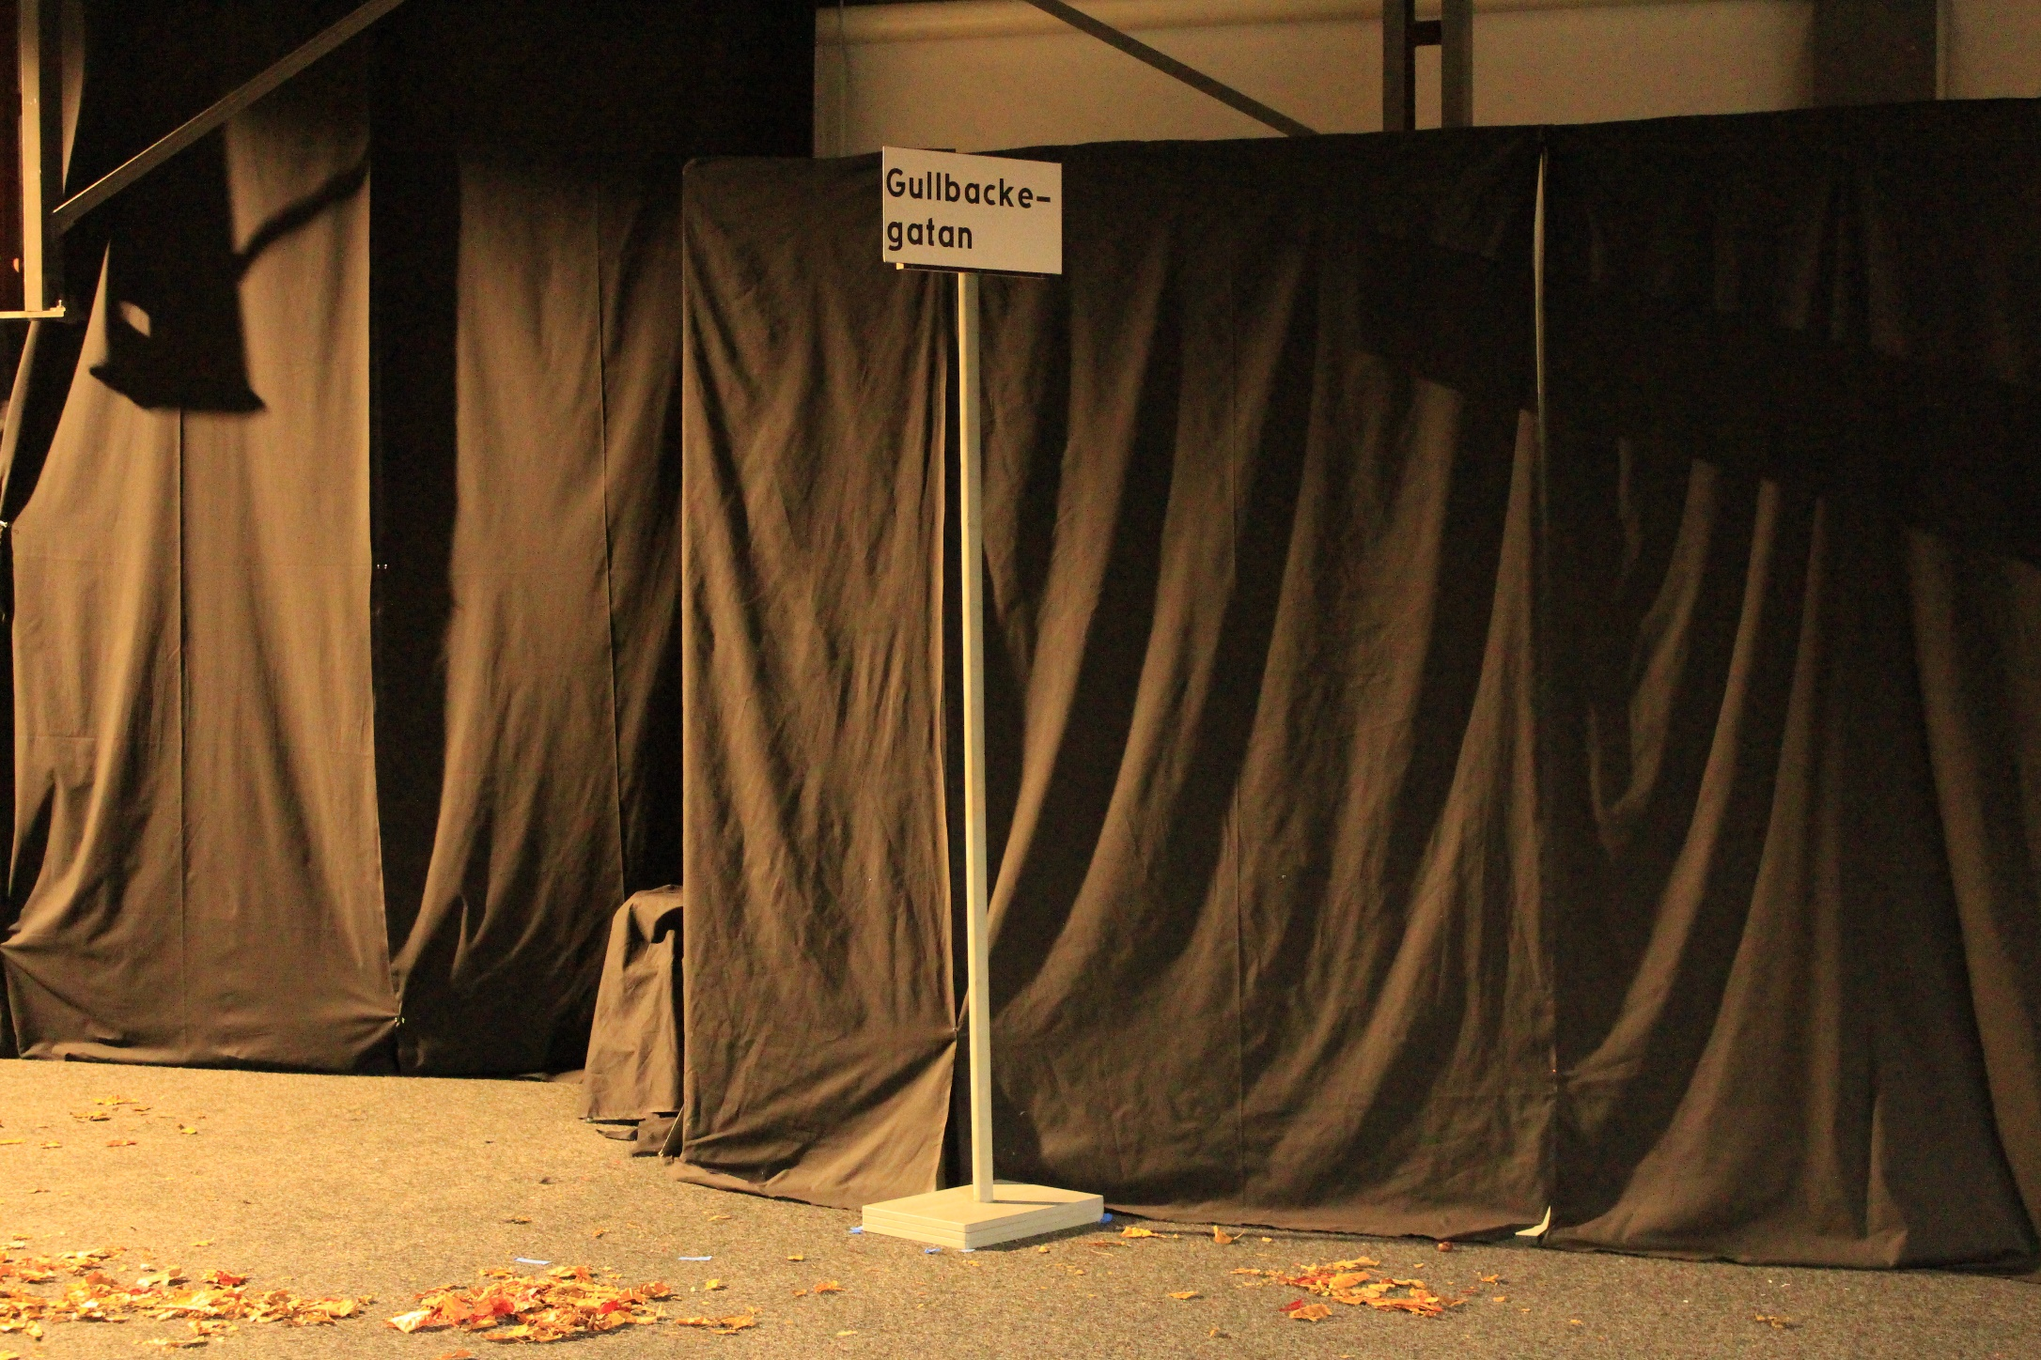
Perception: Sign reading

Slide 13
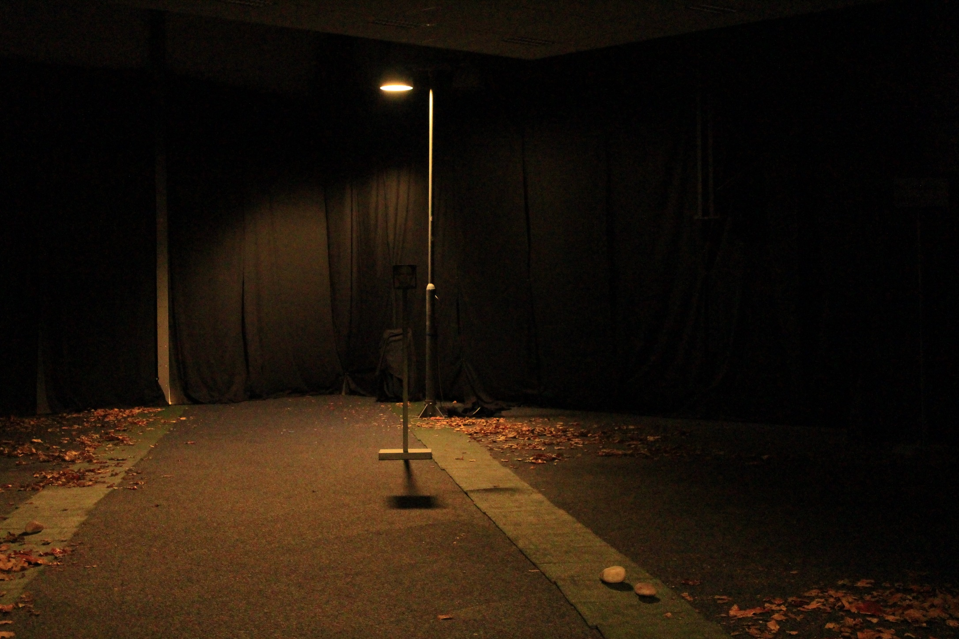
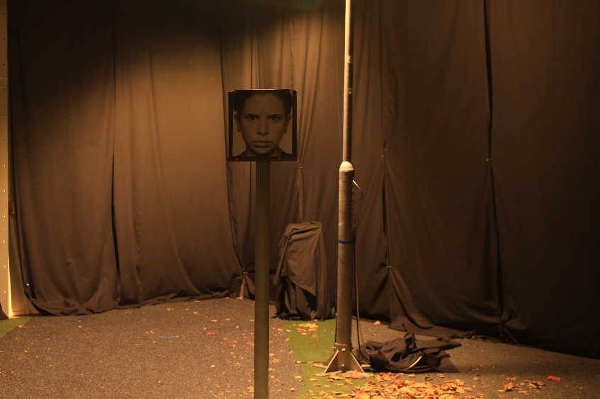
Perception: Facial emotion recognition

Slide 14
Results
Perception | Within subject | Between groups | Post hoc
Obstacle detection | p = .000 | p = .002 | C > A > B
Facial expression distance | p = .000 | p = .008 | C > A & B
Facial expression recognition |  | p = .008
Sign reading distance | p = .000 | p = .000 | C > A & B

Slide 15
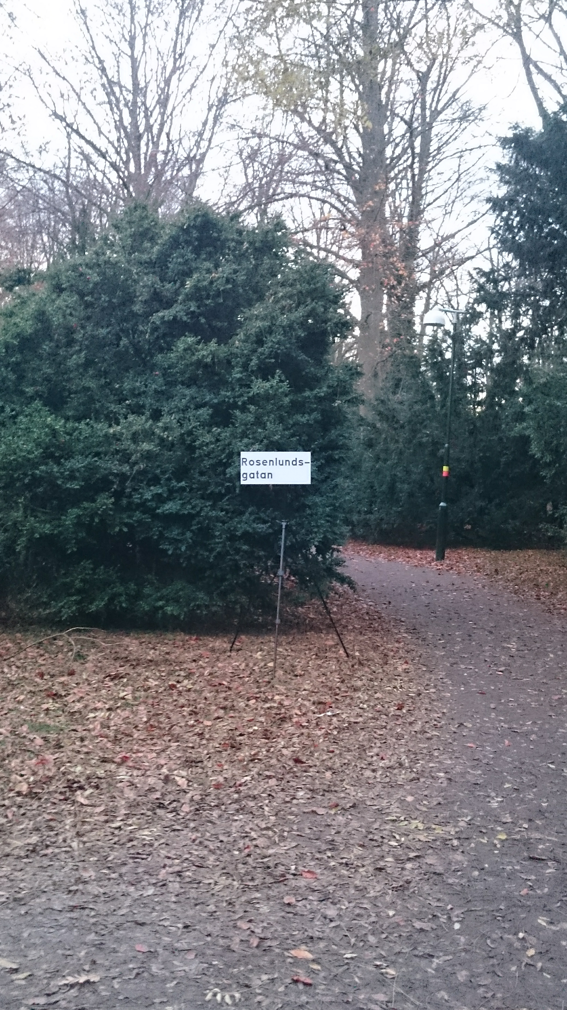
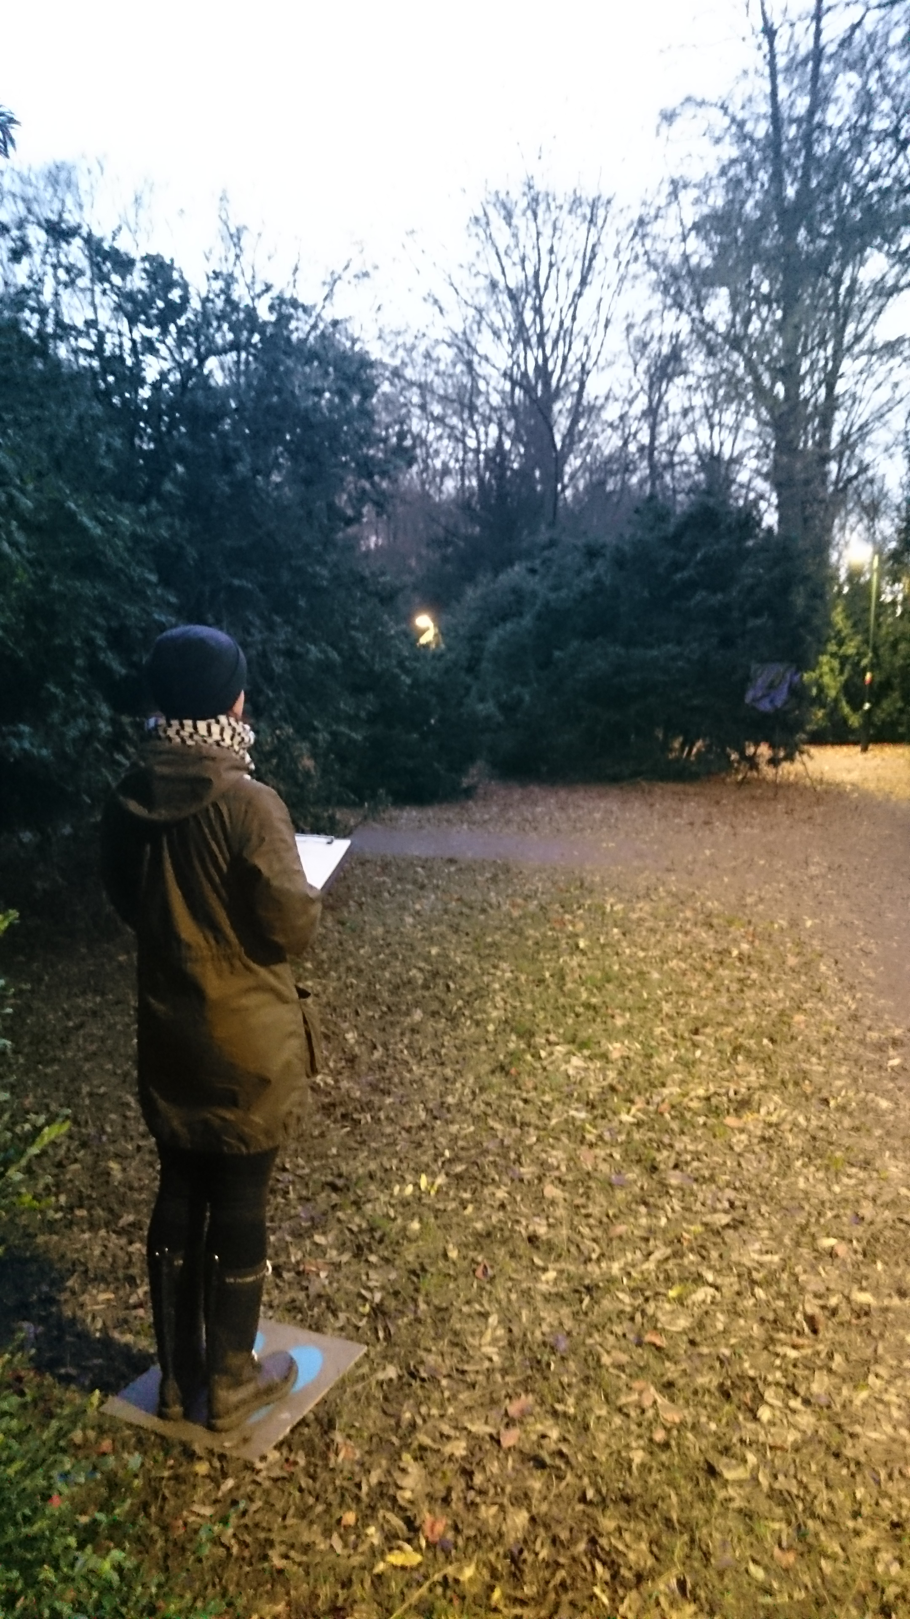
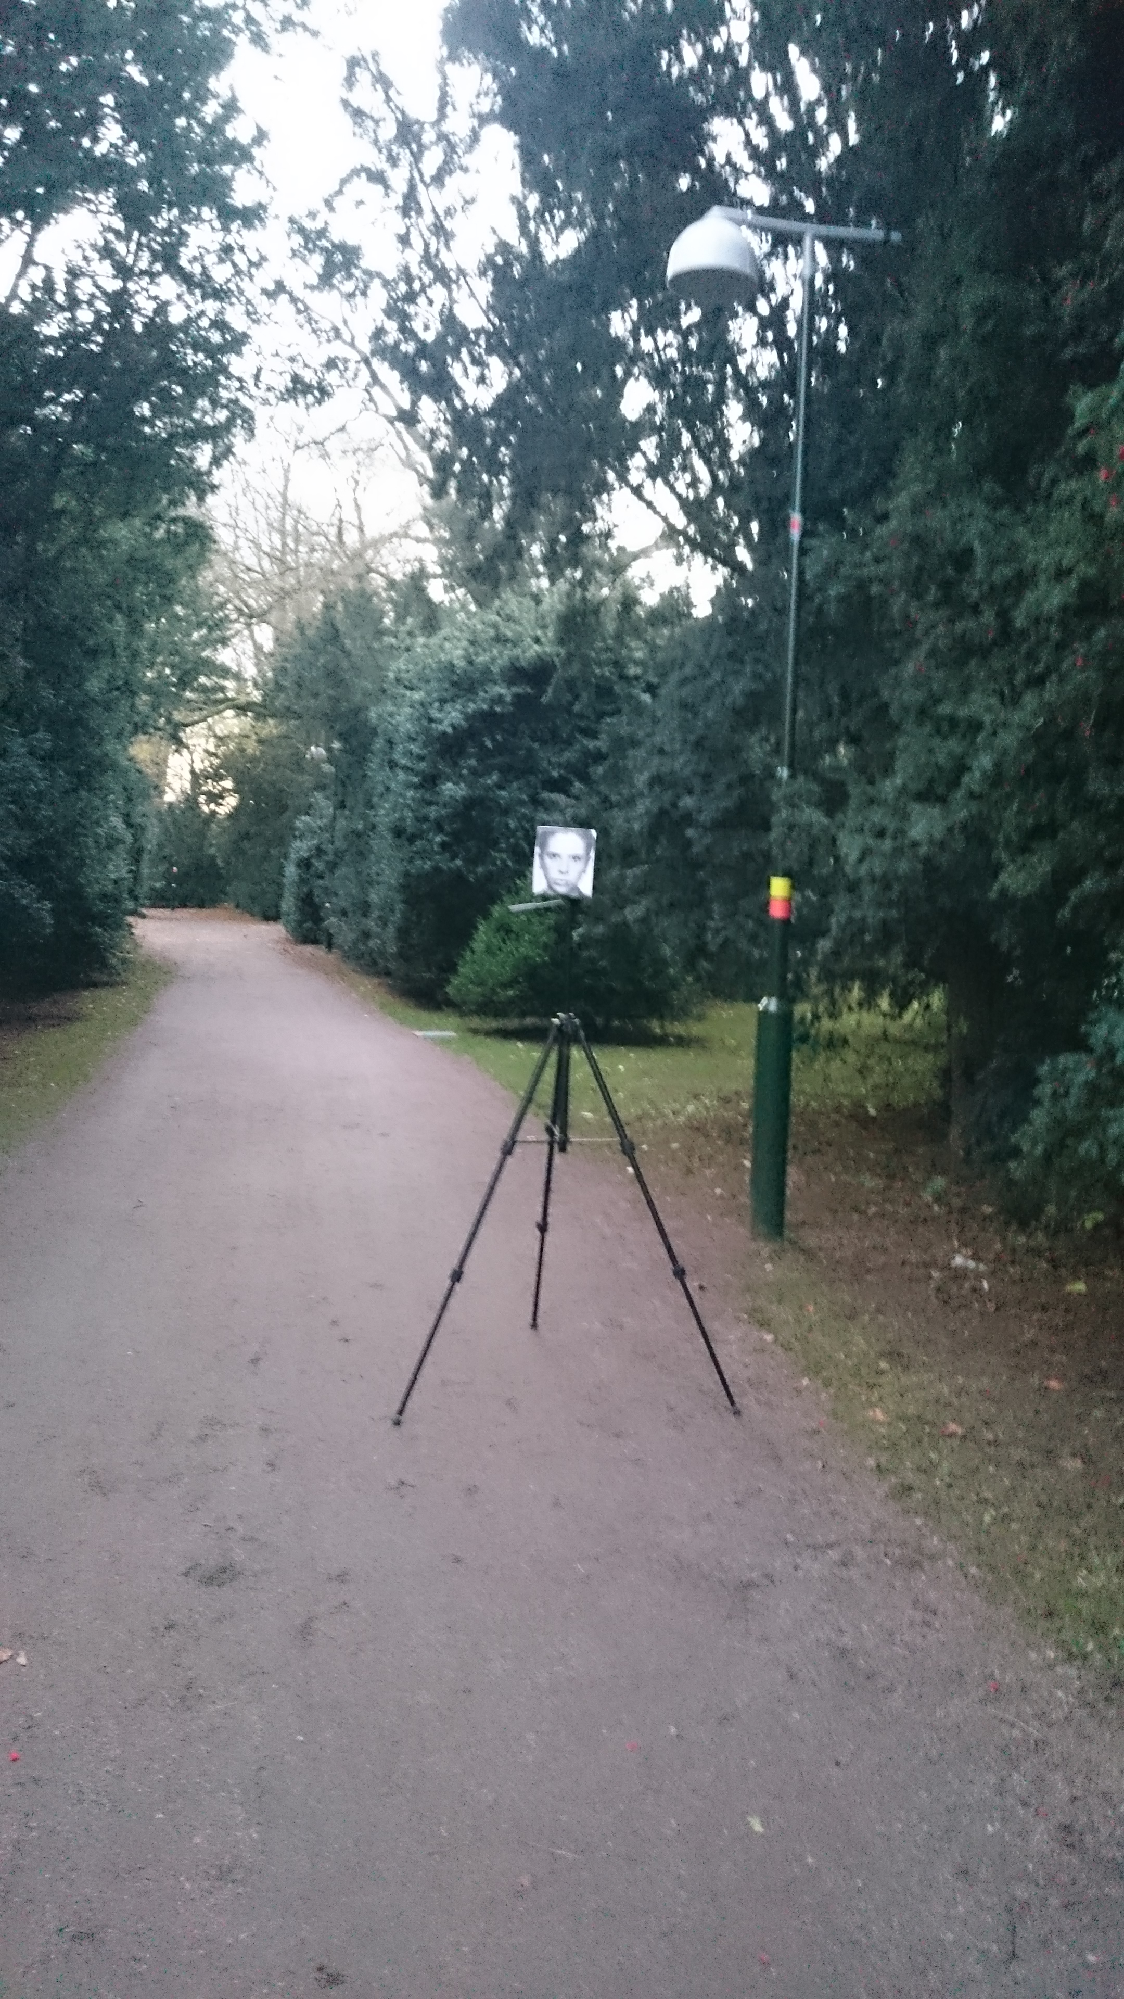

Slide 16
Evaluation of the lit environment
The perceived outdoor lighting quality scale - POLQ
Perceived comfort quality
Perceived strength quality
Johansson et al., 2014

Slide 17
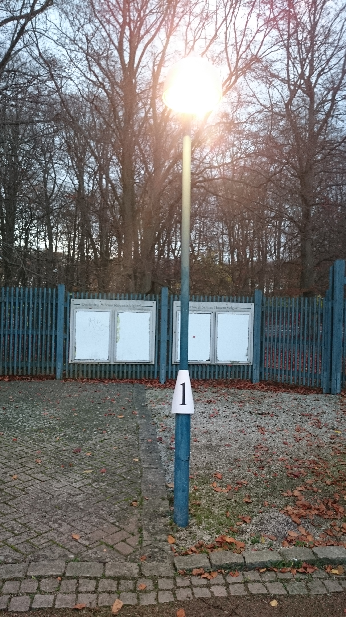
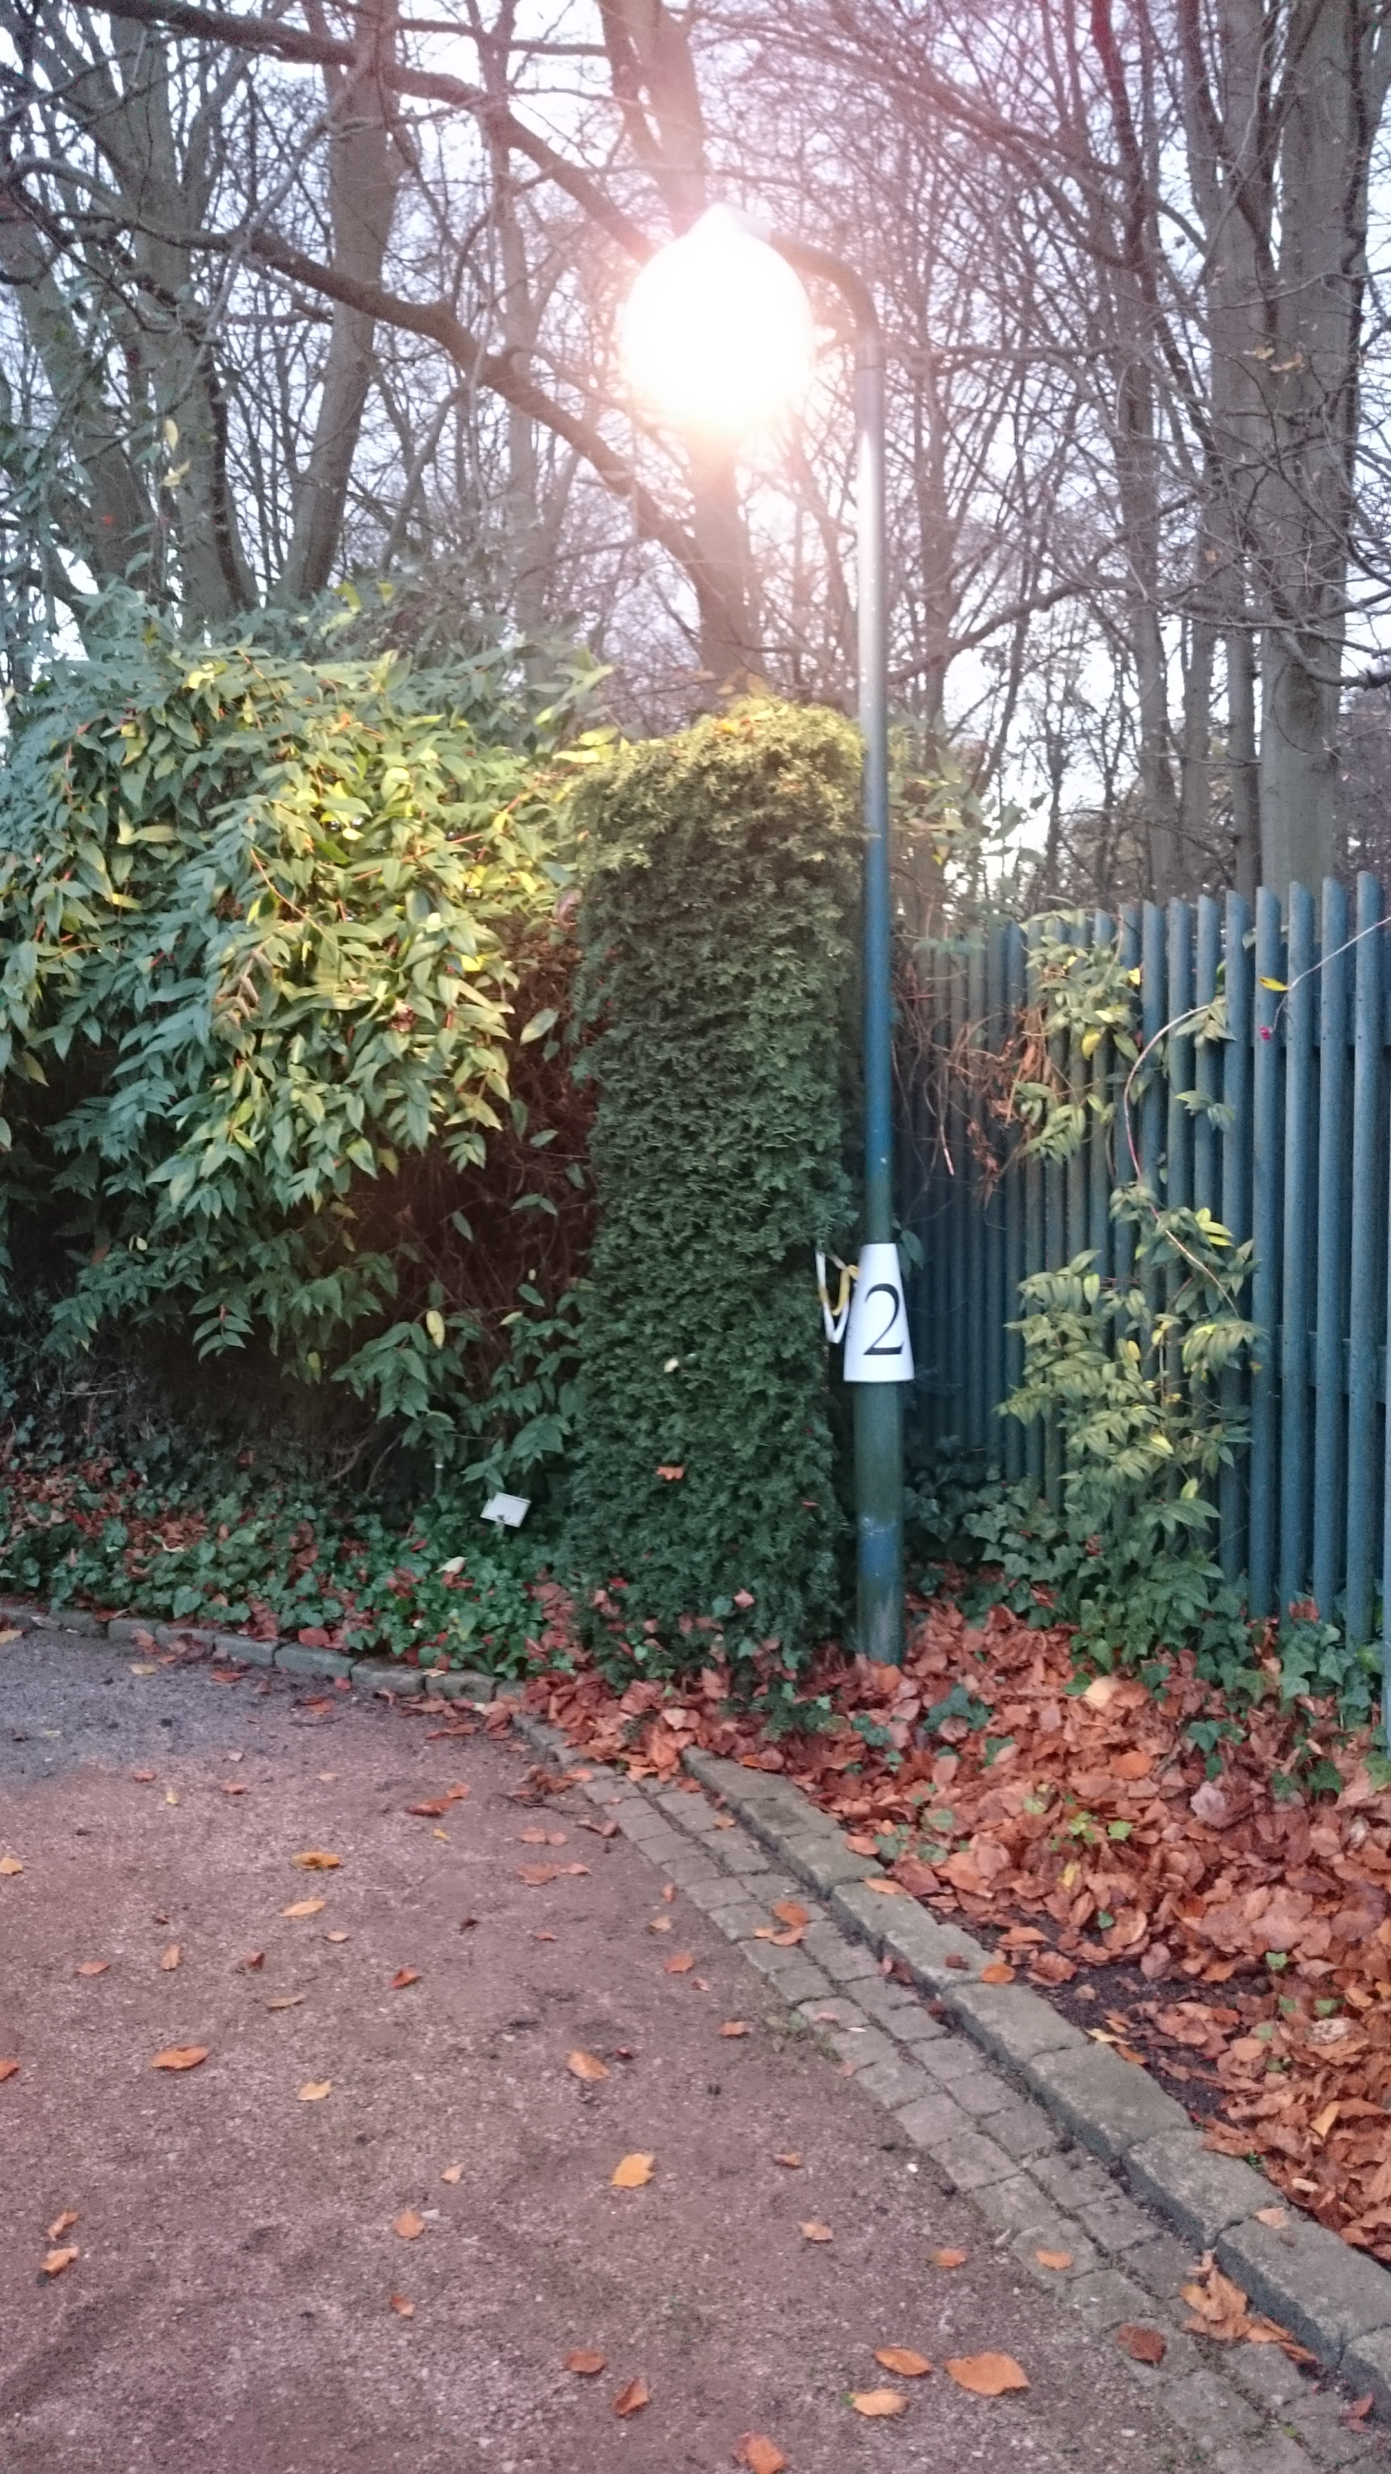
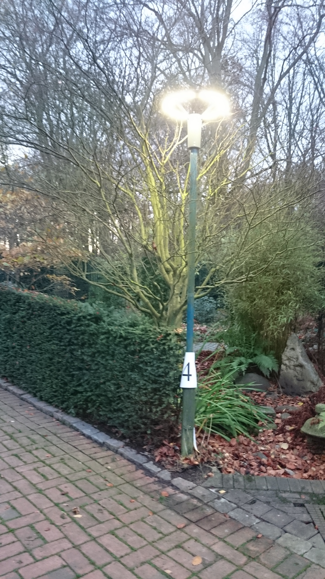
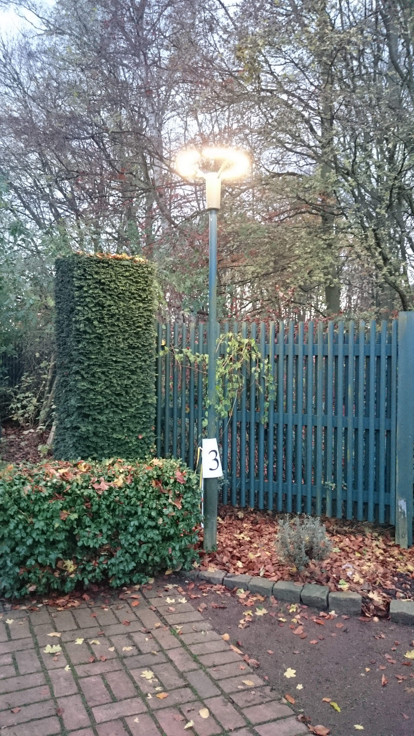
Evaluation of the lit environment
Foto: Maria Johansson

Slide 18
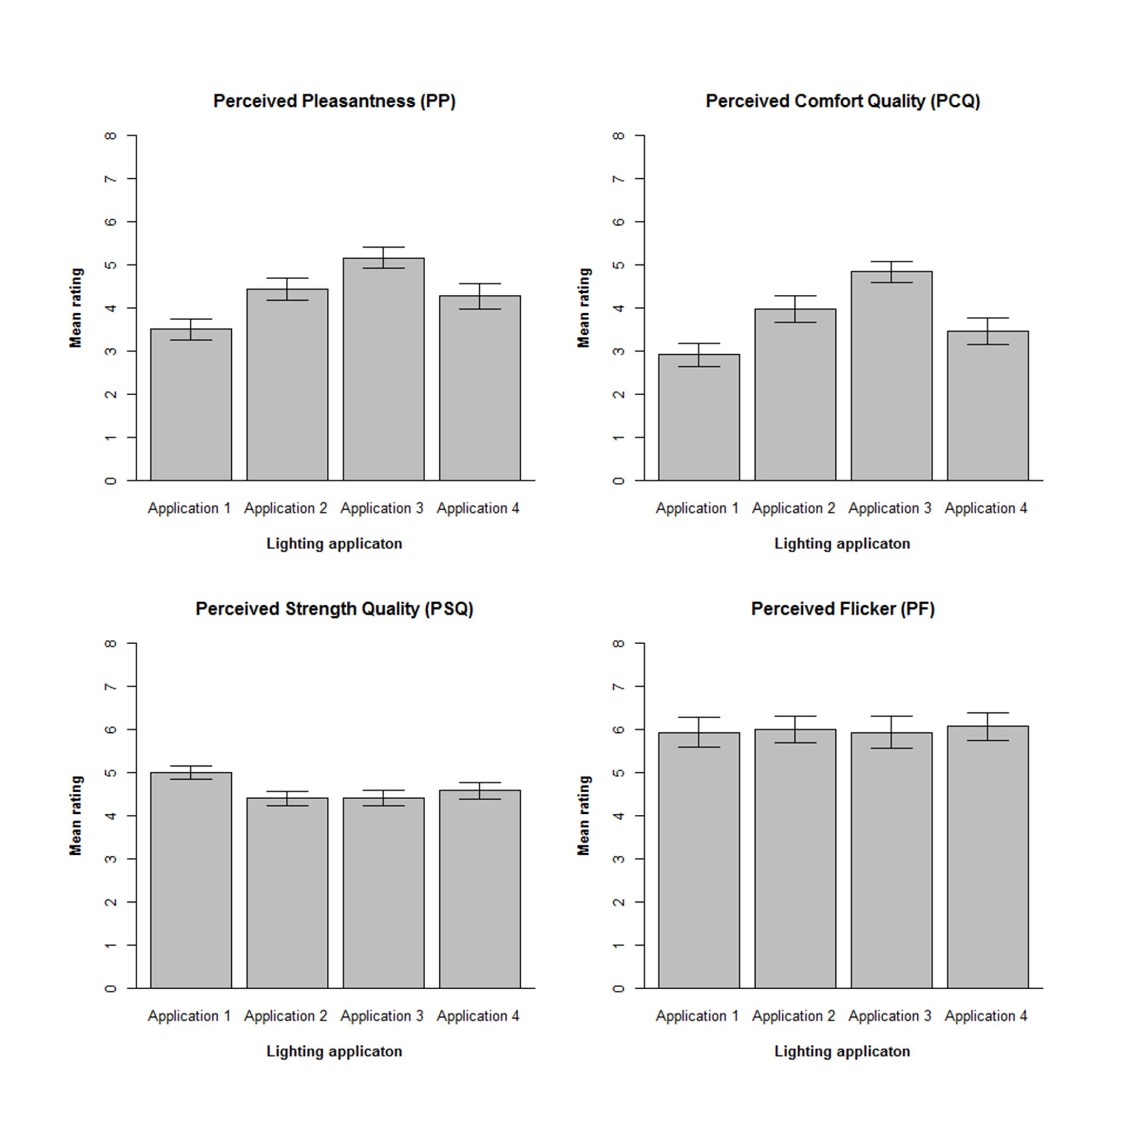
Patching et al., 2017

Slide 19
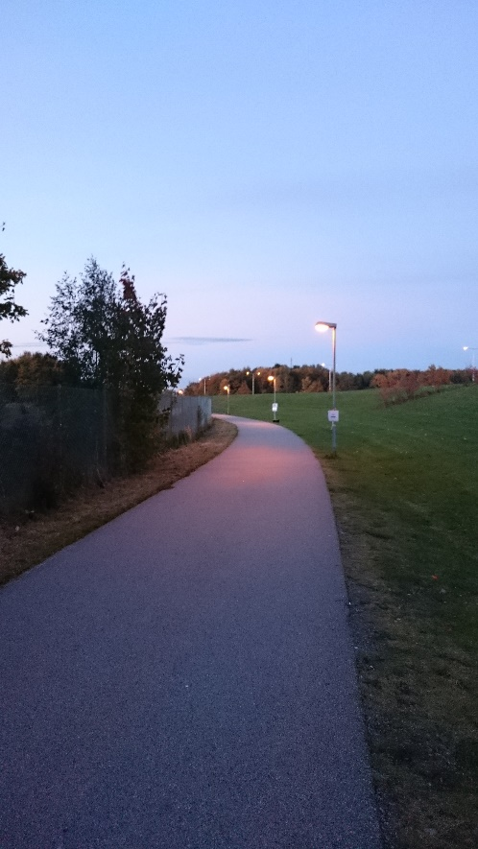
Behaviour in the lit environment: Positioning
Johansson et al., 2017

Slide 20
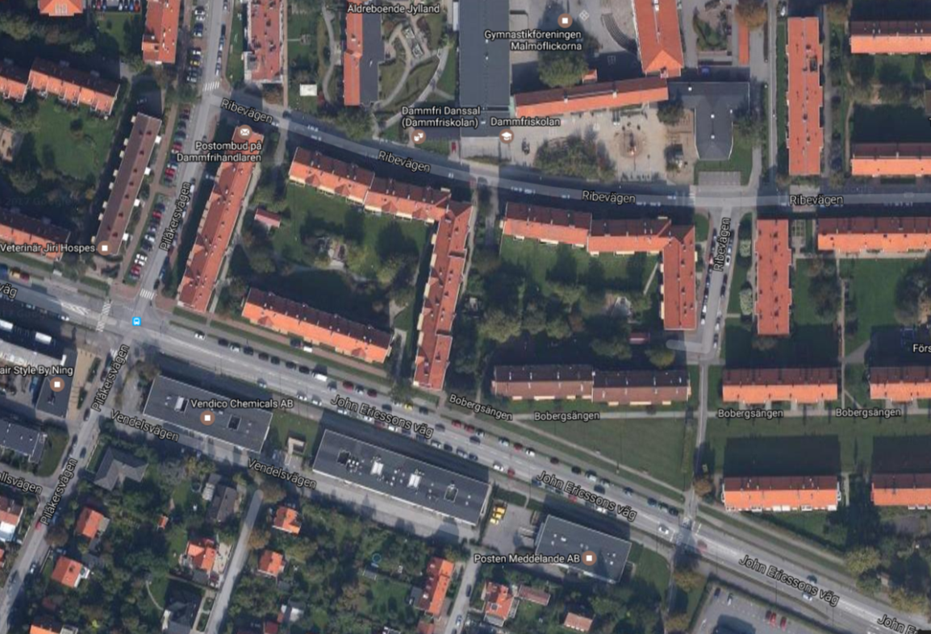
Field study
Universal pedestrian design

Slide 21
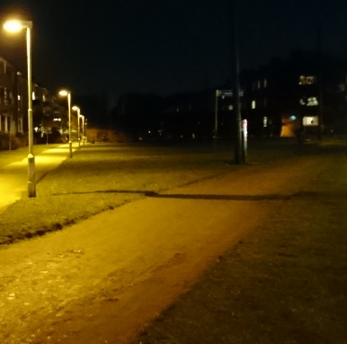
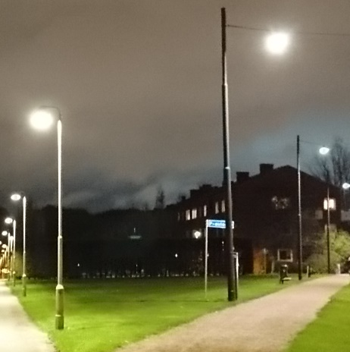
A
Notes:
Efter: ofta man ser skillnad mellan grus och gräs

Slide 22
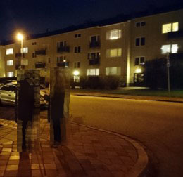
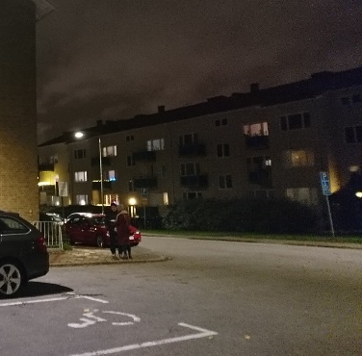
C

Slide 23
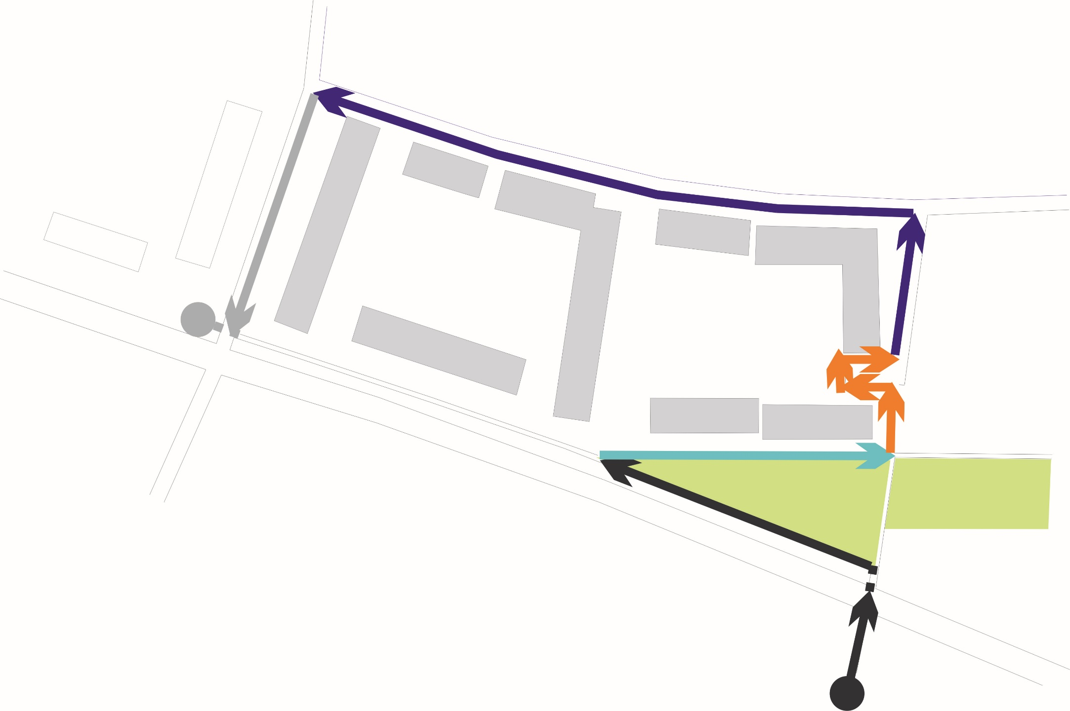
Walked in the middle of walkway (rather than along left-edges)
Better detection of walkway, sign posts/lamp posts, pedestrain crossing, front doors, bike parking, basement entrances, post box, electrical cabinets
Walked along left egdes
Better detection of lamp posts, drive way, pedestrain crossing, edge, walkway, cobblestone
D
E
D
Walked in the middle of walkway
Better detection of lamp posts/sign posts, bushes
C
B
Made turning easier
Better detection of walkway, bushes, tree, fence, bike-parking, posts
A
Walked in the middle of walkway
Made turning easier
Better detection of warning surfaces, white line and edge
Mattsson et al., in manuscript
Notes:
Results – observed data (summary of changes after the intervention)

Slide 24
Risk assessment of the indoor visual environment
Hillevi Hemphälä
Ergonomics, Design Sciences, Lund University, Lund, Sweden

Slide 25
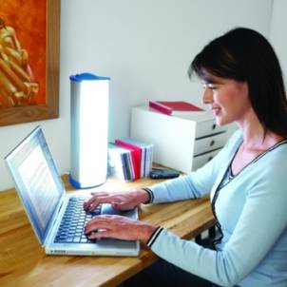
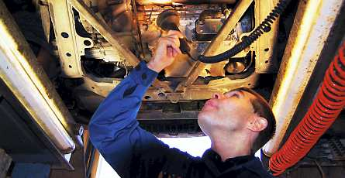
Visual Ergonomics
The eye leads the body
If you cannot se clearly you adapt your body posture
Studies show that individuals with eyestrain have more muskuloskeletal strain
20-40 percent of us are more sensitive to visual stimuli

Slide 26
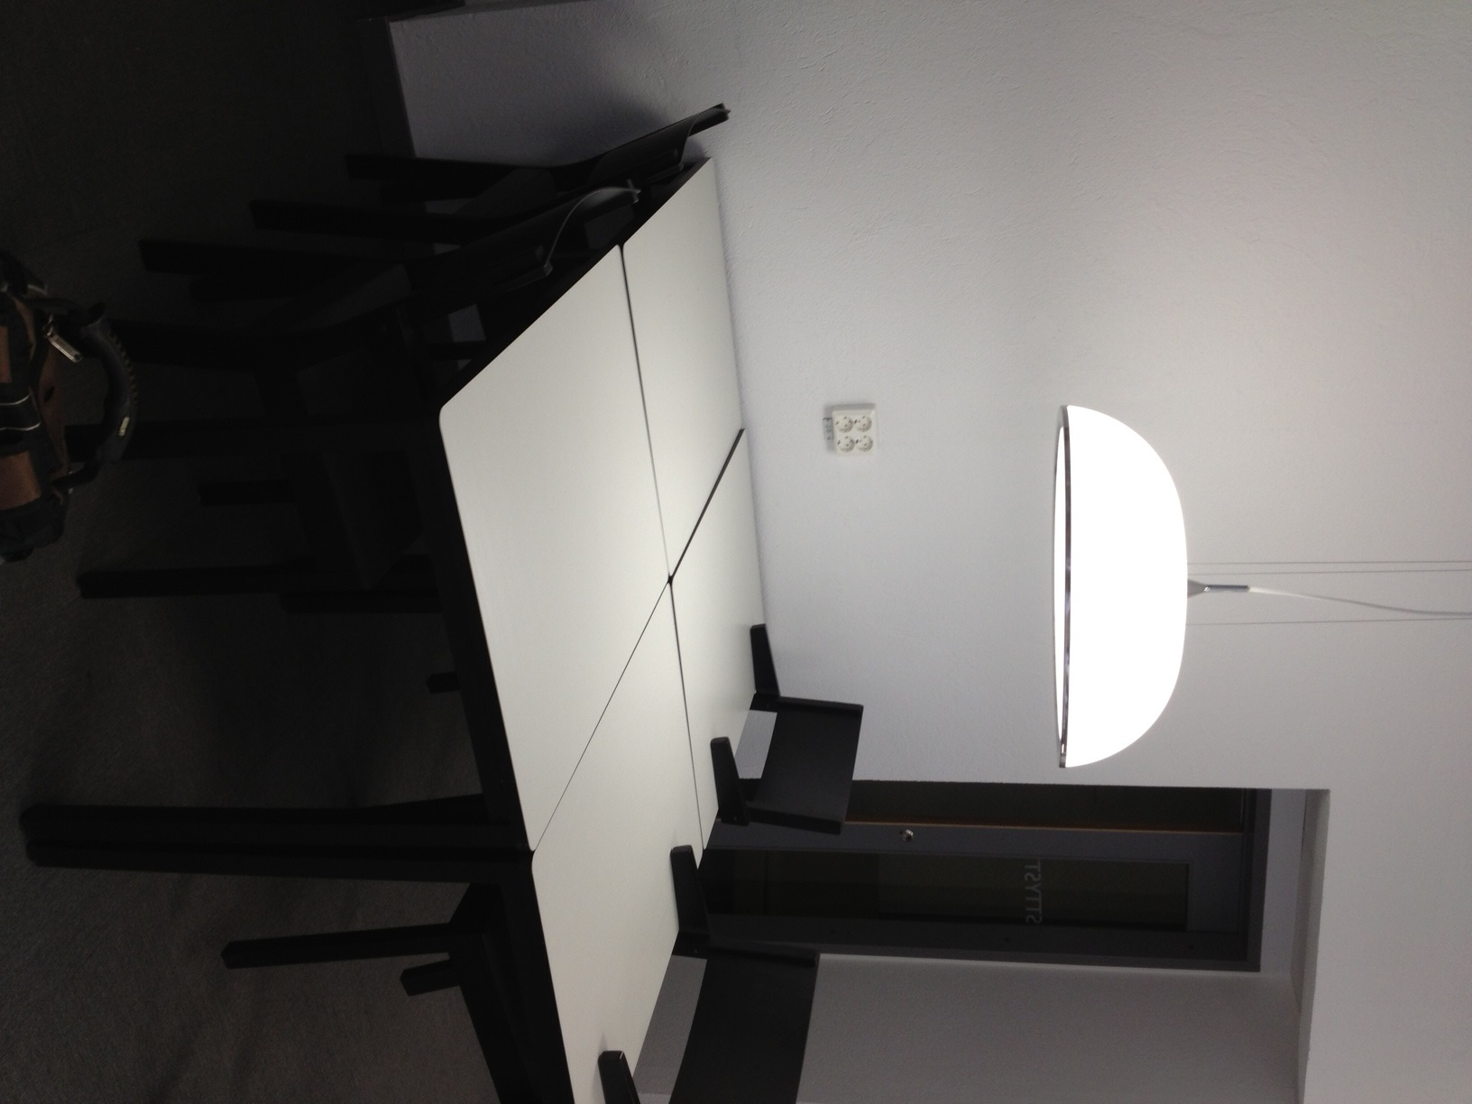
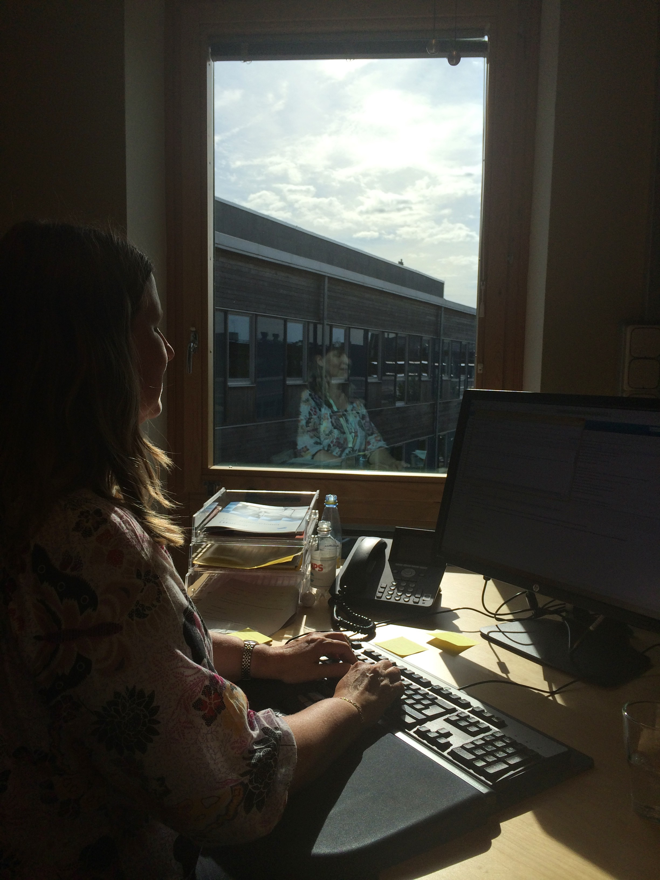
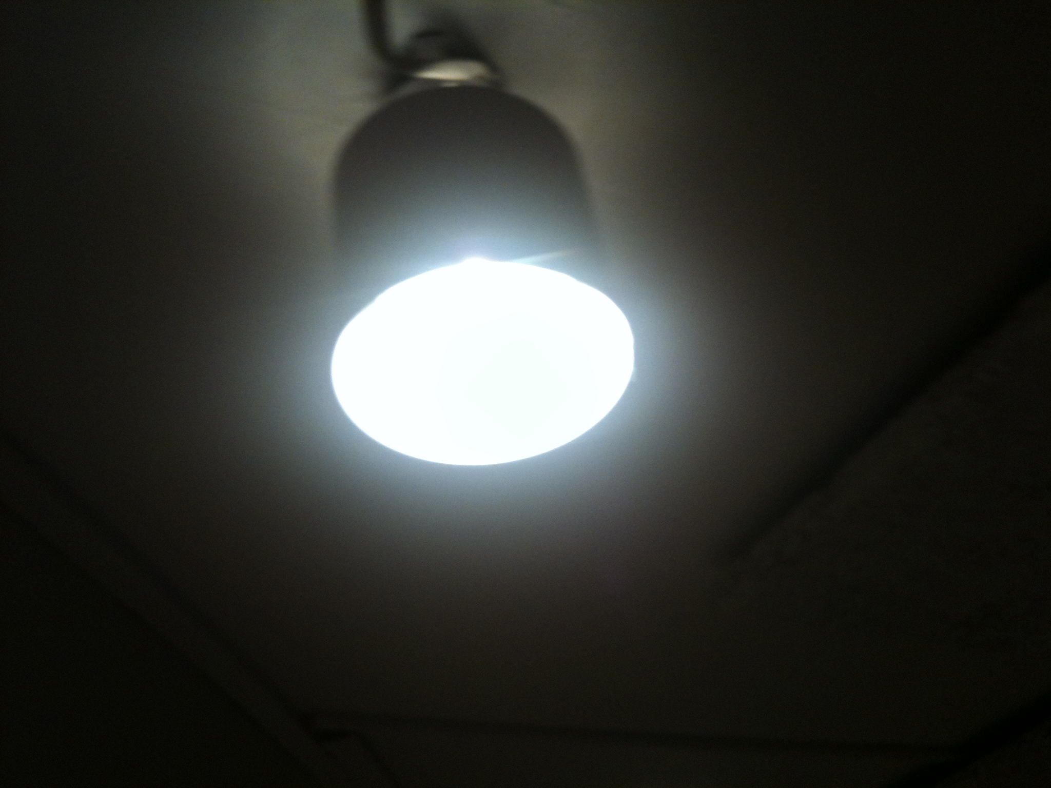
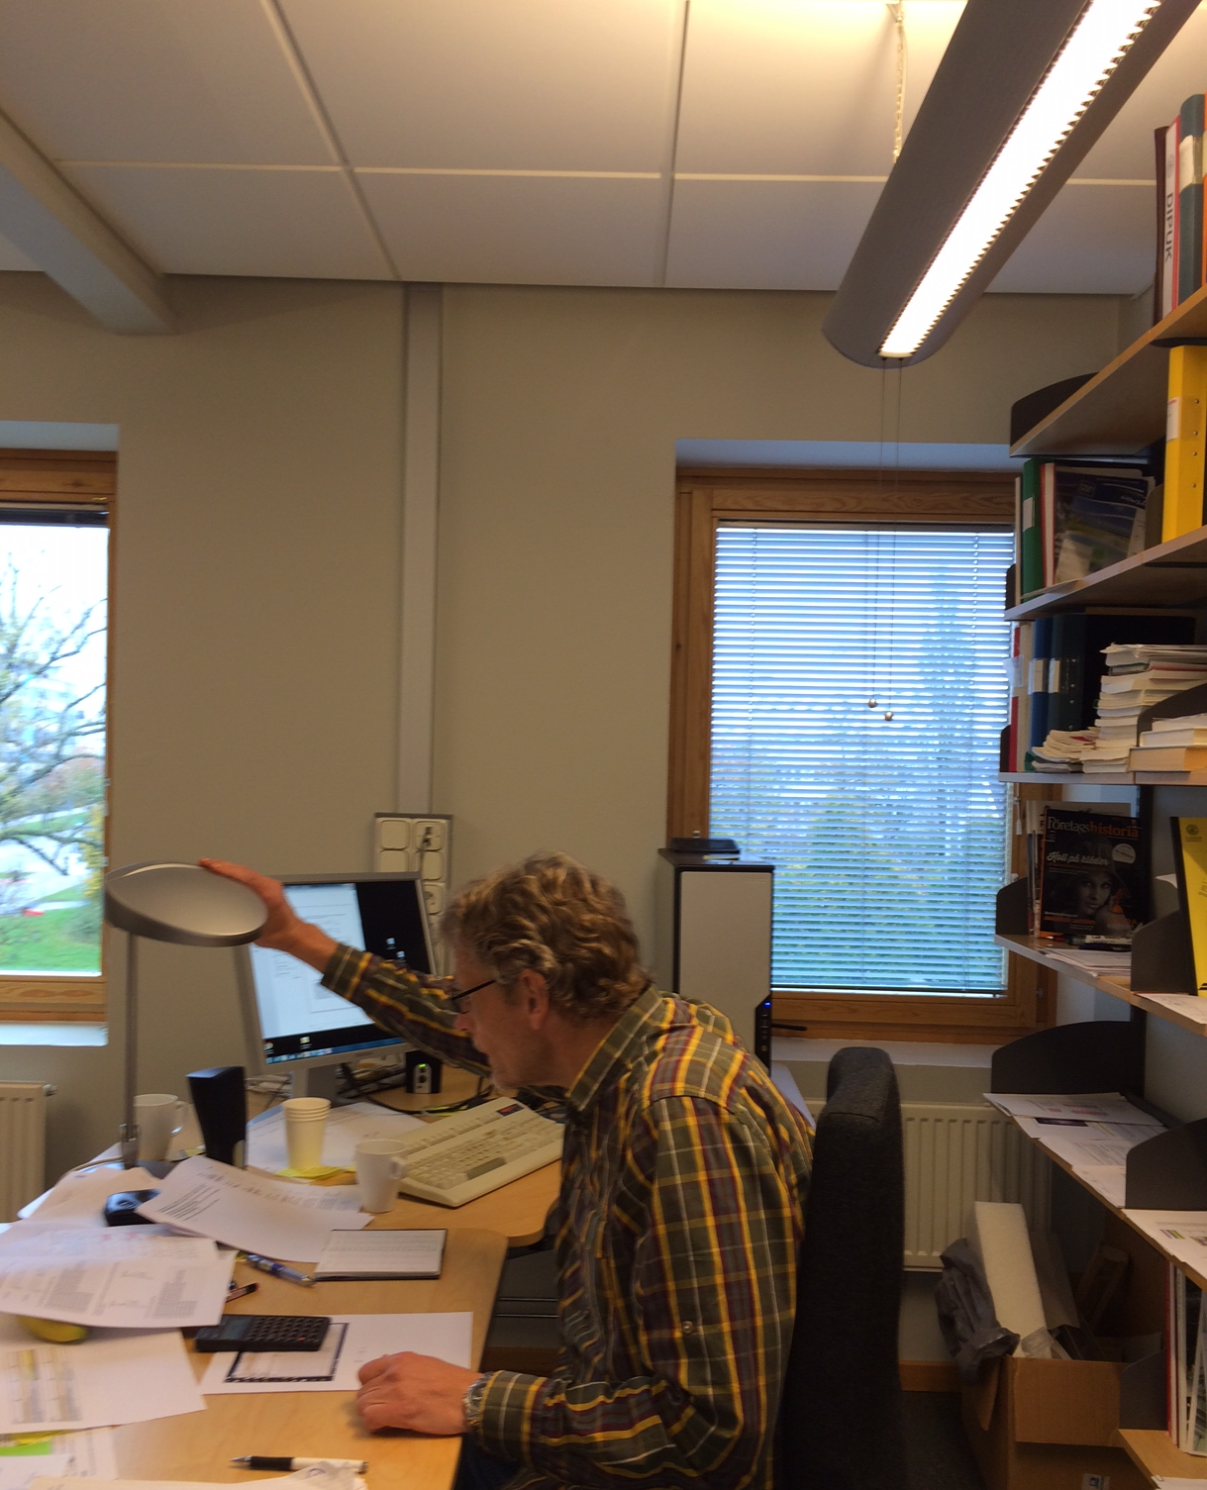
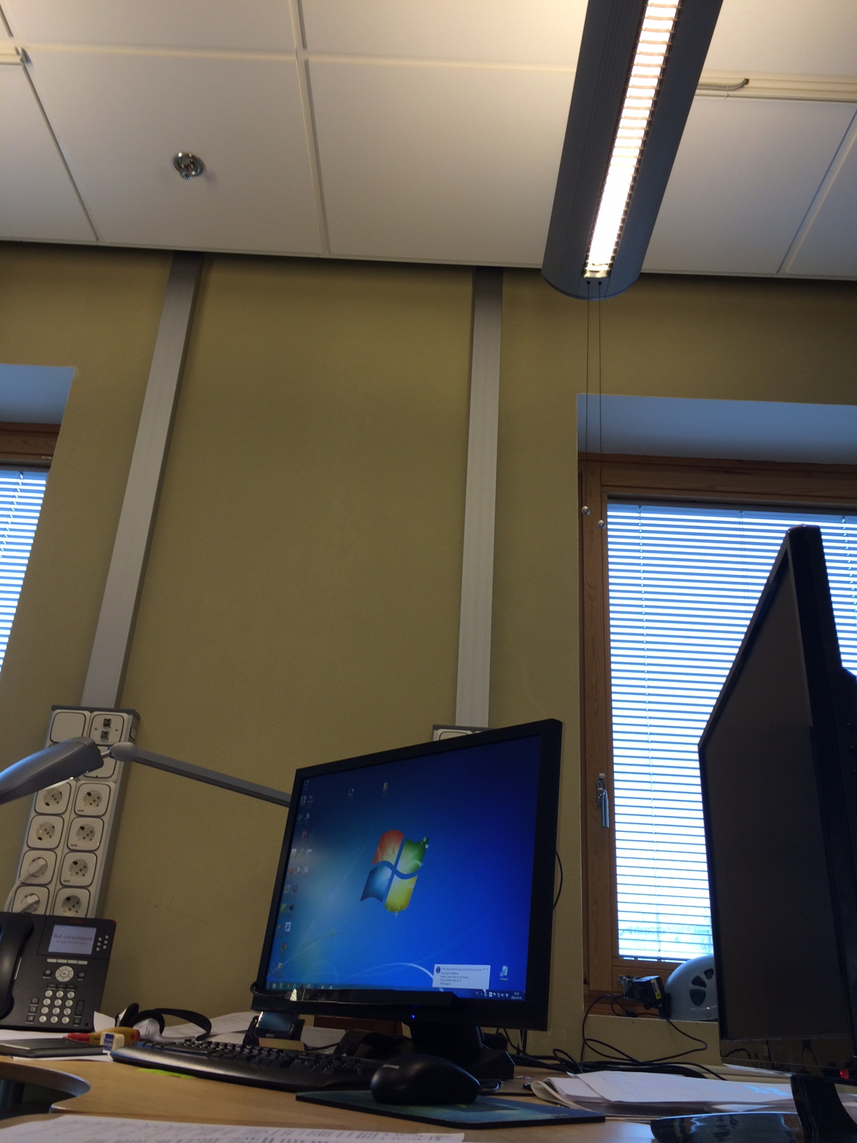
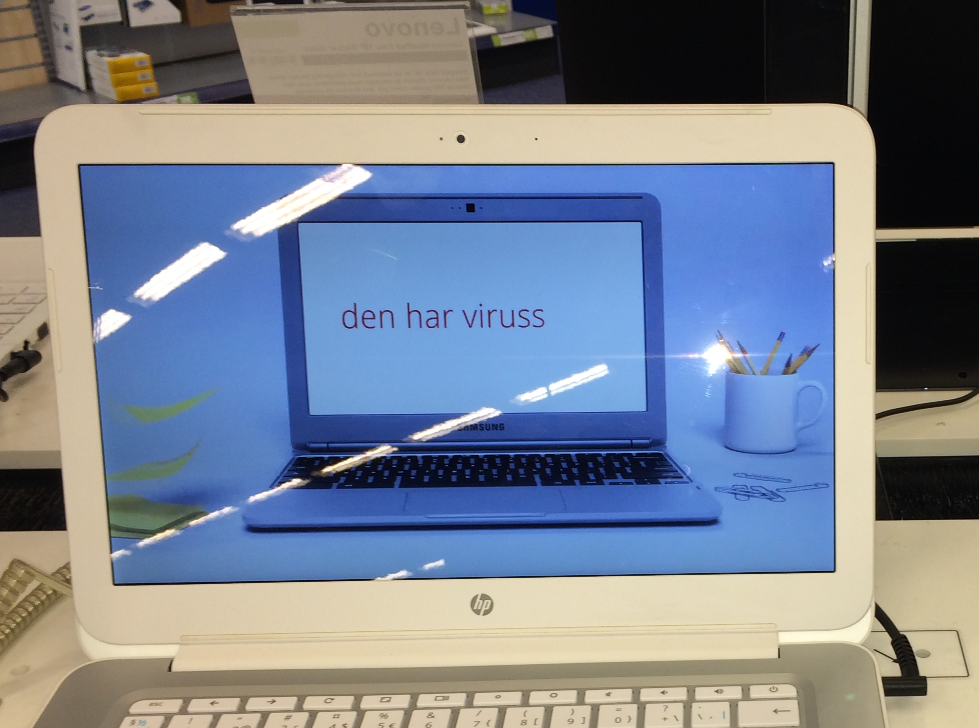
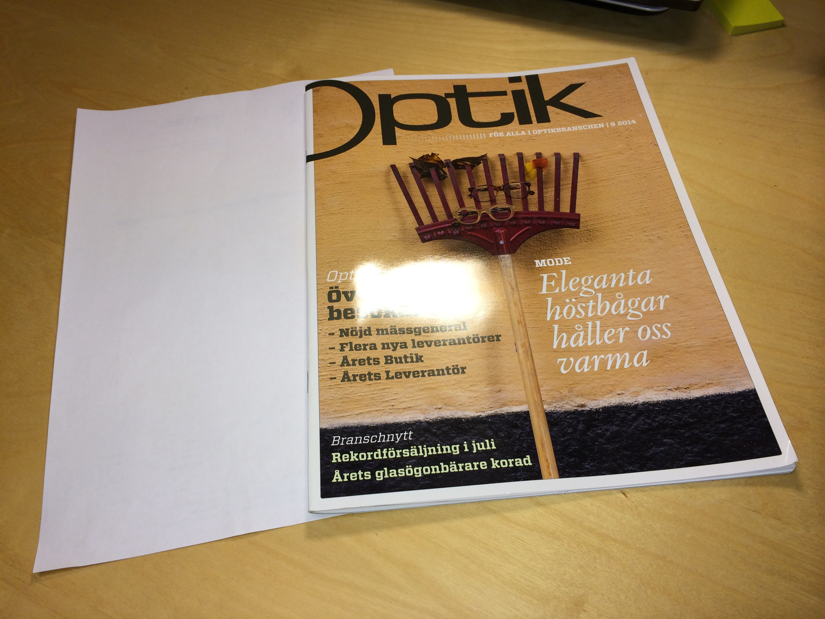
Visual Ergonomics designing of the visual environment

Slide 27
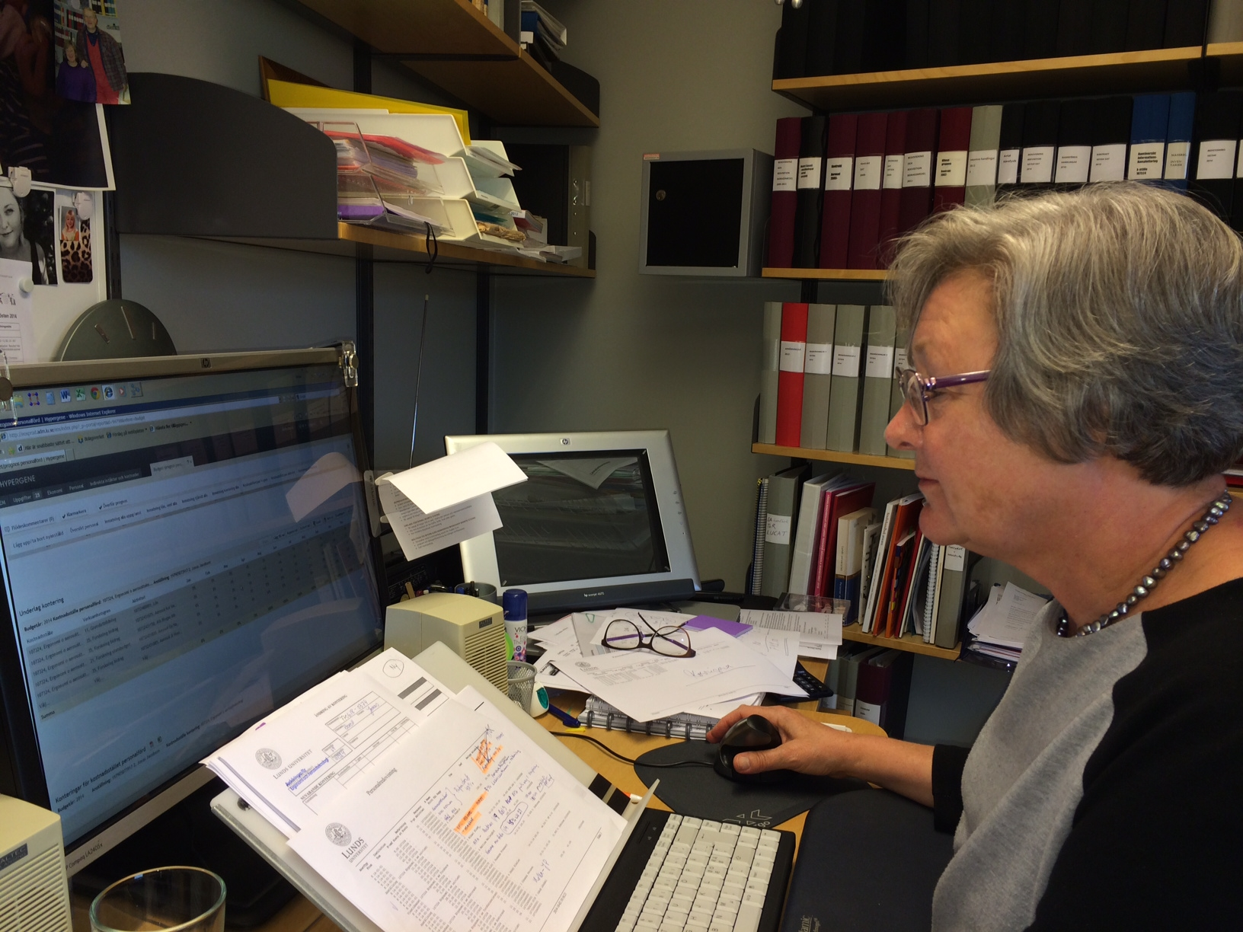
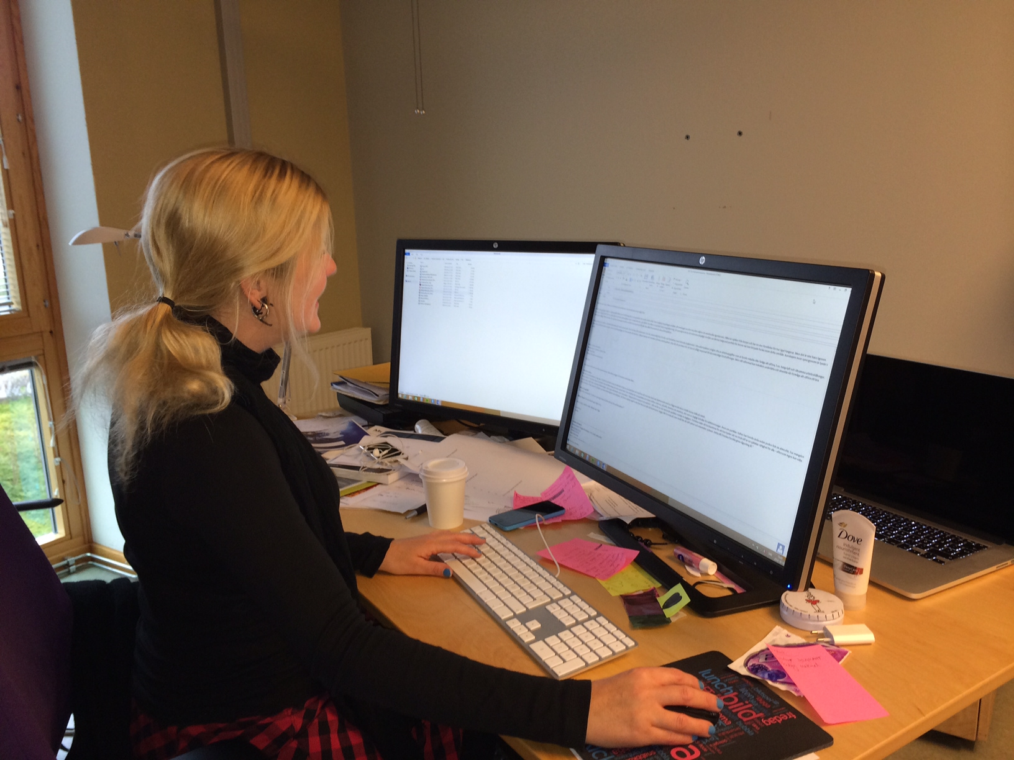
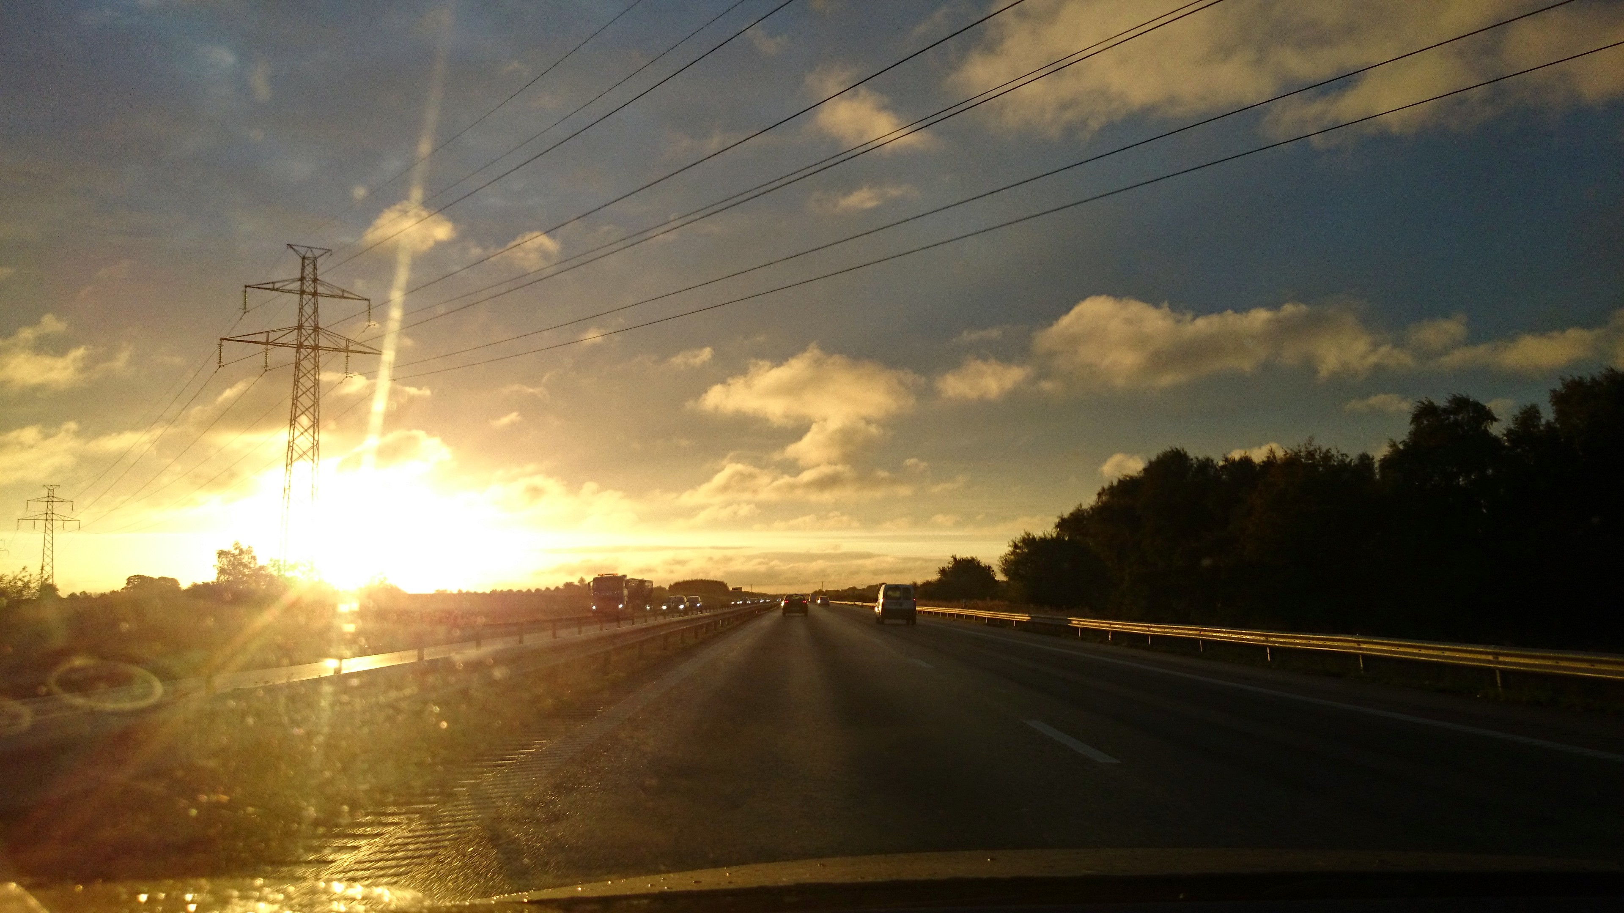
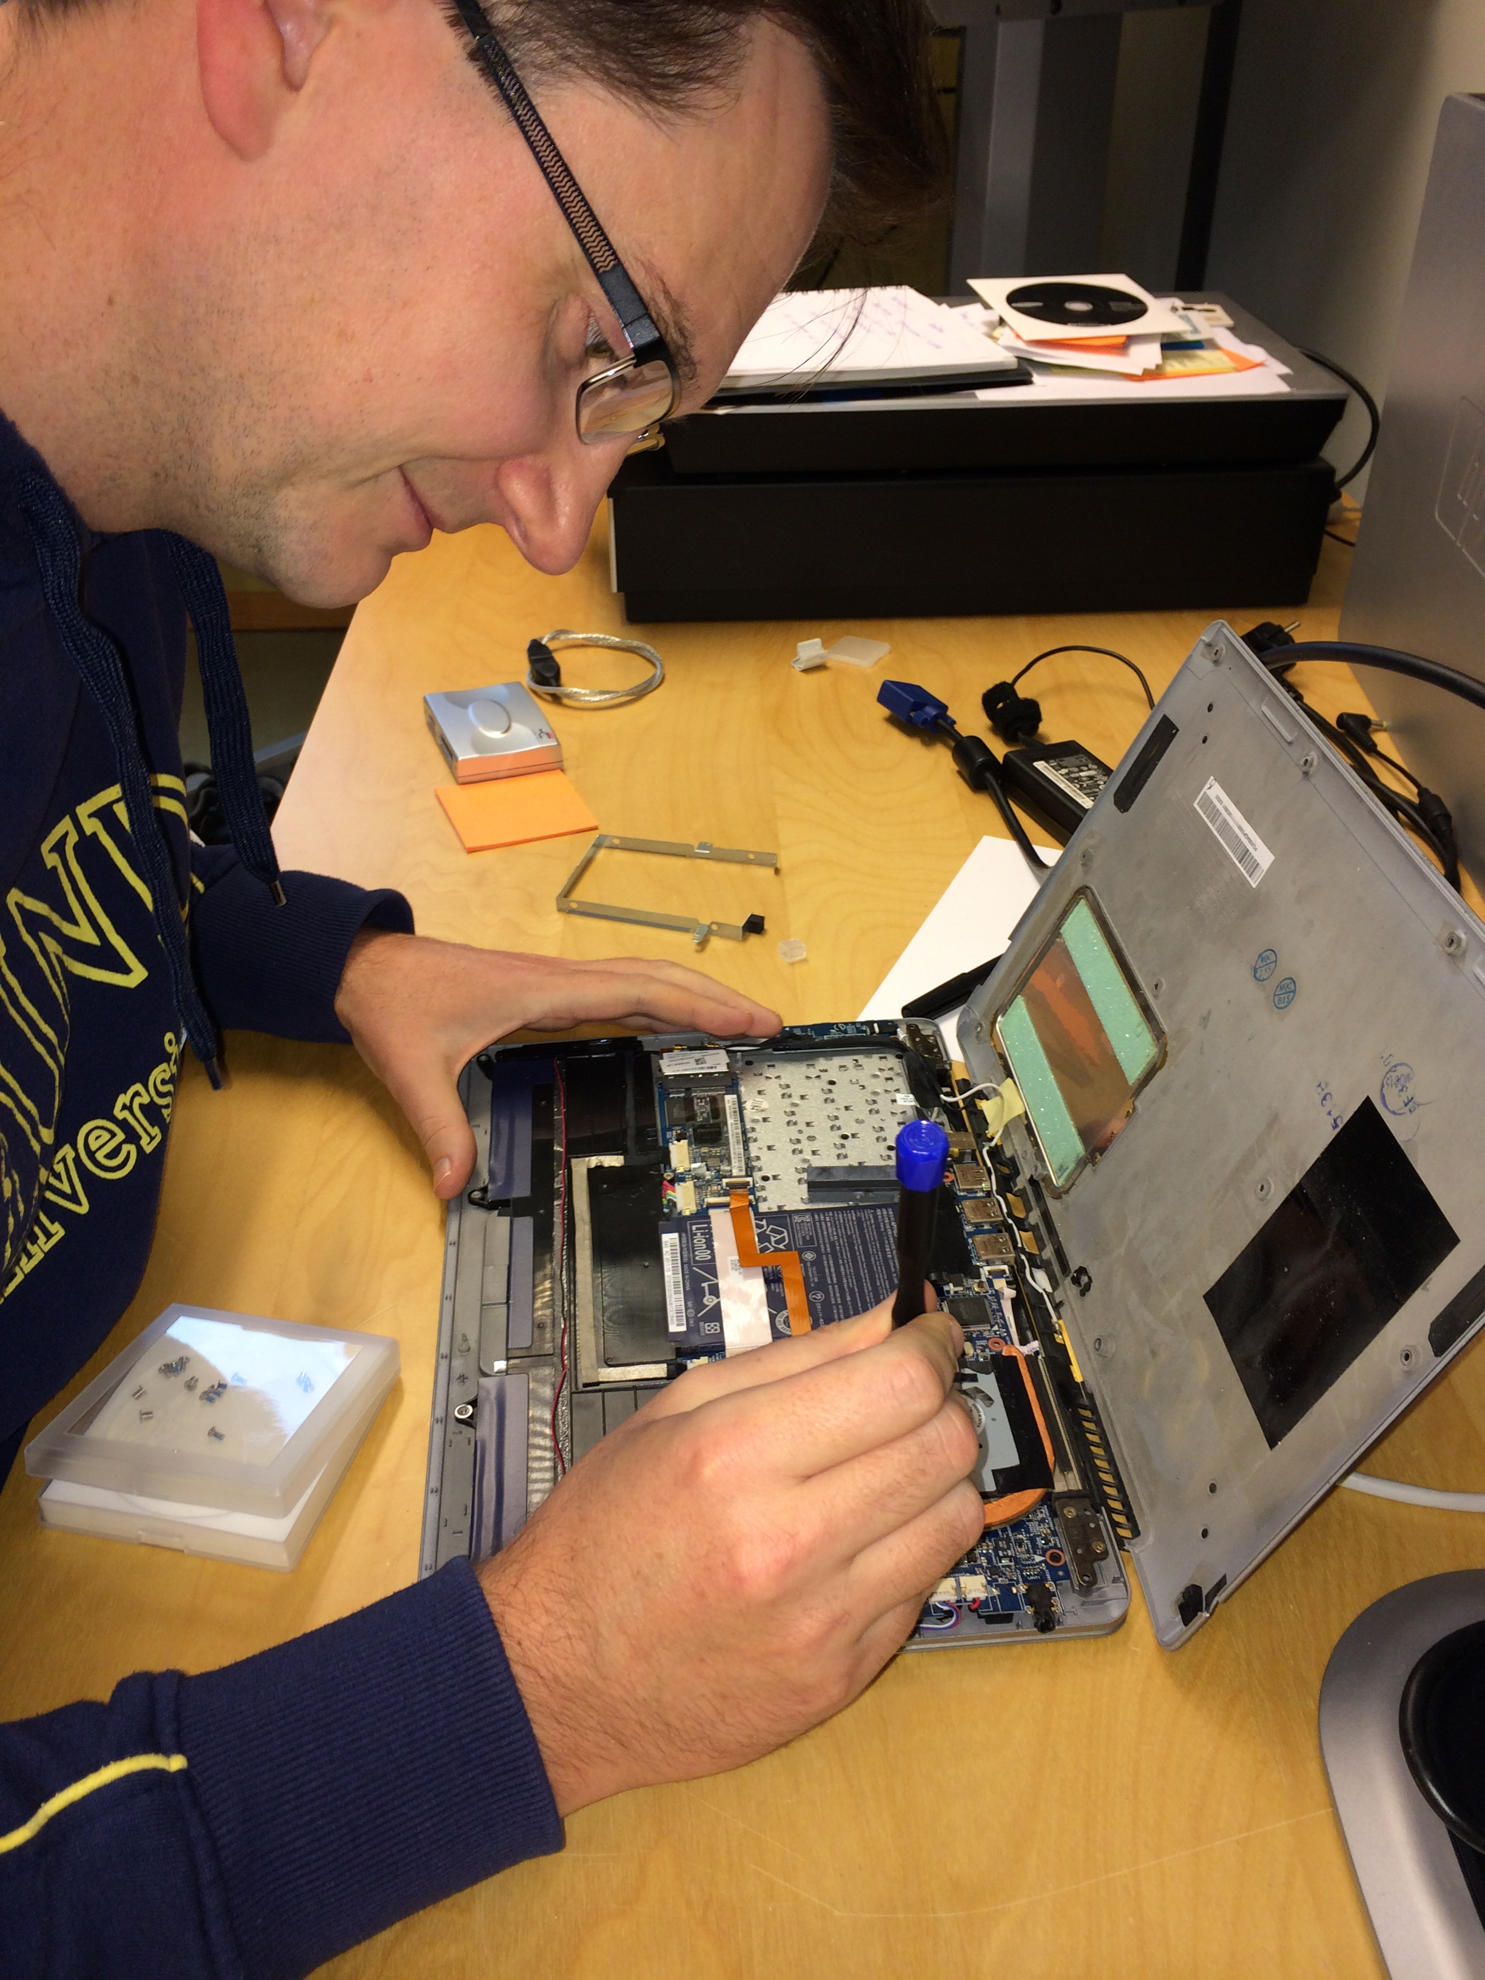
Visual Ergonomics individual requirements

Slide 28
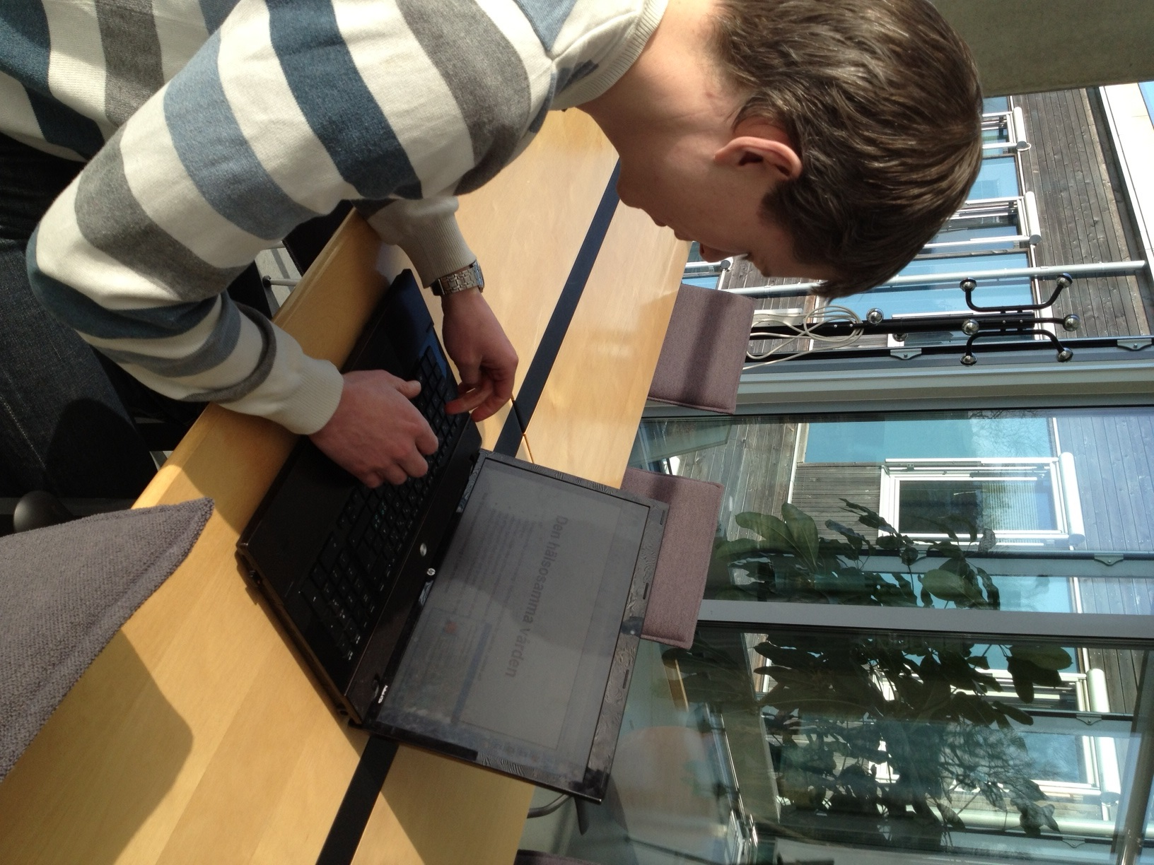
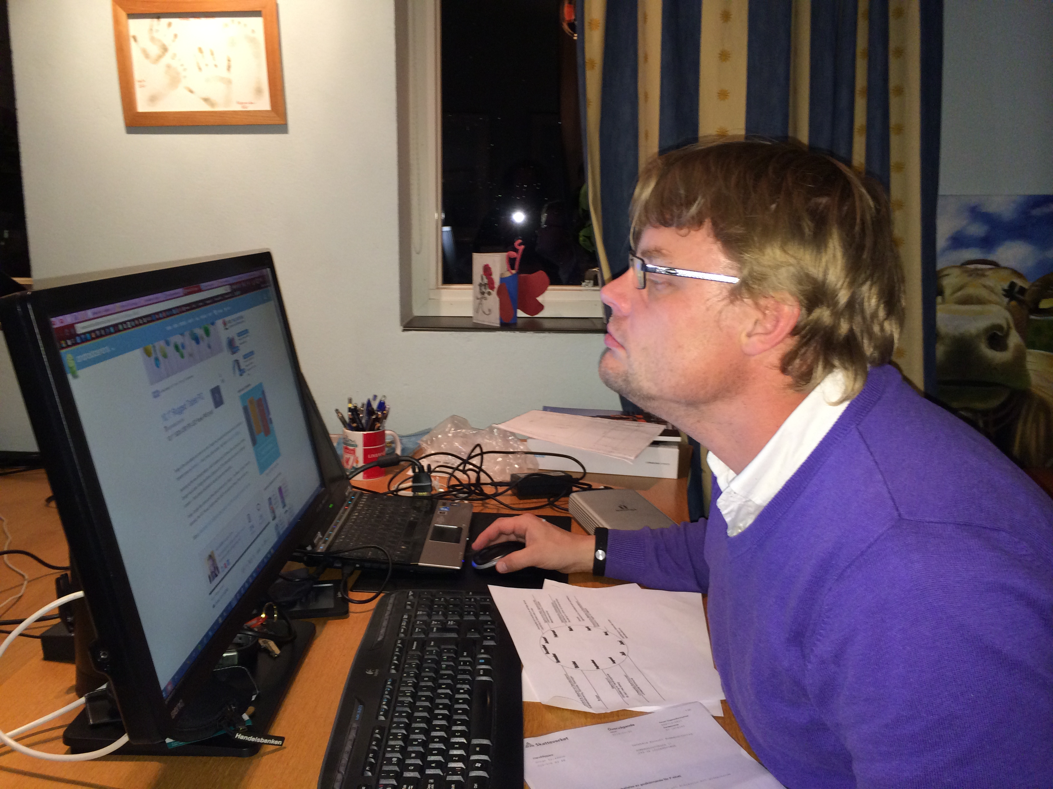
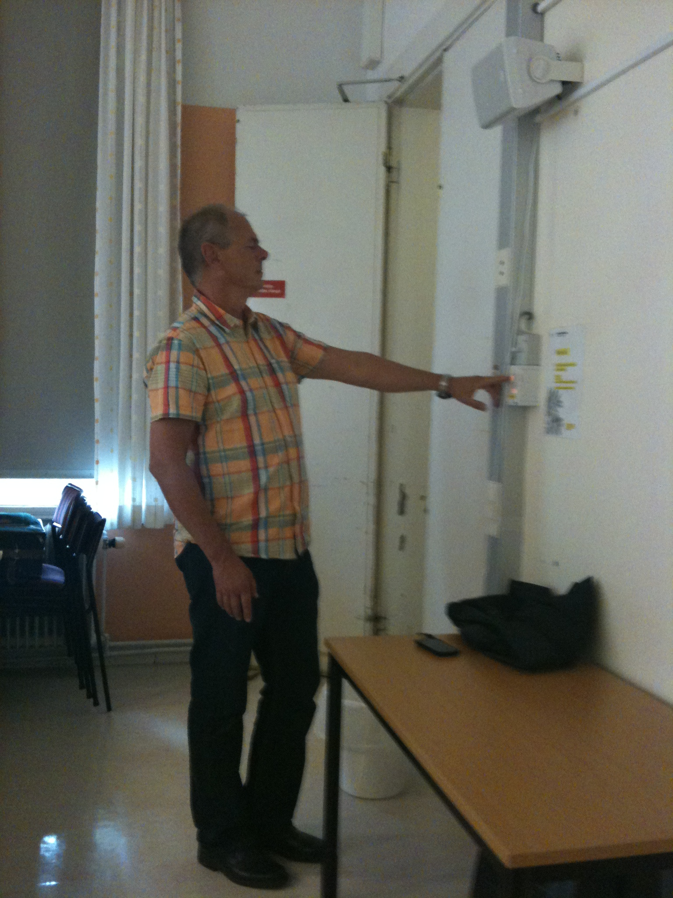
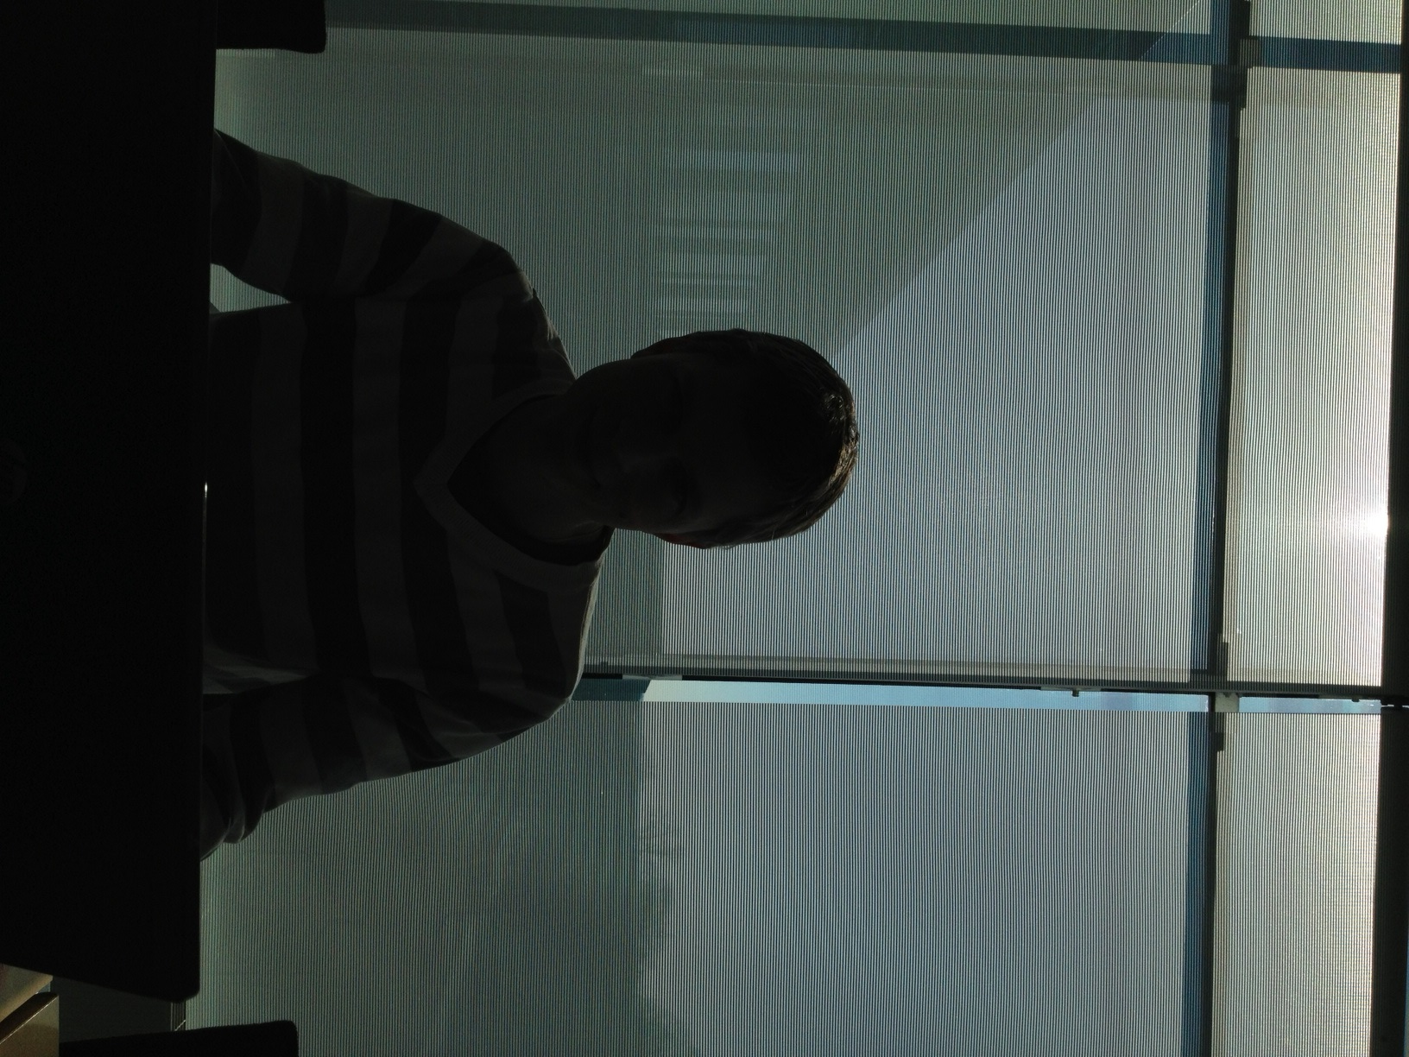
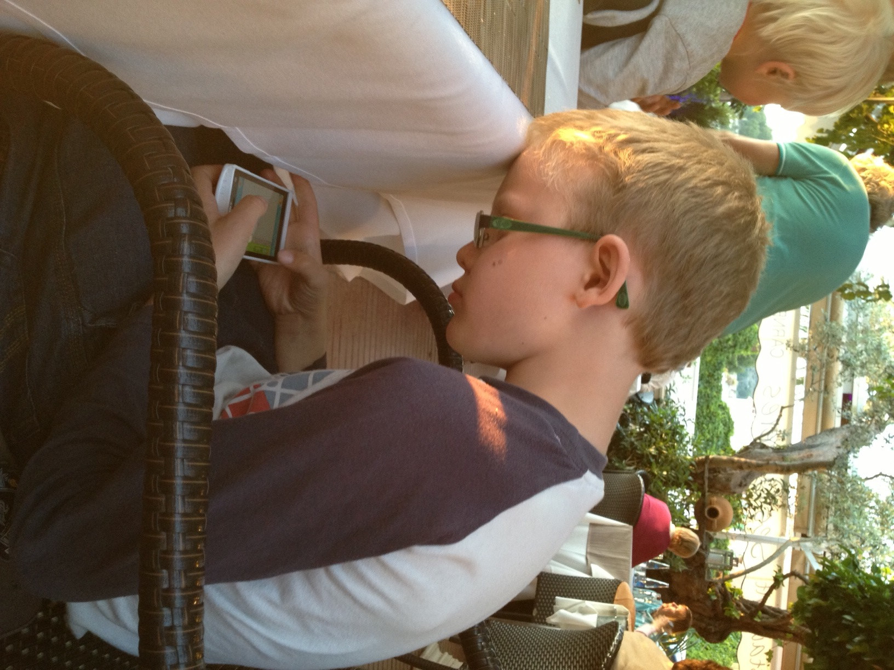

Visual Ergonomics the eye leads the body

Slide 29


Non-visual Flicker

Slide 30
VERAM
A new method for the visual environment have been developed
Objective risk analysis by trained assessors
Expert assessment of the risk for glare
Measuring the illuminance and luminance
Evaluating daylight
Measuring the flicker
Subjective questionnaires regarding strain and visual environment
subjective ratings of visual ability
eyestrain
musculoskeletal discomfort

Slide 31




VERAM results – objective risk (275 work places)
Daylight
Lighting
Green Yellow Red
Green Yellow Red
Illuminance
Glare
Green Yellow Red
Green Yellow Red

Slide 32
VERAM results (275 work places)
Difference in subjective and objective rating of the glare risk
Exposed to glare/ Too much light from luminaires

Slide 33
VERAM result (275 work places)

Slide 34
Conclusion
A risk analys tool like VERAM can identify factors in the visual environment
VERAM can only be used by individuals that have taken a course in visual ergonomics (lighting designers, ergonomists, working life inspectors, optometrists)
We wish to thank AFA försäkringar for funding this research

Slide 35

Key takeaways
Pedestrian’s perception, evaluation and behaviour in the lit environment must be considered in the choice of outdoor lighting.
A good visual indoor environment can reduce eyestrain, headache and musculoskeletal symptoms.
Adequate tools based on user experiences must be employed to complement photometric measures indoors and outdoors

Slide 37


Slide 38


Slide 39


Slide 40


Slide 41


Slide 42


Slide 43


Slide 44


Slide 45


Slide 46
Att tänka på
En socialt hållbar utomhusbelysning måste ta hänsyn till hur fotgängare uppfattar, bedömmer och beter sig i den belysta miljön.
Observationsbaserad miljöbedömning kan användas som ett verktyg för att kommunicera med brukare hur väl en belysningsapplikation passar i en specifik miljö.
Upplevda ljuskvaliteter har betydelse för fotgängares upplevelse av visuell tillgänglighet och trygghet i miljön, vilket i sin tur har implikationer för gående.

