Slide 1


The lighting revolution in Greater Copenhagen – the City
Matthew Nunn, CEO, Citelum Denmark

Slide 2
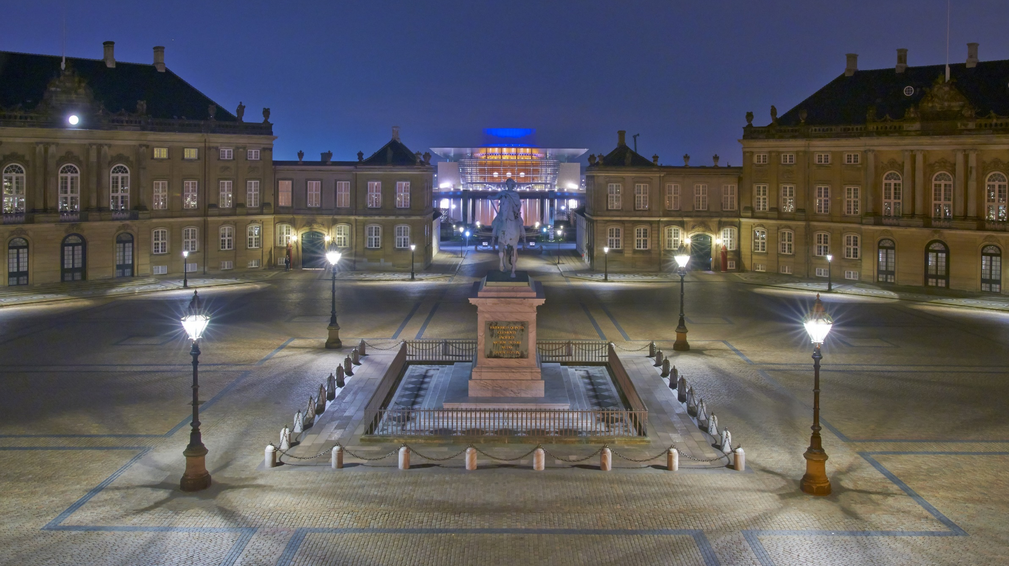

Citelum – A Leading Global Player
Over €300m Turnover
Over 2500 employees
Mainly present in Europe and the Americas
1,000 contracts - Including Copenhagen, Madrid, Rome, Barcelona, Venice, Naples, Mexico City, Puebla, Santiago of Chile, Salvador de Bahia, Nice, Toulouse, Dijon, Sète and Nîmes
2.5 million lighting points

Slide 3
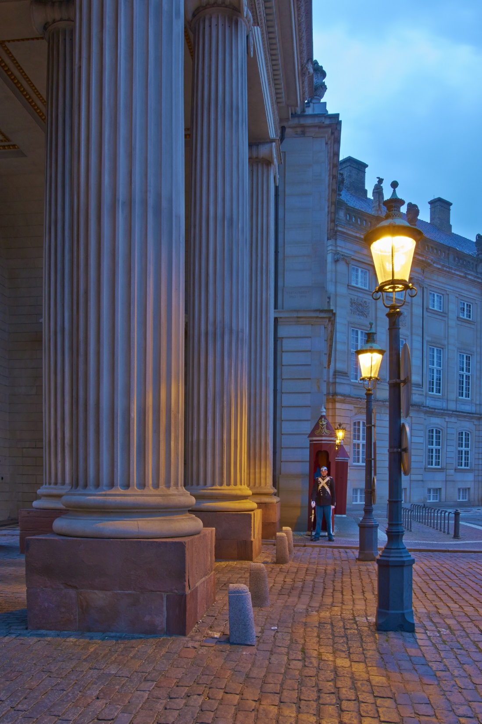
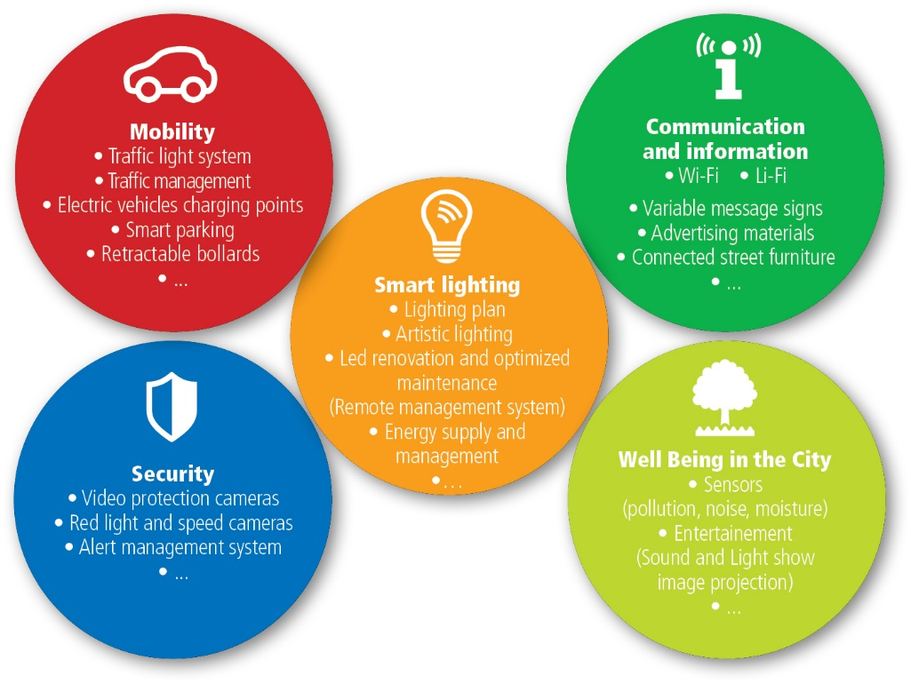
Services to municipalities and private sector customers
- supported by MUSE®
Citelum – A Leading Global Player

Slide 4
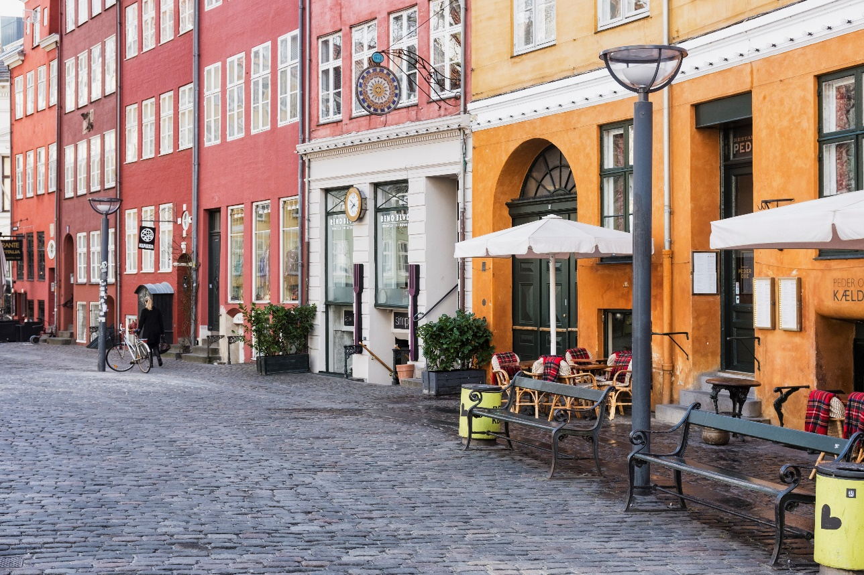
KEY POINTS
300 km. streets and paths provided with new lighting
New urban communication network prepared for intelligent controlling and alternative Smart City Solutions
18.814 light fixtures replaced with new energy-efficient LED light sources
6.800 poles replaced
1.140 cabinets reduced and replaced with 930 new cabinets
83,8 km. cables moved from air to ground
Energy savings of 55.71 %
Savings of 3,223 tons of CO2 per year
Implementation of MUSE
Overall Lighting Masterplan for Copenhagen Municipality
Street lighting for the citizens
Innovative thinking
Overall vision for the City
Individual considerations
Operational optimization
Energy savings

Slide 5
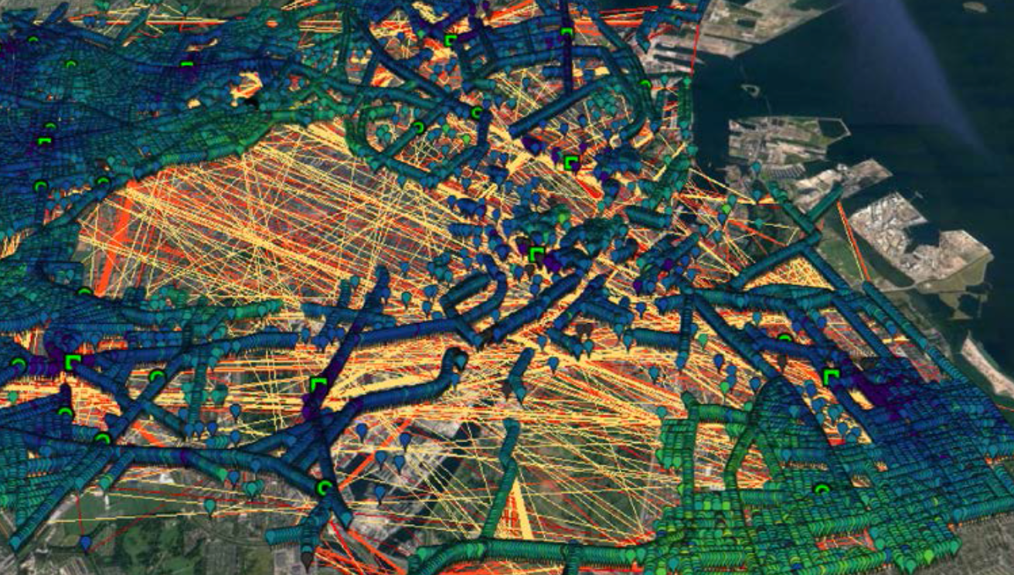
Picture: Overview of the new, urban communication network The yellow and red lines show communication routes
© Silver Spring Networks
INNOVATIVE THINKING
It has been possible to implement a city-wide communication network
Easy detection of problems to enable quick and proactive maintenance
Automatically adjusting when the light is on / off, and the level of the light (dimming) either for events, traffic conditions, environmental conditions, evolving use of the city streets
Fully redundant mesh network – ready to add new use cases (air pollution, traffic sensors, etc)

Slide 6
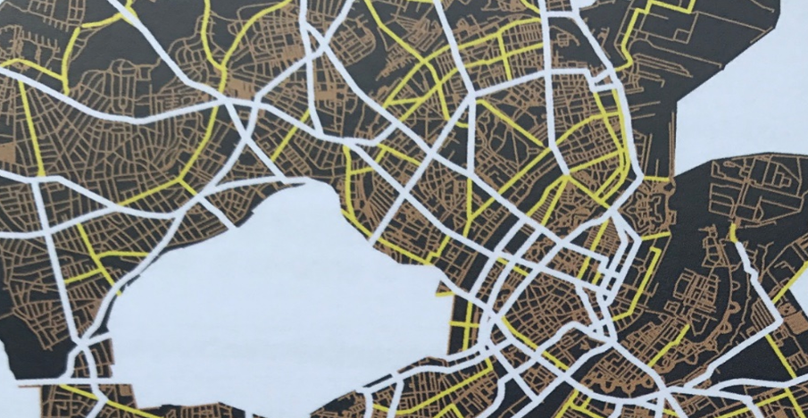
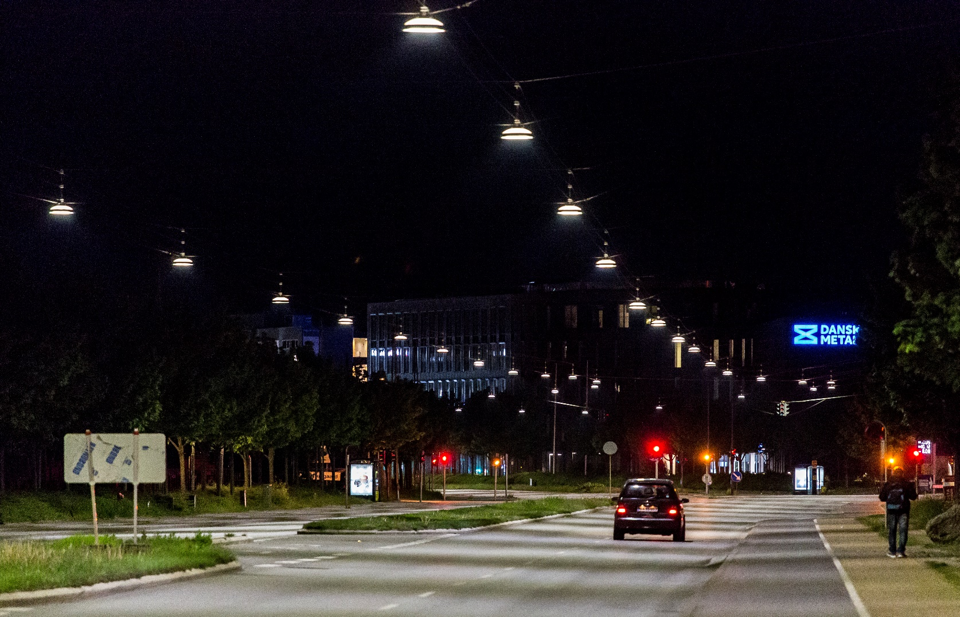
OVERALL VISION
With the Renewal project, the City of Copenhagen has focused on creating a coherence across the city. A connection between the residential neighbourhoods, the streets, the historic inner city and the many recreational areas in Copenhagen.
MASTERPLAN
The lighting master plan provides the background for the entire rollout of the renewal project, and it also presents a plan for future lighting trails in Copenhagen.
The master plan is developed on the basis of urban analyses, housing analyses, meetings with the city's local committee, qualitative user interviews and environmental analyses.

Slide 7
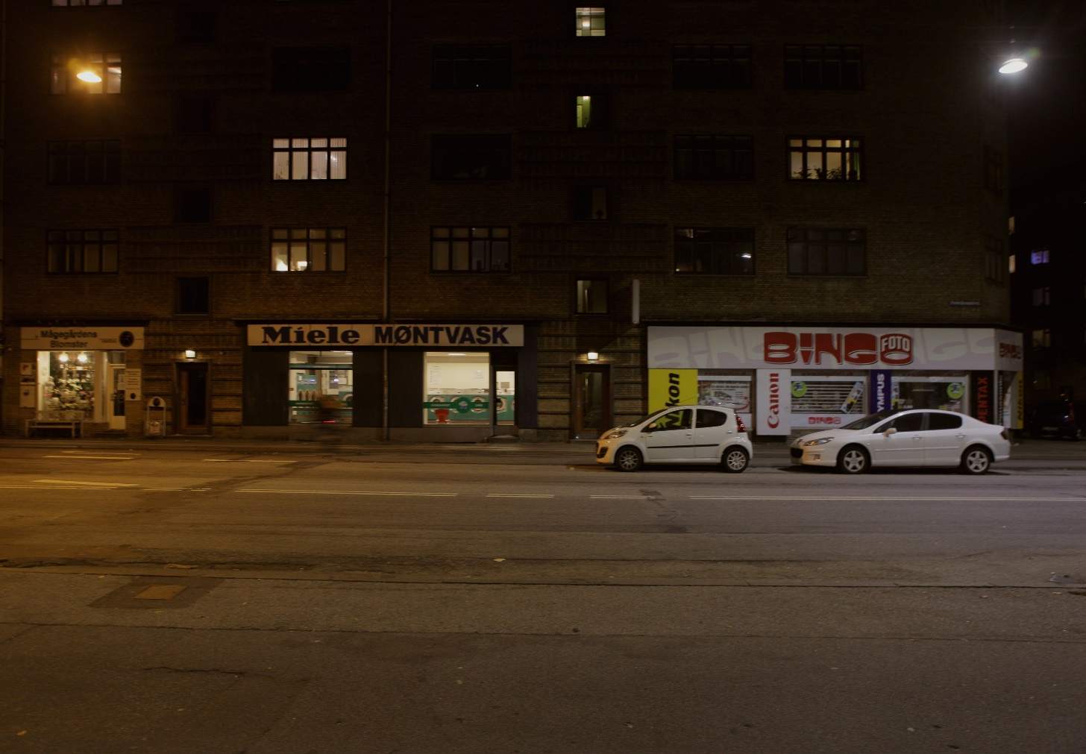
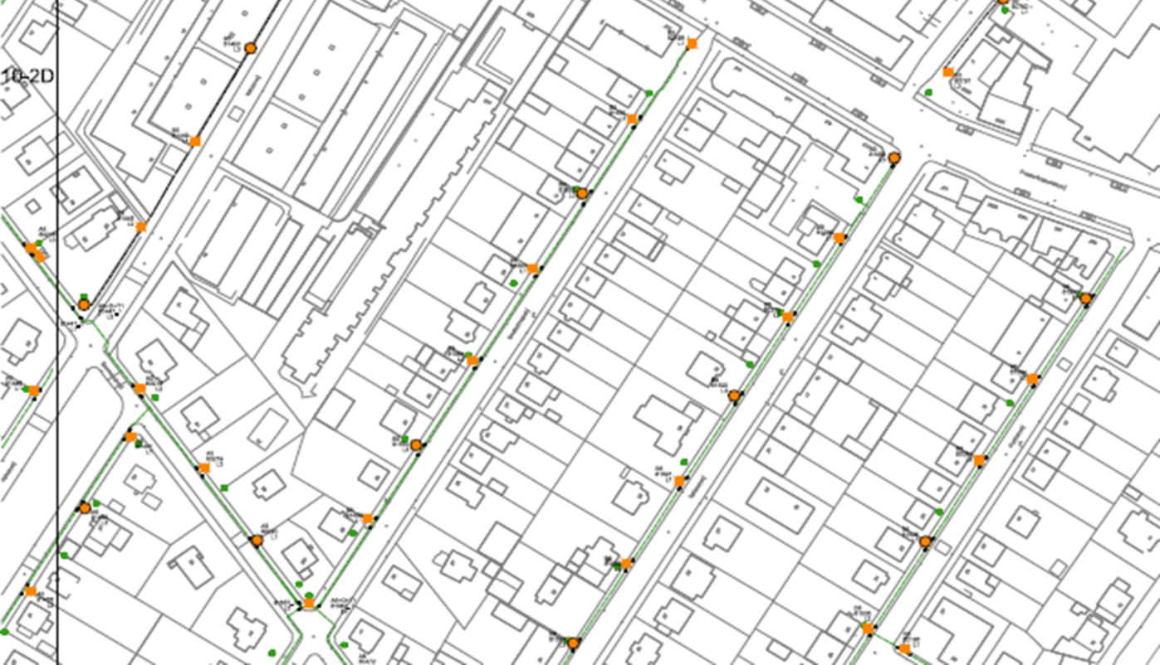
INDIVIDUAL CONSIDERATIONS
The Renewal Project has taken into account the individual neighbourhoods, roads, road users and citizens in the city.
In addition, there has been a focus on how local landmarks can be included and contribute to the area's atmosphere and how they interact with the surrounding light environment.
This has resulted in a dimming profile that is both adapted to the individual road usage and time of day, as well as each light point is adjusted to ensure the right amount of light on the road.

Slide 8
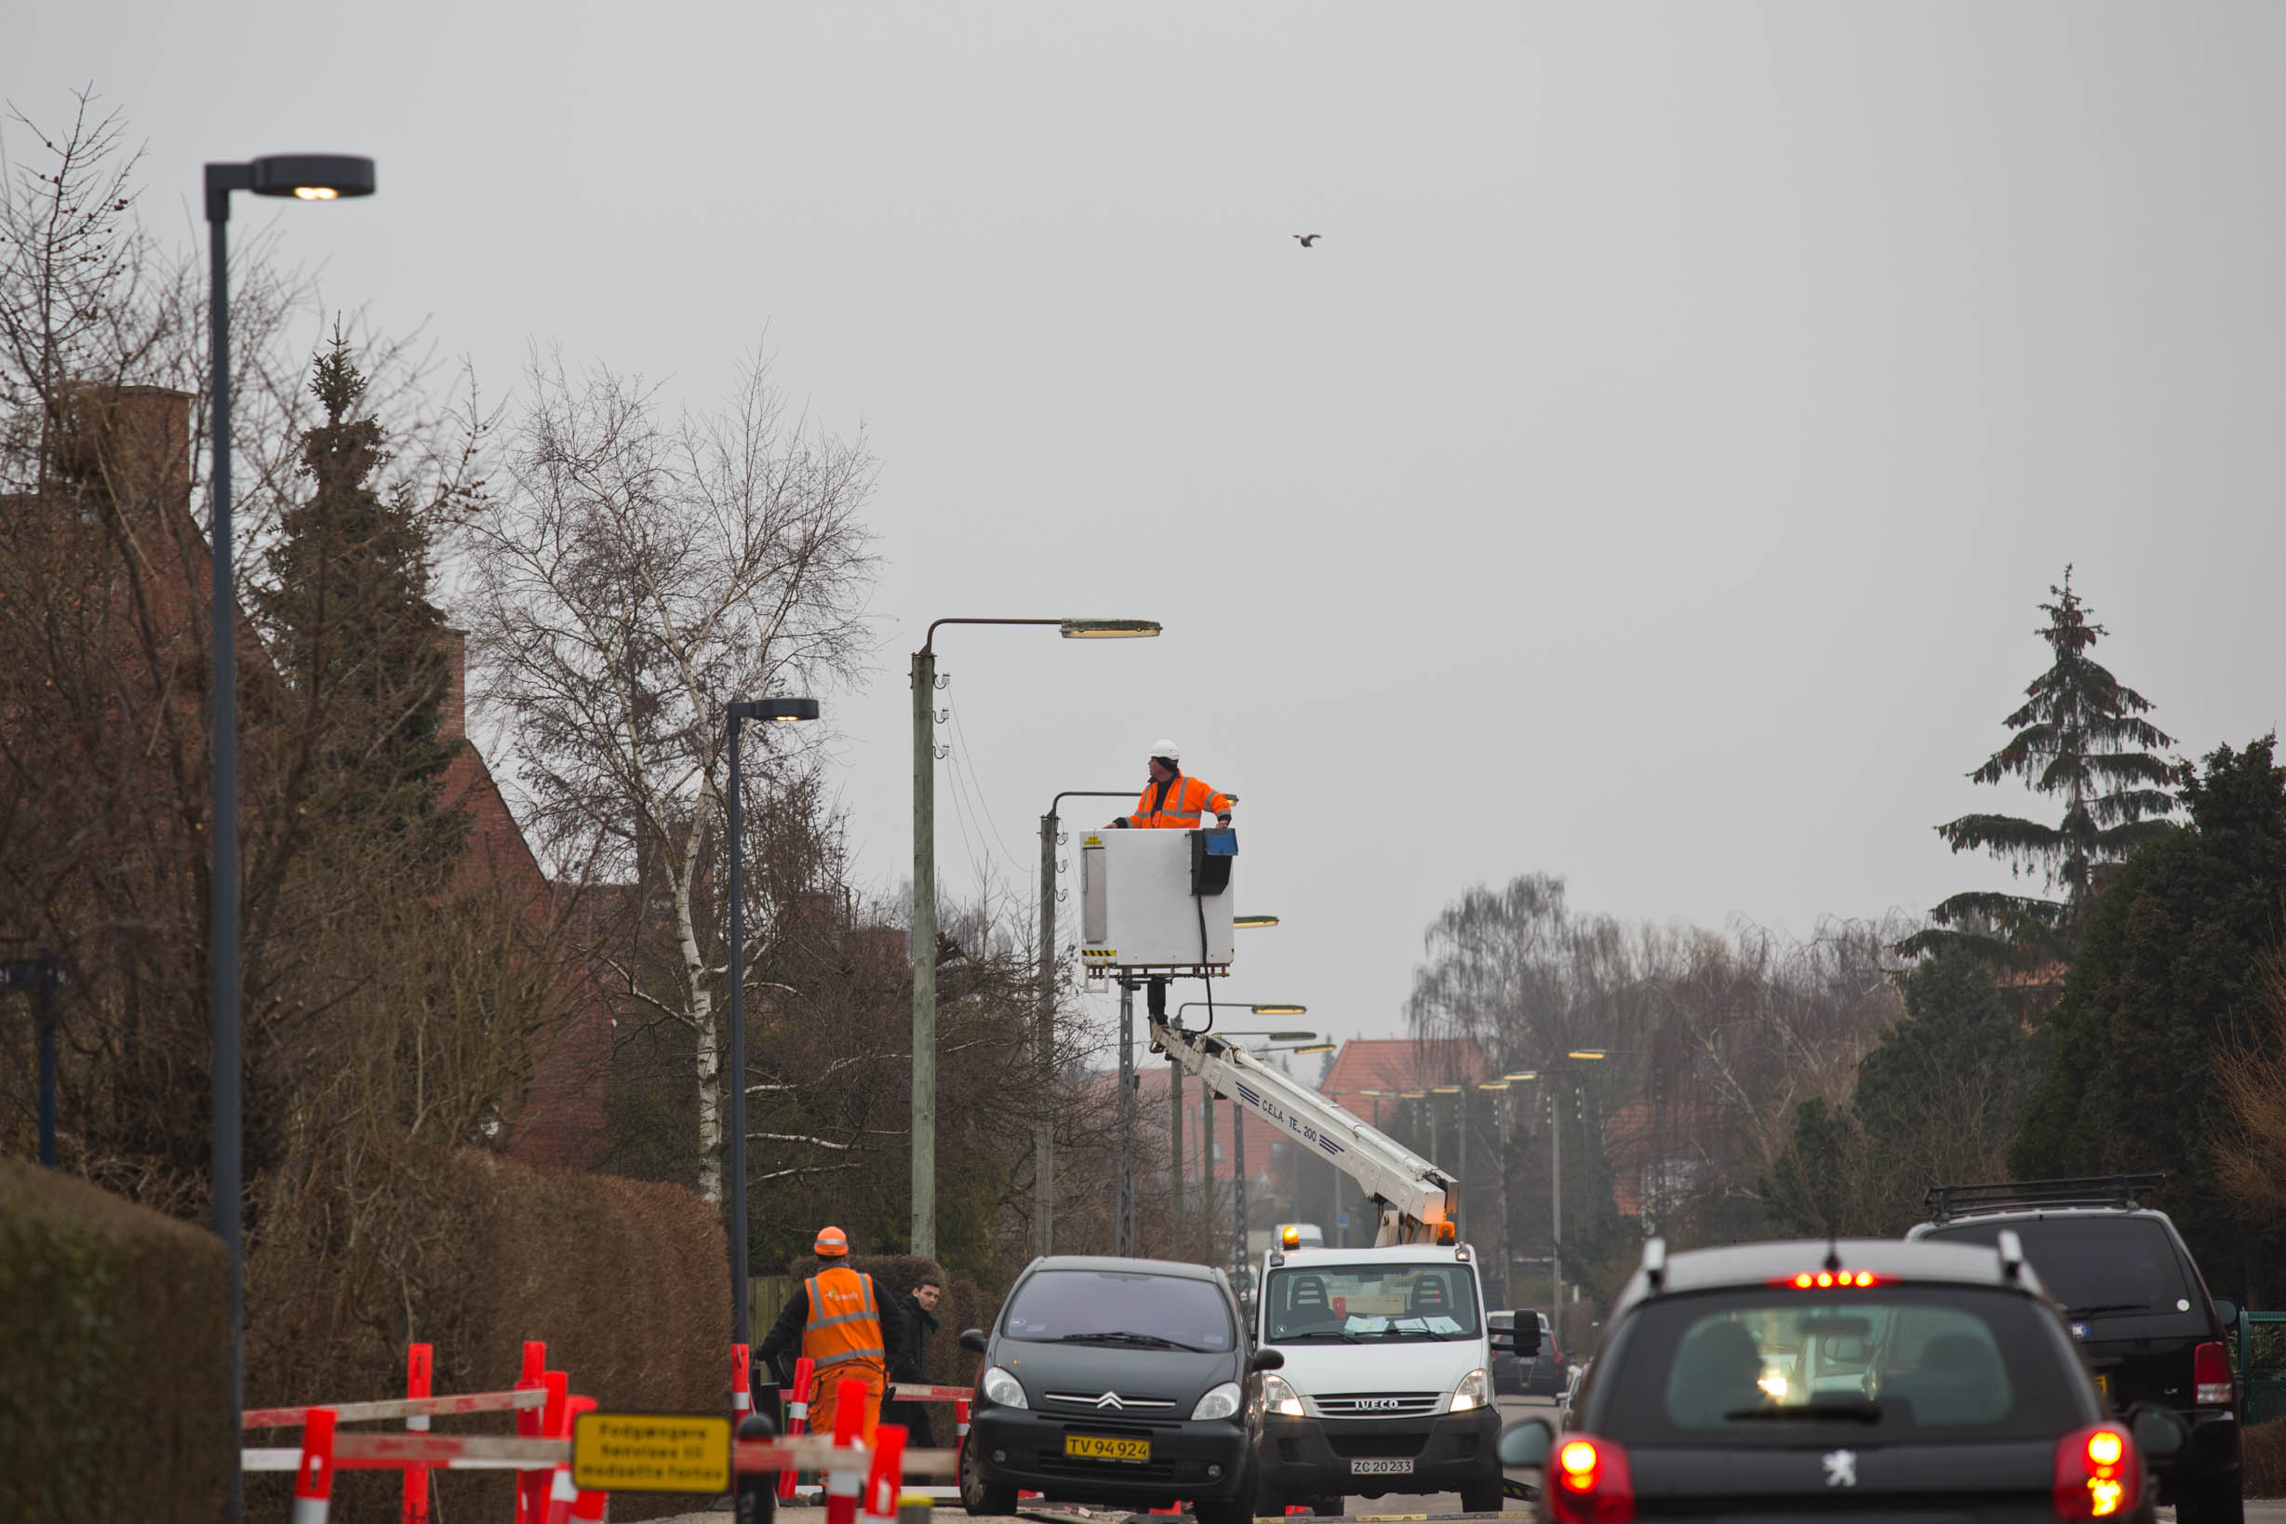
OPERATIONAL OPTIMIZATION
ENERGY SAVINGS
Implementation of MUSE and the Smart Communications Network results in a faster response time to any errors and a greater stability of the lighting system.
The cable laying of the old air lines on the local streets also gives greater reliability in bad weather.
Energy saving of 55,71 %
A significant reduction in Copenhagen's CO2 emissions. The municipality saves 3,223 tonnes of CO2 per year compared to 2010, which corresponds to the emissions from energy consumption from either 4,600 apartments (2 persons 70 m2) or 2,700 villas (4 persons 150 m2). It will support the City of Copenhagen's goal of being a CO2-neutral capital in 2025.

Slide 9
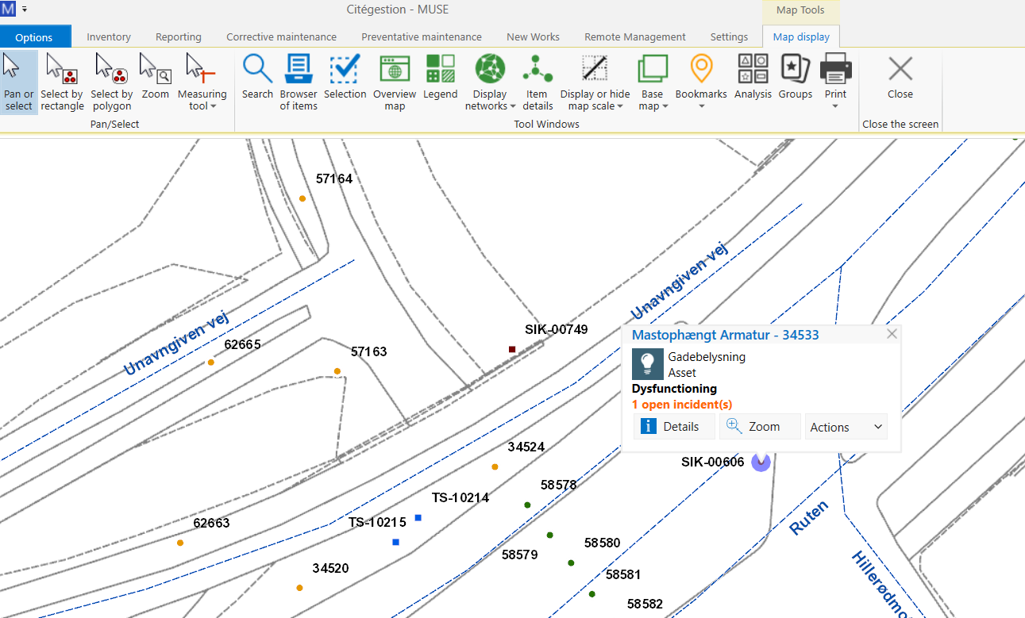

Slide 10
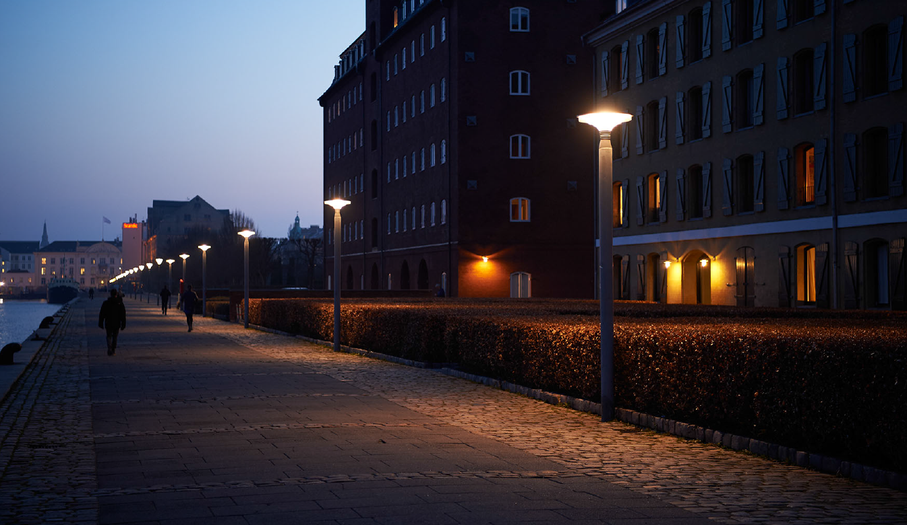
RELATION TO CITIZENS AND USERS
The project affects a large part of the capital's citizens and users due to its size. With the modernization, the street lighting is now at the very top - a priority, which should always be a matter of course in a traffic hub as important as Copenhagen. The parties concerned will be able to enjoy a lighting that:
Increases traffic safety
Strengthens the experience of security
Supports movements, city life and local identity
Takes into account sustainability

Slide 11

Key takeaways:
Lighting renovations offer attractive business cases due to the high levels of energy savings
A lighting masterplan substantially improves the overall aesthetics of the City
Building a Smart Communications Network into City Lighting brings real benefits

