Slide 1
Environmental aspects of lighting
ISSUES FROM A LIFE CYCLE PERSPECTIVE
Jessika Luth Richter, PhD researcher
IIIEE, Lund University

Slide 2
Environmental Impacts from Lighting Products
Overview of the environmental impacts from lighting products
Update on current revision of EU green public procurement for street lighting

Slide 3
Life cycle system
Inputs
Distribution
Outputs
Manufacturing
Use
Product’s lifecycle
Raw materials
End-of-Life Management

Slide 4
Inventory and system boundaries
Raw Materials
Transport
to manufacturer I
Transport
to manufacturer II
Manufacturing I LED chips packages
Manufacturing II LED lamps, luminaires
Transport to POS/EU
Inputs from Ecosphere:
Land, resources (energy carriers, metals, rare earths, crude oil, water, process chemicals)
Outputs to Ecosphere:
Emissions to air, water and soil, hazardous waste, e-waste
Use Phase (electricity use)
Collection & transport to EoL
End-of-Life treatment

Slide 5
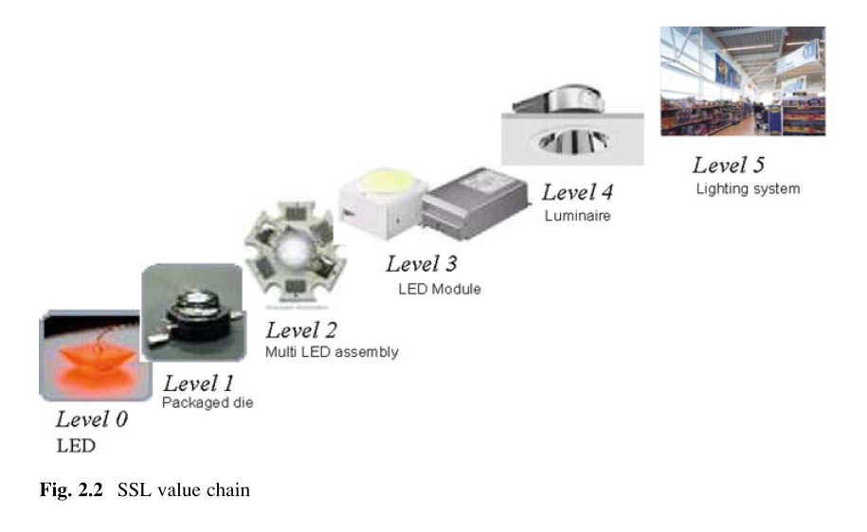
LED production
This stage can have higher scores when considering single indicators (e.g. metal depletion or human toxicity)
Largest environmental impact in this stage are the aluminium parts (e.g., heat sink), electronics (the driver) and LED packaging.
Heat sinks have been decreasing in size and using different materials recently
The production of an LED electronic driver also has a significant impact
many processes in manufacturing a printed circuit board
SSL value chain
Source: Driel & Fan (2013

Slide 6
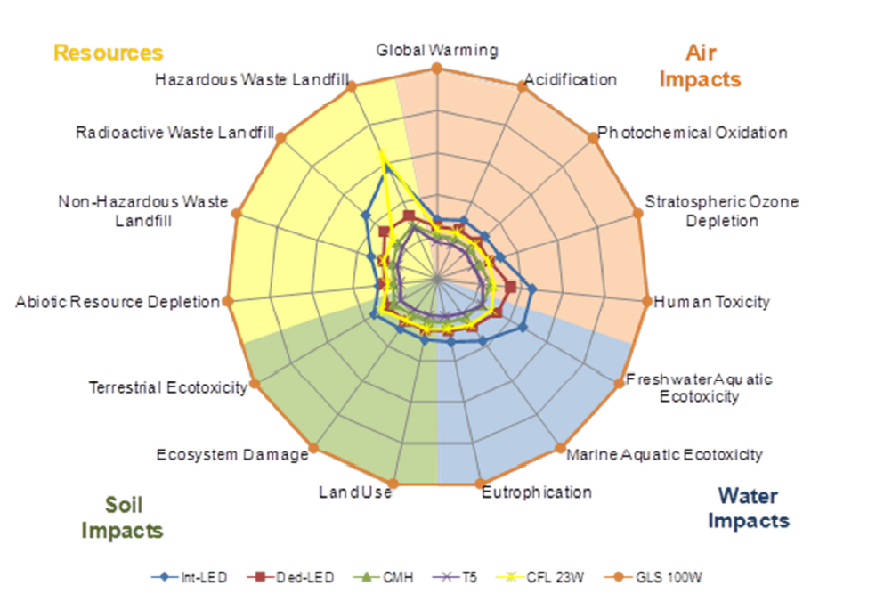
Source: Defra, 2009

Slide 7
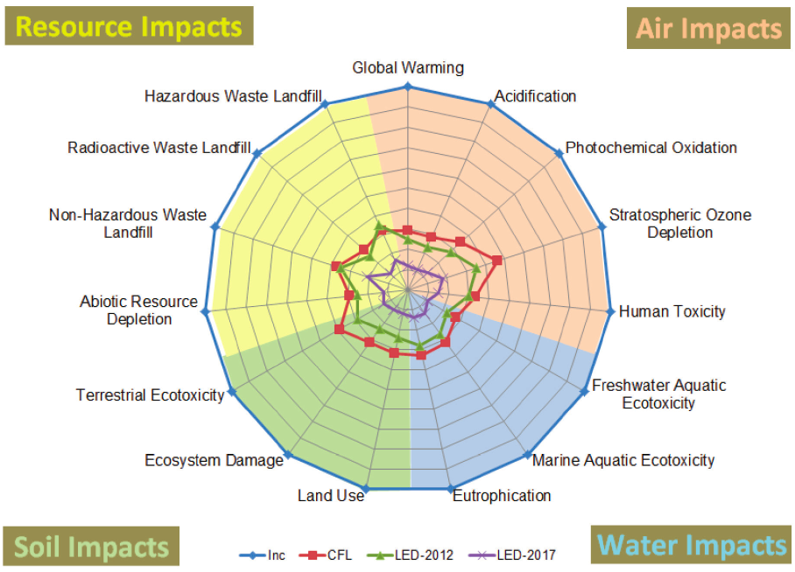
Source: Scholand & Dillon, US Department of Energy, 2012
Comparison of manufacturing, transport and use stages

Slide 8
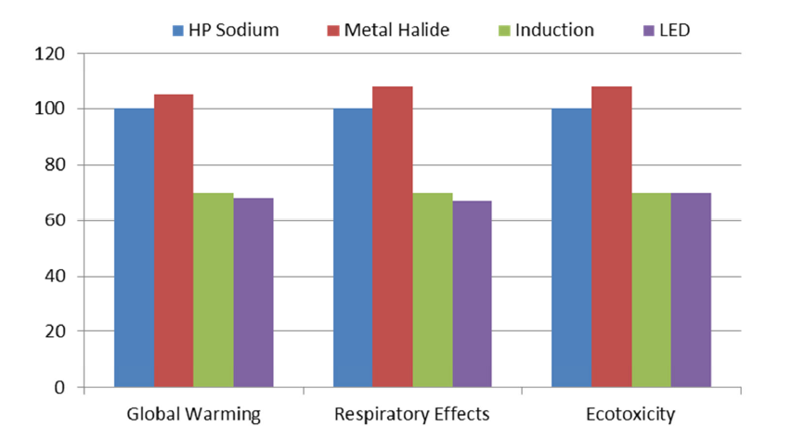
Total life-cycle impacts of 4 street lighting technologies in 3 impact categories. 100 % represents the impacts of the HPS luminaire
Source: Dale et al. (2011).

Slide 9
Largest Impact Areas
The largest environmental impact is linked to the use phase (usually >80%)
The second largest impact is in the manufacturing stage (varies 2-20%)
The impacts of the transport phase only account for 1% - 2% of total.
End-of-life management for SSL is generally low
Can be a little higher for fluorescent (max 15%)
Source: Solid State Lighting Annex – Life Cycle Assessment of Solid State Lighting Final Report (2014) Energy Efficient End-Use Equipment (4E), International Energy Agency

Slide 10
Life cycle environmental aspects
The two most significant parameters contributing to the environmental impacts of lighting products are luminous efficacy (lm/W) and useful life (hours of operation during lifetime).
Electricity mix and product development matters
Improving efficiencies are more important than long lifetimes (from LCA perspective) in electricity mixes with fossil fuel (e.g. EU average)
In decarbonised energy mixes (e.g. in Swedish mix) useful life is more important than in
Source: Solid State Lighting Annex – Life Cycle Assessment of Solid State Lighting Final Report (2014) Energy Efficient End-Use Equipment (4E), International Energy Agency

Slide 11
EU average electricity mix

Slide 12
Swedish electricity mix

Slide 13
Other environmental issues in life cycle
Lighting Pollution
Lighting Pollution
Rapid changes in design
How to influence ecodesign
Standardization (Zhaga)?
Modularity / upgradeability

Slide 14
Impact categories (e.g.)
Resource use
energy and materials
water
land (including wetlands)
landfill
Human health
toxic impacts
non-toxic impacts
impacts in work environment
Ecological impacts
Global warming
Ozone depletion
Acidification
Eutrophication
Photochemical oxidation
Eco-toxic impacts
Biodiversity
Light pollution?
…

Slide 15
Other environmental issues in life cycle
Light Pollution
Ecological but also health impacts of lighting
Rapid changes in design
How to influence ecodesign
Extended lifetimes (Standards? Warranties)
Modularity / upgradeability /repairability
Availability of spare parts
Standardization (Zhaga)?
Use of recycled materials?
Notes:
These are being discussed as part of EU Ecodesign regulations for lighting, but lots of questions still and progress is slow. Main focus continues to be on energy efficiency and quality requirements. More happening with GPP currently.

Slide 16
Notes:
LCA and LCC approaches underpin GPP

Slide 17
Two levels of criteria
Core
Focus on key areas
Comprehensive
More aspects considered
Higher level of ambition
Core
Comprehensive

Slide 18
Life cycle perspective incorporated in GPP
Lowest life cycle cost awarded points
Time period
Real interest /discount rate (%)
Electricity price (kr/kWh)
Annual electricity price change (apart from inflation) (%)
Investment costs (kr)
Running & maintenance costs
Reduction factor for automation:
e.g. Daylight detection (0.8) x Motion-detection (0.75) = 0.6
https://www.upphandlingsmyndigheten.se/en/subject-areas/lcc-tools/

Slide 19
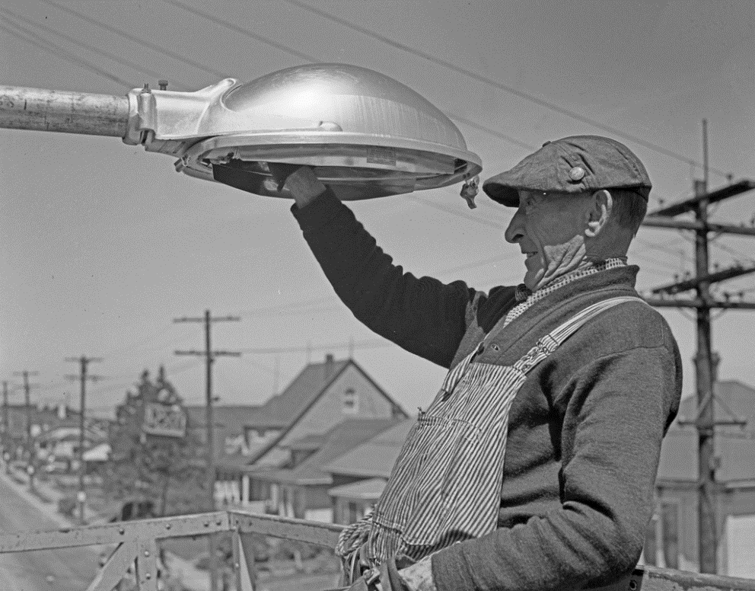
Revised and new GPP criteria
Lifetime extension
Proposed warranties of min. 4 years
Industry divided
case by case?
Some asking for 8 years
Ensure reparability
Diagram to aid repair
Guarantee of accessibility (i.e. able to use common tools)
Availability of spare parts
Enforcement?
Source: Seattle Municipal Archives.

Slide 20
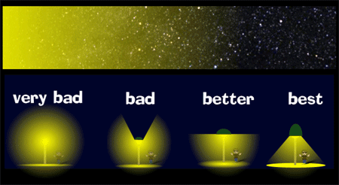
Light Pollution
Max light above horizon is not more than 1%
Sensitive areas
CCT≤ 3000k, CRI < 70
Source: U.S. National Park Service

Slide 21
Others
Points for metering and measuring
Plays a strategic role in overcoming challenges,
improve maintenance processes
reducing energy consumption
communicating CO₂ savings
Source: U.S. Air Force

Slide 22
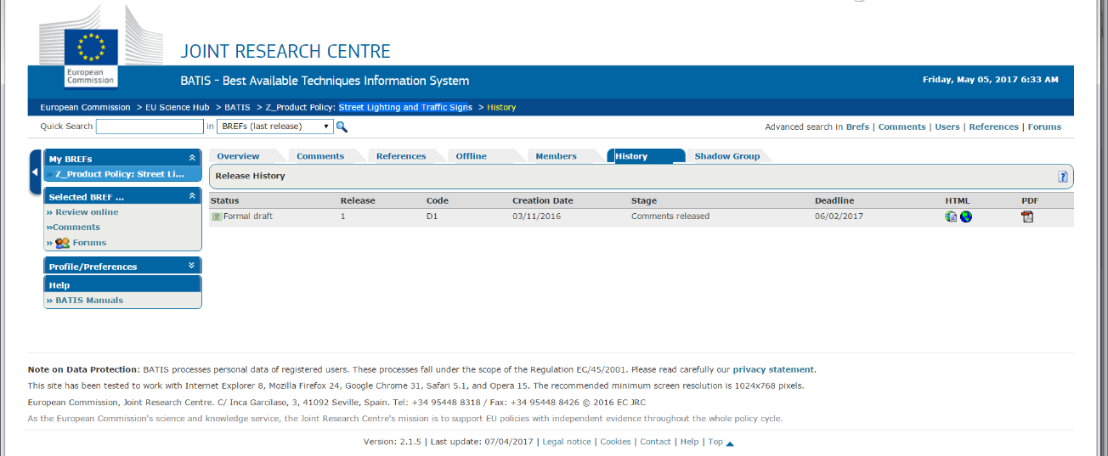
GPP revision process
150 members observing process
Workshop in Seville in November 2016
Preliminary report on technical and environmental performance
Comments on draft document in February 2017, final document October 2017
Mostly industry and NGOs

Slide 23
Other environmental issues in life cycle
Critical materials and embodied impacts
Rebound

Slide 24
Source: Gielen, 2011

Slide 25
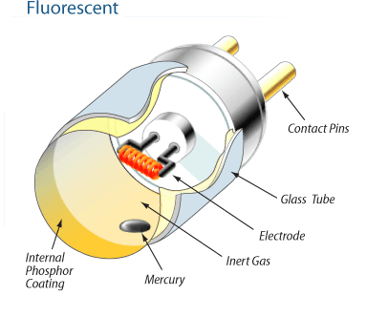
White Light
Yellow phosphor (e.g. YAG/CASN – containing Y, EU, Ce)*
YEu Oxide
Eu oxide
La Oxide
Tb Oxide
Ce Oxide
Others
Blue LED (e.g. InGaN)
Others
*YAG = (Y_{0.98}Ce_{0.02})3Al₅O₁₂; CASN = Ca_{0.98}Eu_{0.02}AlSiN₃)

Slide 26
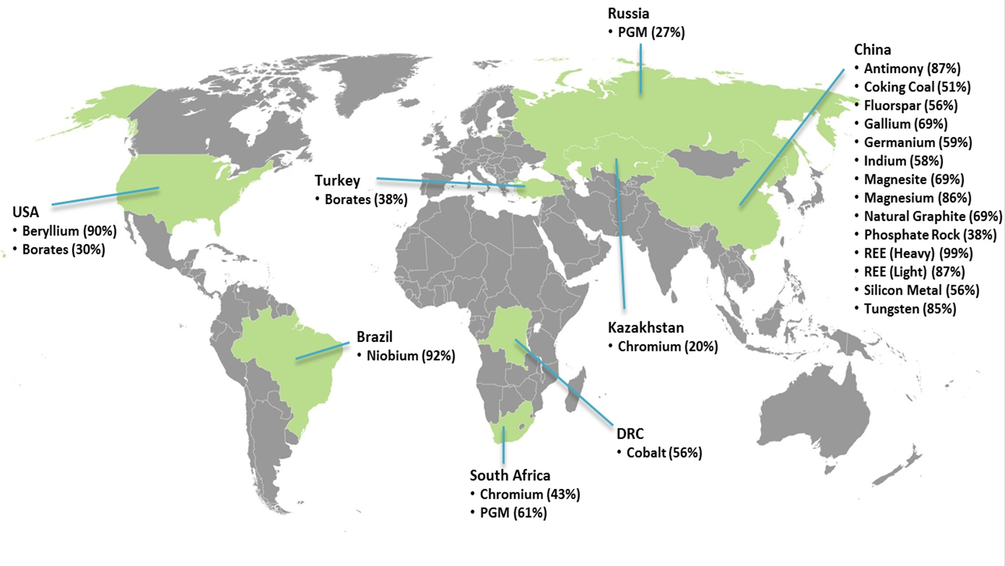
Source: EU Commission, 2014

Slide 27
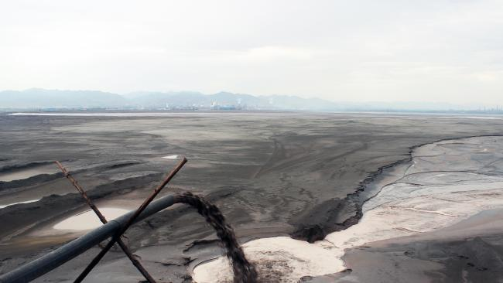
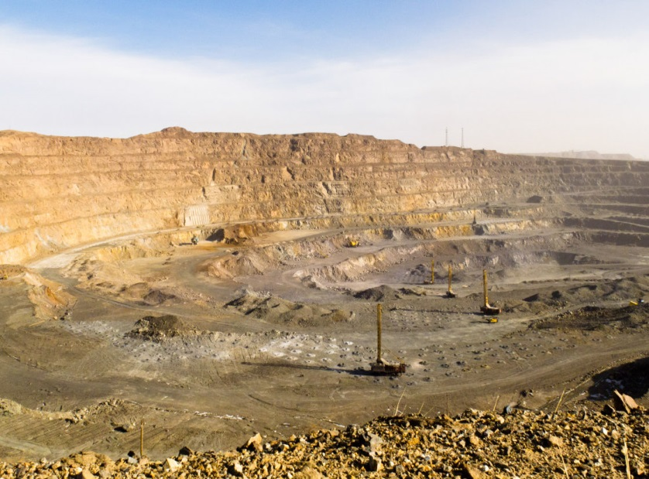
Example: impacts of mining rare earths
Complex global value chains for materials make it difficult to avoid
Starting to see material certification for conflict materials (e.g. conflict-free tin, tantalum, gold, etc.)
Images: Unknown Fields Project
Notes:
Environmental impacts:
land use
leachate into groundwater (e.g. heavy metals, arsenic, fluorides, sulphides, thorium and uranium)
dusts emissions ( with contents of e.g. heavy metals, thorium, uranium)
Air emission of process chemicals (SO2, HCl)
waste water generation
GHG emissions due to energy use

Slide 28
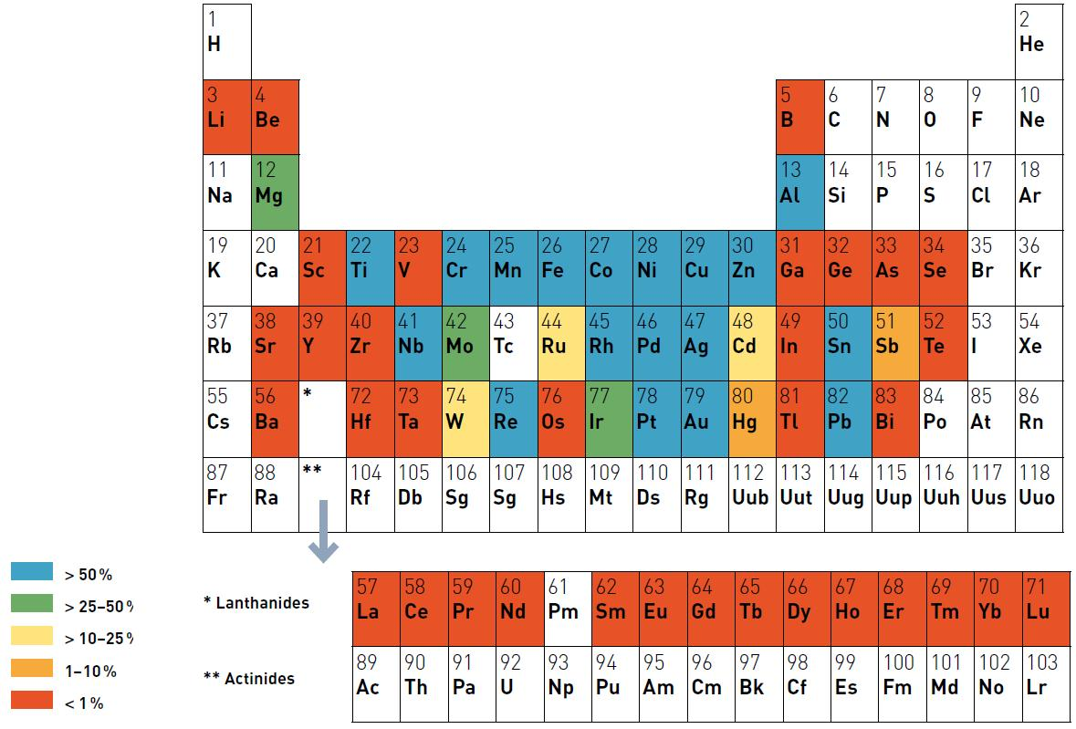
Recycling Critical elements
Source: UNEP, 2011
Notes:
Recycling almost non-existent for most critical materials in lighting. It will prove technically difficult to recover from LEDs due to small amounts and low prices of primary material production. Another strategy is to ensure lifetimes.

Slide 29
Dealing with rebound
Framing and formulation of efficiency goals
Focus on function as well as efficiency
Decide what will be done with energy and monetary savings to avoid unwanted rebound
Maximum lighting requirements as well as minimum?
Right light at the right place at the right time
Focus on what contributes to wellbeing

Slide 30
Environmental aspects for lighting - summary
Extending life cycle thinking beyond energy efficiency
Extending lifetimes through warranties, standardization, modularity, repairability, availability of spare parts
Addressing issues still constrained by what is possible to measure and enforce
Additional resources:
I4E Solid State Lighting: https://ssl.iea-4e.org/
EU: http://susproc.jrc.ec.europa.eu/Street_lighting_and_Traffic_signs/index.html
ICLEI: http://www.iclei.org/activities/agendas/sustainable-local-economy-and-procurement.html

