Slide 1
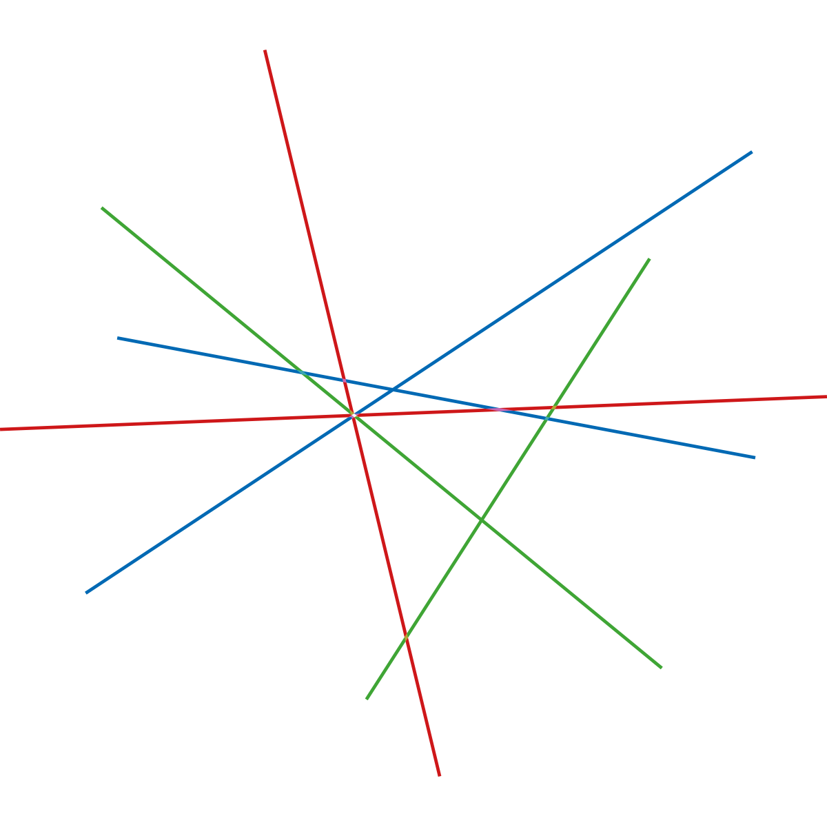

New Research in Lighting
Jessika Luth Richter

Slide 2



Lighting: life cycle and
environmental perspectives
Jessika Luth Richter, PhD researcher

Slide 3
Life cycle system
Inputs
Distribution
Outputs
Manufacturing
Use
Product
life cycle
Raw materials
End-of-Life
Management

Slide 4
Inventory and boundaries in life cycle assessments (LCAs)
Raw Materials
Transport
to manufacturer I
Transport
to manufacturer II
Manufacturing I LED chips packages
Inputs from Ecosphere:
Land, resources (energy carriers, metals, rare earths, crude oil, water, process chemicals)
Outputs to Ecosphere:
Emissions to air, water and soil, hazardous waste, other waste
Manufacturing II LED lamps, luminaires
Transport
to POS/EU
Use Phase (electricity use)
Collection & transport
to EoL
End-of-Life treatment

Slide 5
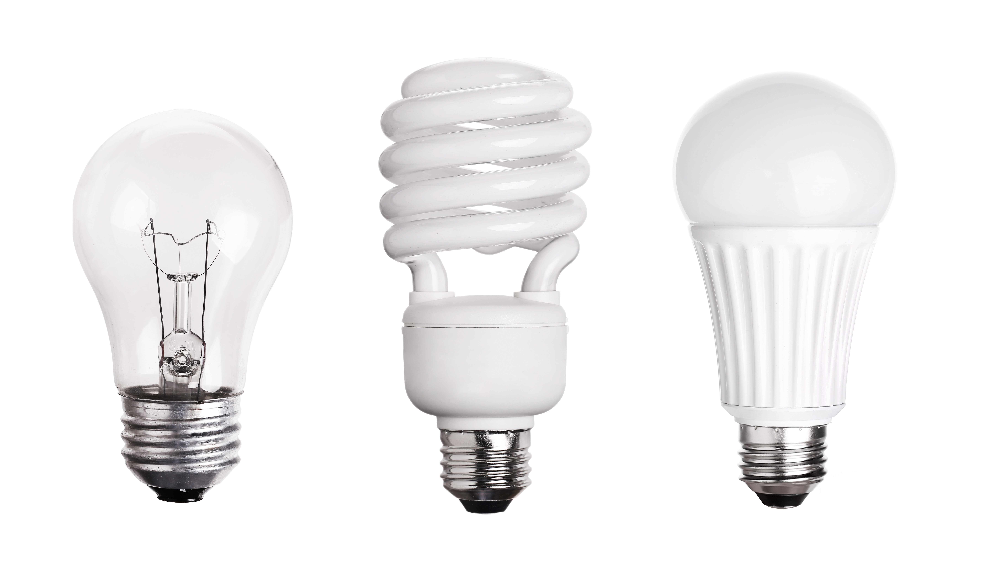
Which product is better from the life cycle perspective?

Slide 6
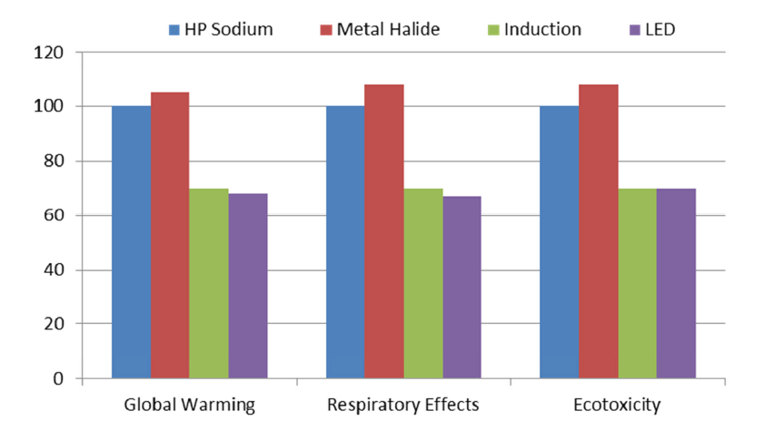
Total life-cycle impacts of 4 street lighting technologies in 3 impact categories.
100 % represents the impacts of the HPS luminaire Source: Dale et al. (2011)

Slide 7
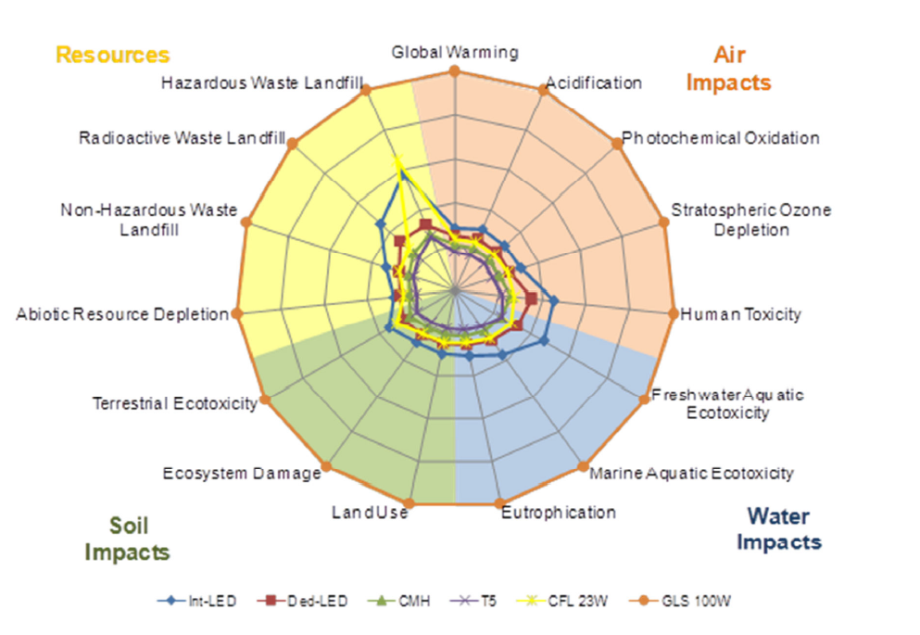
Source: Defra, 2009

Slide 8
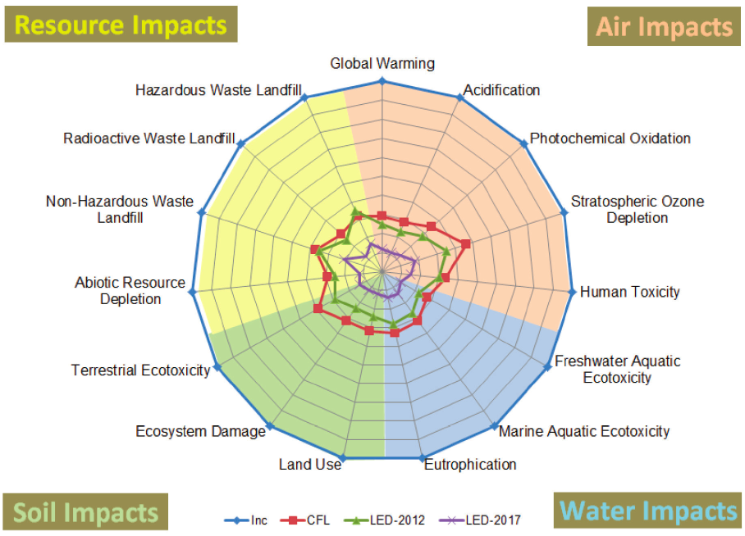
Source: Scholand & Dillon, US Department of Energy, 2012

Slide 9
Which life cycle stage has the largest environmental impact?

Slide 10


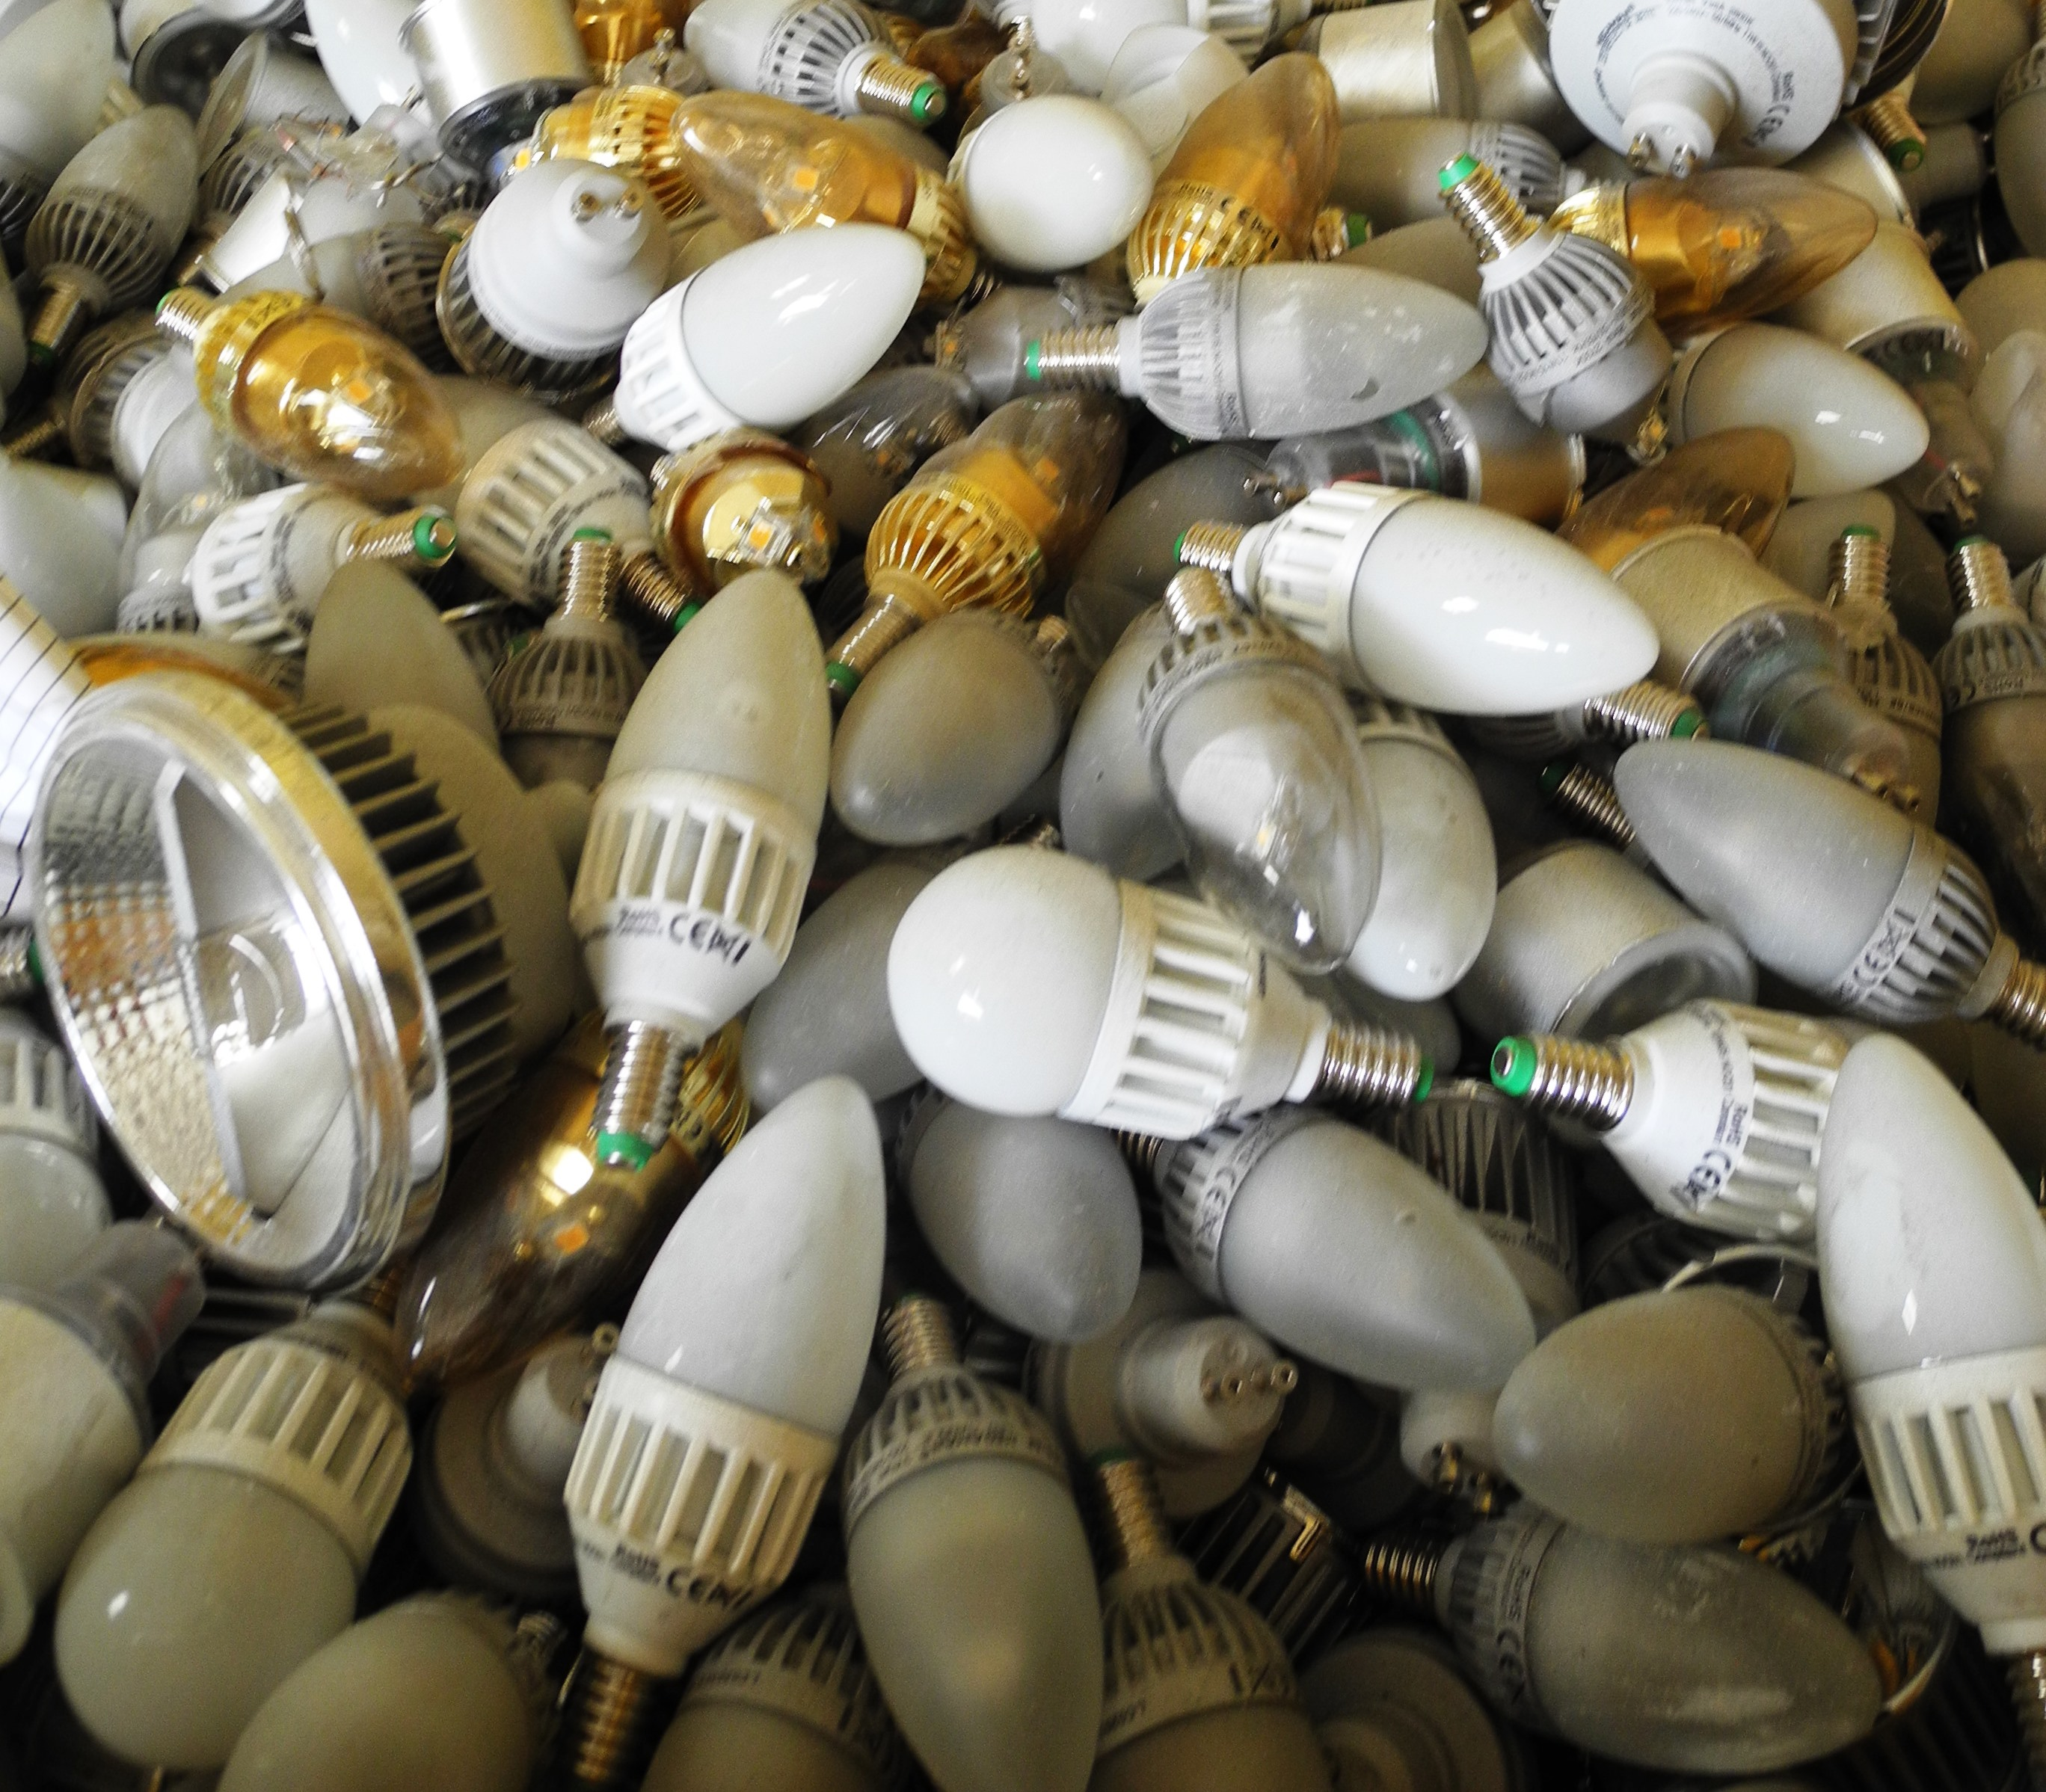

Energy efficient lighting products: largest impact areas based on 13 LCAs from 2009-2017
1) use phase generally dominates
2) manufacturing stage rising in importance
3) end-of-life phase impacts are generally low, except for particular impact categories
4) transport and packaging always smallest impact (<1%-2%)
See e.g. Solid State Lighting Annex – Life Cycle Assessment of Solid State Lighting Final Report (2014) Energy Efficient End-Use Equipment (4E), International Energy Agency; Franz & Wenzl (2017) Critical review on life cycle inventories and environmental assessment of LED-lamps, Critical Reviews in Environmental Science and Technology 47:21.

Slide 11
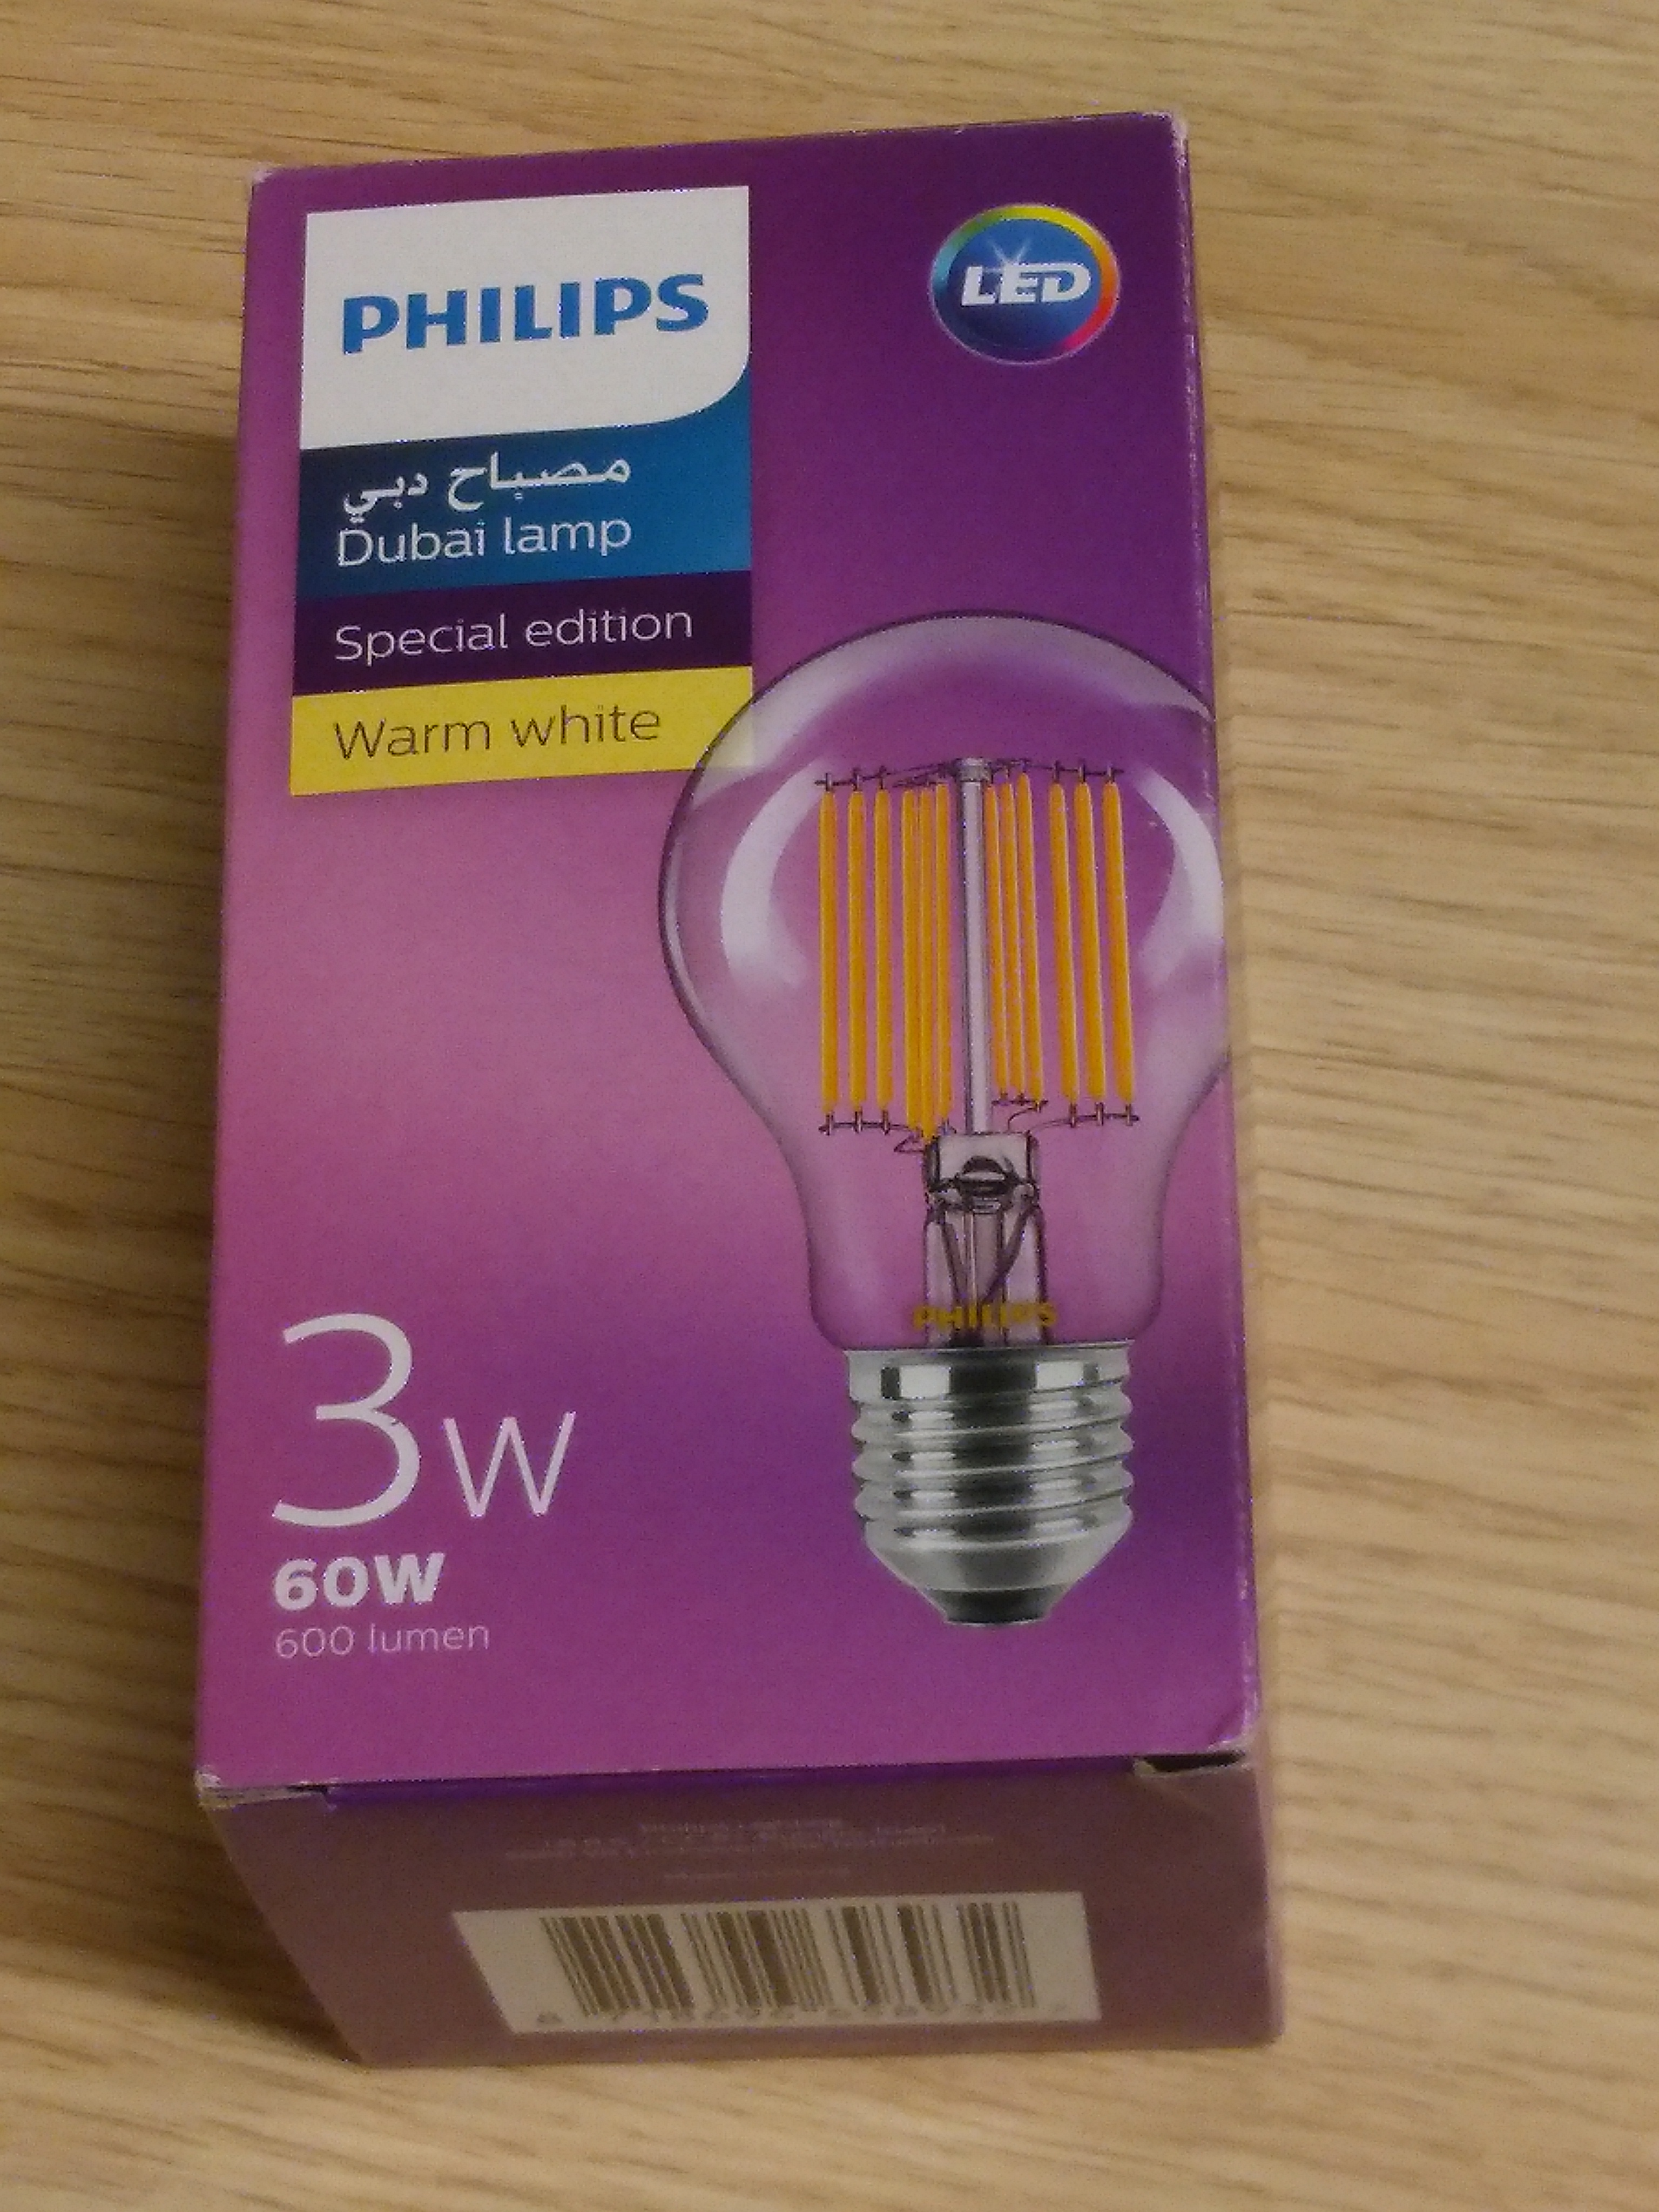
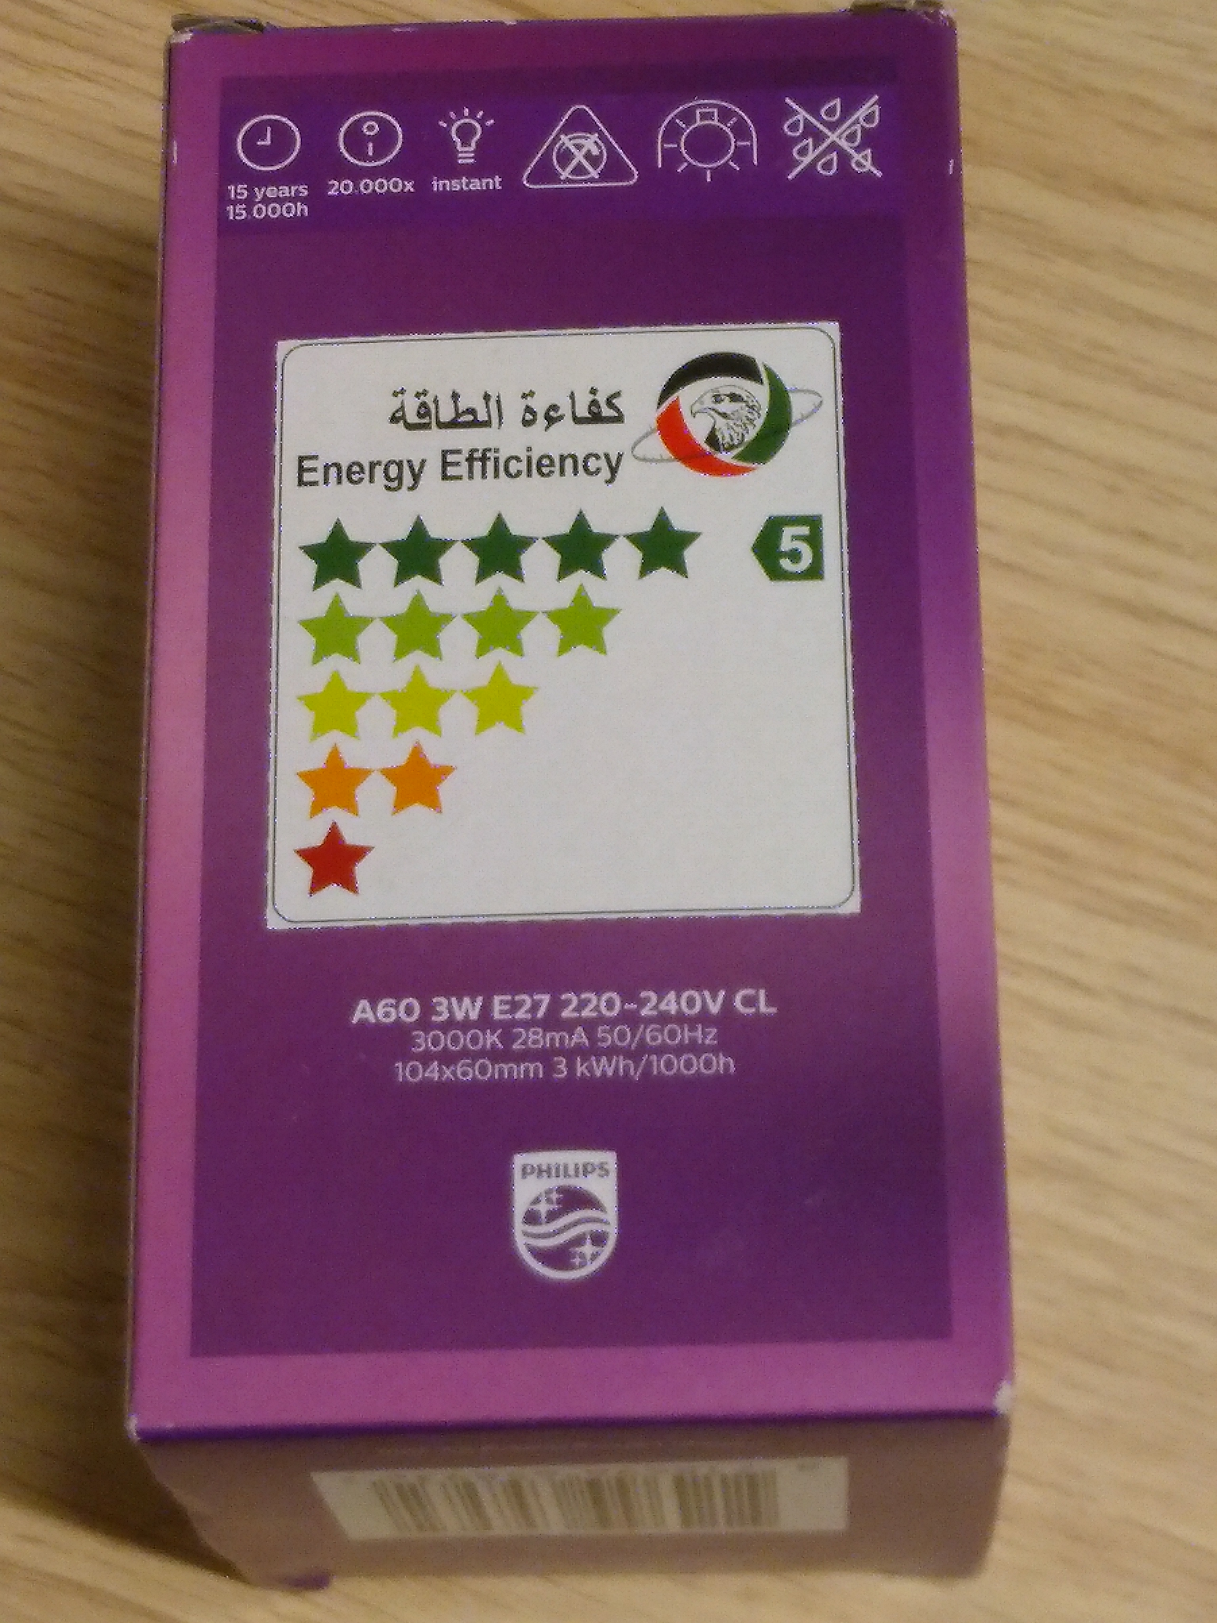
Life cycle environmental aspects
The two most significant parameters contributing to the environmental impacts of lighting products are luminous efficacy (lm/W) and useful life (hours of operation during lifetime).

Slide 12
LCA: environmental aspects and trade-offs
Electricity mix and product development matters
  Improving efficiency has greater environmental benefits than long lifetimes in electricity mixes with fossil fuels
  Longer lifetimes have environmental benefits in descarbonised electricity mixes
LED Package Efficacy Projections for Commercial Products
Source: U.S. Solid State Lighting R&D Plan, 2017

Slide 13
EU average electricity mix

Slide 14
Swedish electricity mix

Slide 15
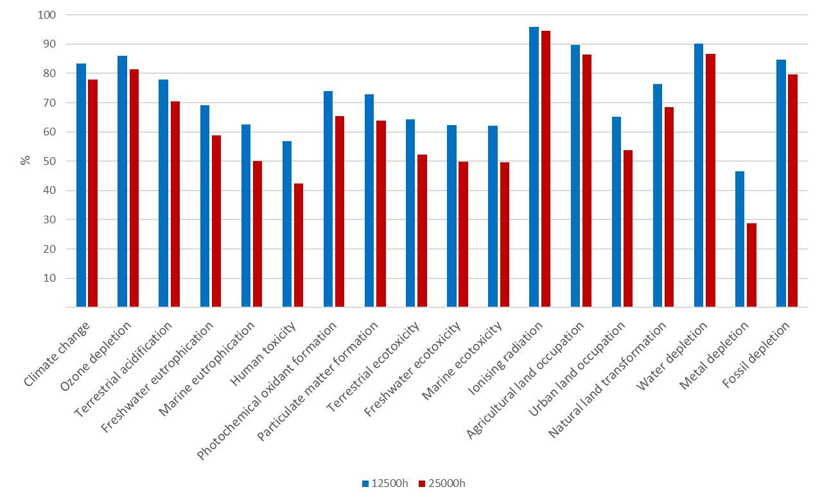
EU average electricity mix, no improvements

Slide 16
Impact categories (e.g.)
Resource use
energy and materials
water
land (including wetlands)
landfill
Human health
toxic impacts
non-toxic impacts
impacts in work environment
Light pollution?
Ecological impacts
Global warming
Ozone depletion
Acidification
Eutrophication
Photochemical oxidation
Eco-toxic impacts
Biodiversity
Light pollution?
…
Social Aspects
Socio-economic
Working conditions
Human Rights
Governance

Slide 17
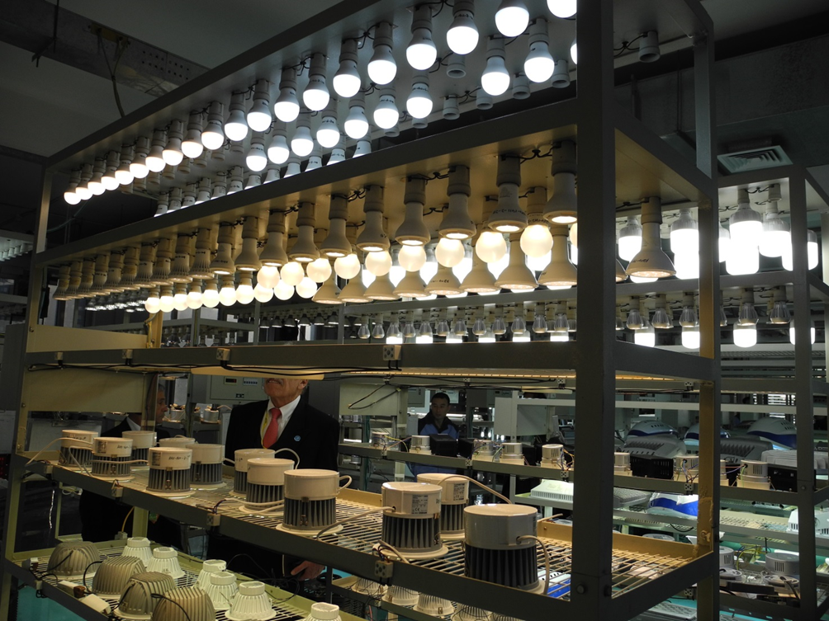
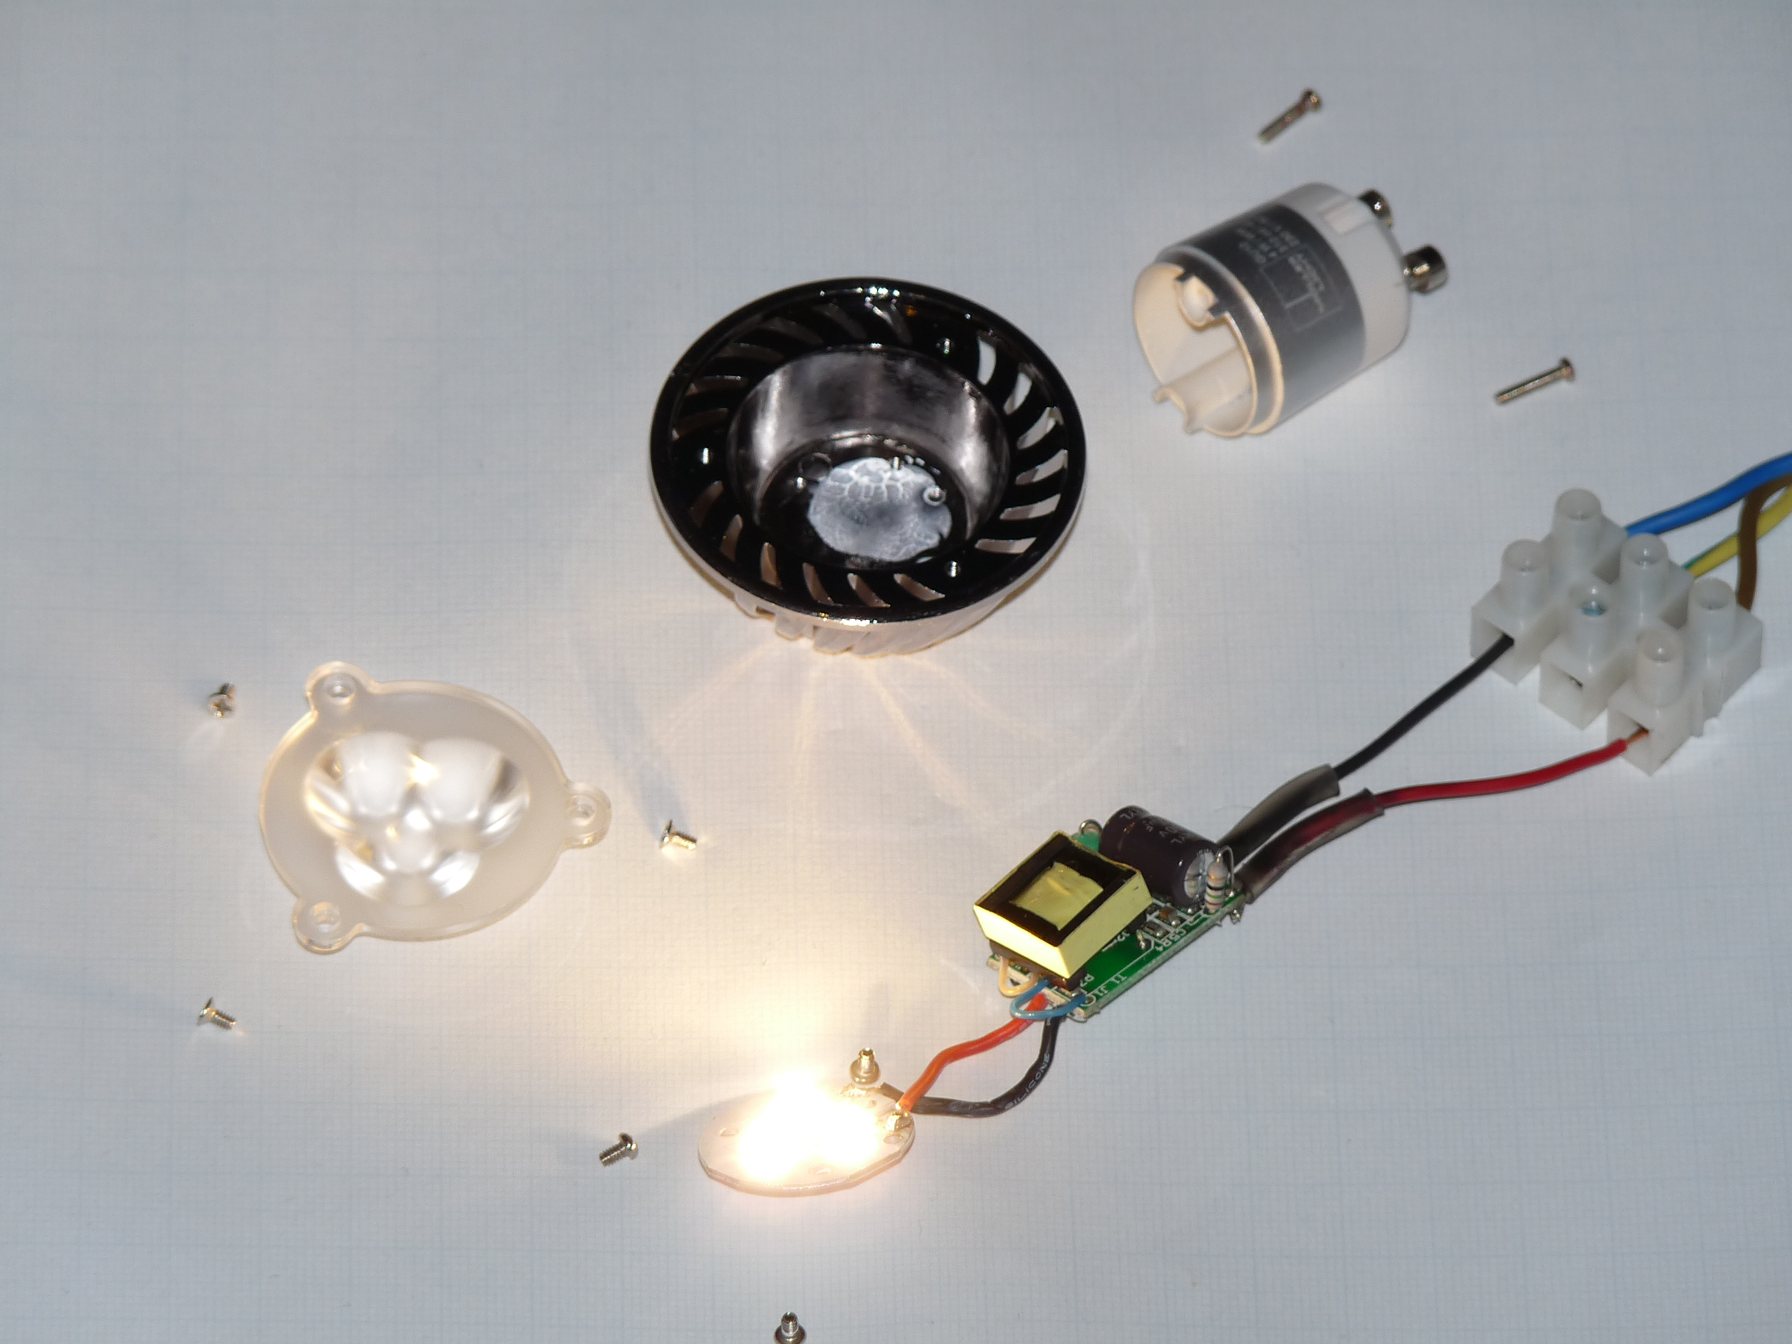
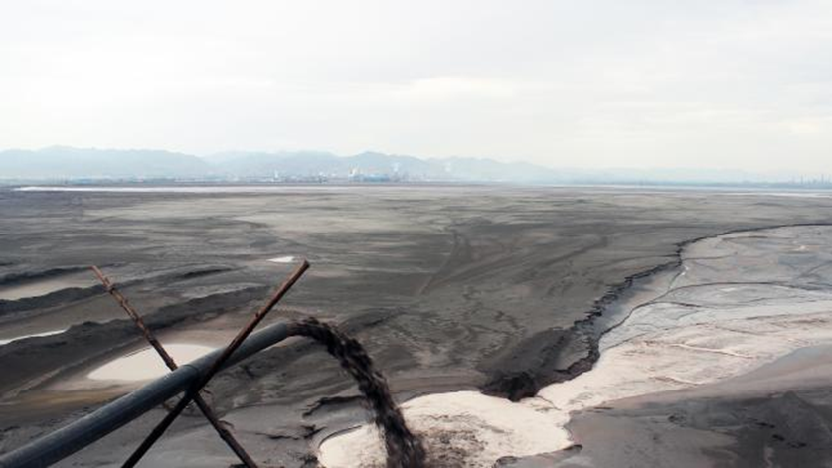
Other environmental issues in life cycle
Rapid changes in design
    Lifetimes?
    Modularity / repairability?
    Availability of spare parts?
    Standardization?
    Use of recycled materials?
    Critical materials?
    Rebound?
Mandatory requirements (e.g. Ecodesign Directive)
Voluntary ecolabel and green public procurement (GPP) criteria
Image:
Unknown Fields Project
Notes:
These are being discussed as part of EU Ecodesign regulations for lighting, but lots of questions still and progress is slow. Main focus continues to be on energy efficiency and quality requirements. More happening with GPP currently.

Slide 18
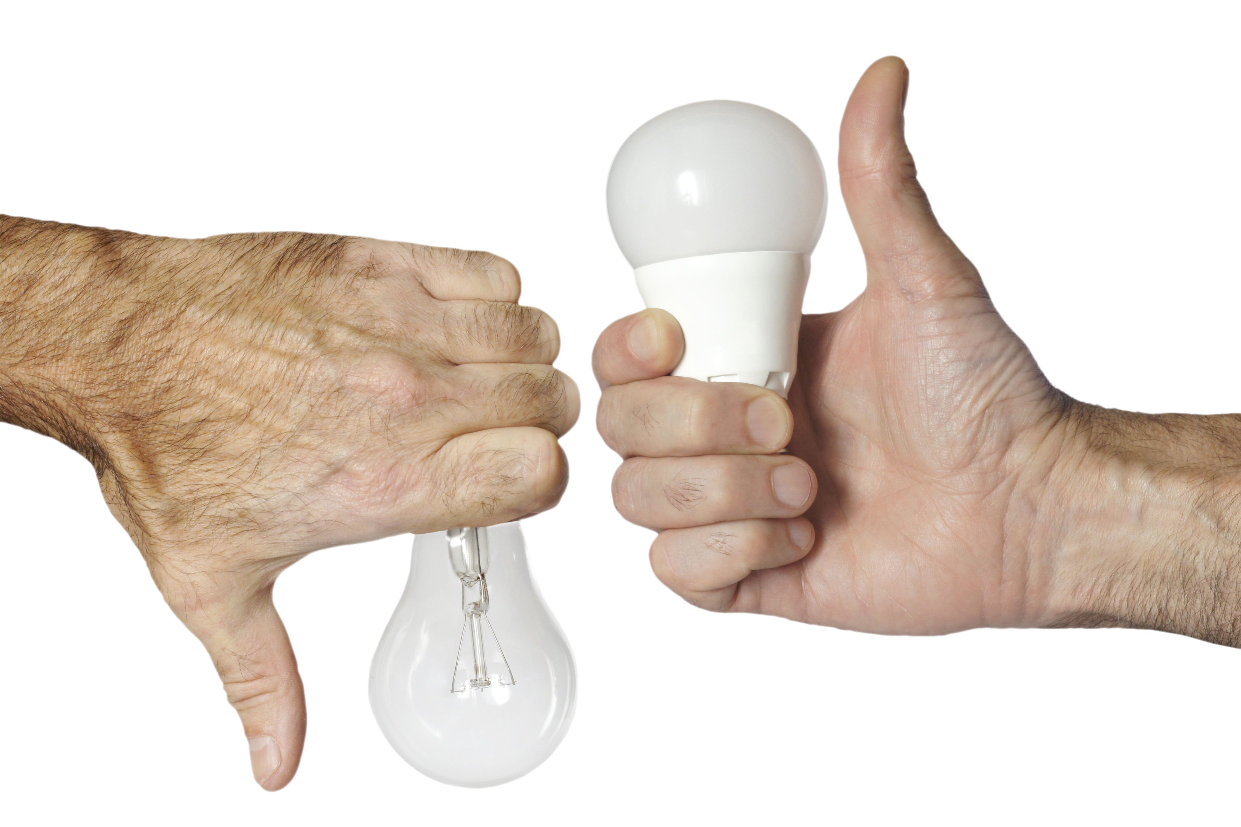
Life cycle perspective can inform decision
Simplified LCA approach used in policy-making
Lowest life cycle cost (LLCC) also used in policy and procurement

Slide 19
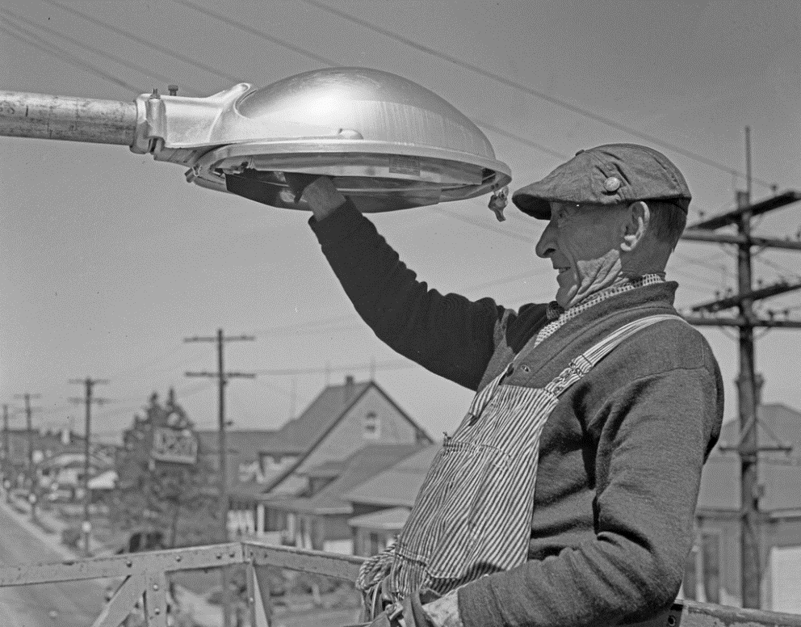
Expanding standards and voluntary criteria
Minimum lifetimes for LEDs in Ecodesign standards
6000 hours
  Constrained by testing methods
Lifetime extension GPP criteria
Warranties
  4 years, some asking 8 years
Ensure reparability
  Diagram to aid repair
  Guarantee of accessibility
  (with common tools)
  Availability of spare parts
    Enforcement?
Source: Seattle Municipal Archives.

Slide 20
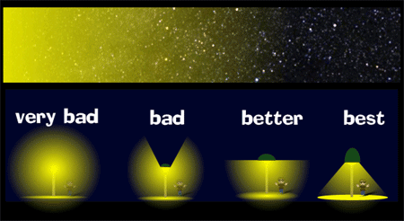
Light Pollution
  Max light above horizon is not more than 1%
  Sensitive areas
    CCT≤ 3000k, CRI < 70
Source: U.S. National Park Service

Slide 21
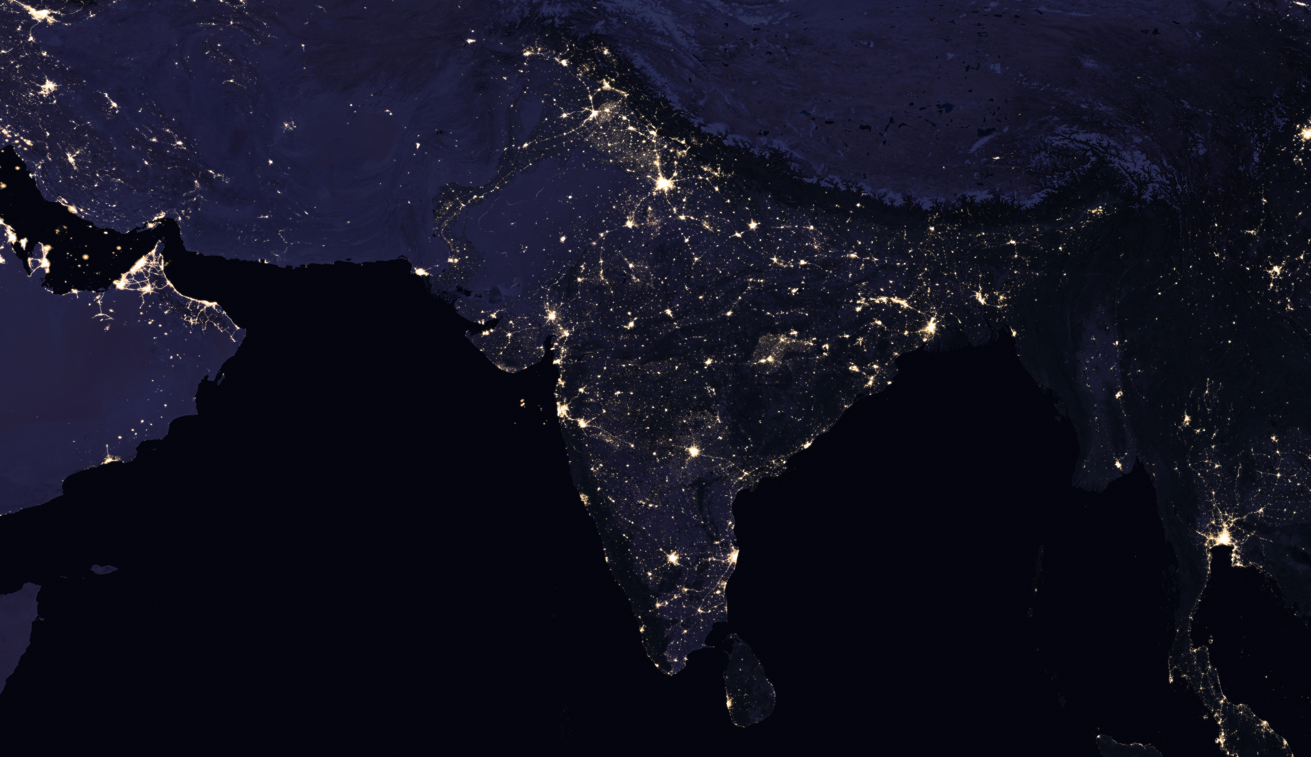

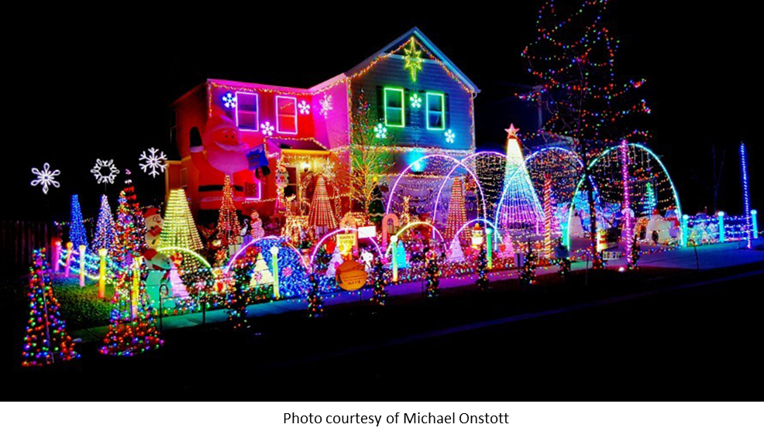
Rebound
  Framing and formulation of efficiency goals
    Maximum lighting requirements as well as minimum?
    Focus on function as well as efficiency
    Energy and monetary savings targets and plans necessary to avoid unwanted rebound
Right light, right place, right time
    Focus on what contributes to wellbeing

Slide 22

Key takeaways -
Energy efficiency is important, but increasingly need
attention on other issues, e.g. lifetime, durability, etc.
There are still trade-offs in environmental impacts to be considered
in design and policy decisions, e.g. energy and material impacts
Sufficiency and quality also important to avoid unnecessary environmental impacts: right light, right place, right time

